Slide 1
Project: IEEE P802.15 Working Group for Wireless Personal Area Networks (WPANs)
Submission Title : Optical camera communication based temperature and humidity monitoring system.
Date Submitted : November, 2020
Source : Md Faisal Ahmed, Moh. Khalid Hasan, Md. Shahjalal, and Yeong Min Jang
Company : [Kookmin University]
Address : [Seoul, Korea]
Voice : [+82-2-910-5068], E-Mail: [yjang@kookmin.ac.kr]
Re
Abstract : This document discusses about the temperature and humidity monitoring using optical camera communications.
Purpose : To support OCC in indoor environment for both static and mobility conditions.
Notice: This document has been prepared to assist the IEEE P802.15. It is offered as a basis for discussion and is not binding on the contributing individual(s) or organization(s). The material in this document is subject to change in form and content after further study. The contributor(s) reserve(s) the right to add, amend or withdraw material contained herein.
Release : The contributor acknowledges and accepts that this contribution becomes the property of IEEE and may be made publicly available by P802.15.

Slide 2
Introduction
Very few works considered small LEDs to implement communication using camera. The detection and recognition of the small LEDs of an LED array in both mobile and static environments are challenging.
On the other hand, the BER will be substantial in mobile conditions. Therefore, considering these limitations, in this contribution, we propose an OCC system using an LED and an LED array as transmitter and a low-frame rate camera as receiver.
To prove the feasibility of our proposed system in a real-world scenario, humidity and temperature data, unceasingly collected from an AM2302 Sensor as the sensing information, are transmitted using the LED, and the camera receives the data concurrently.

Slide 3
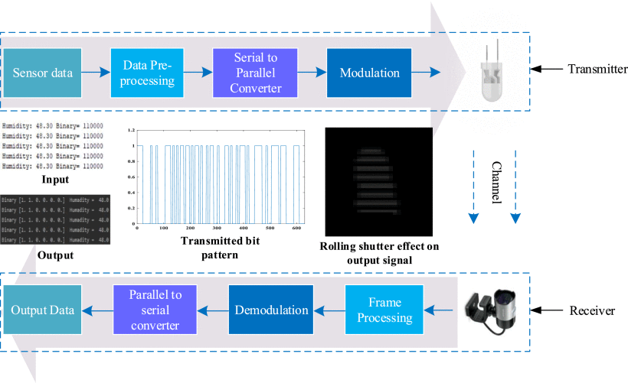
The overall OCC system architecture
Figure shows the overall structure of the implemented OCC system, where the input data collected from the sensor and output data retrieved from the receiver are depicted.

Slide 4
The overall OCC system architecture
Moreover, the data pattern of transmitted signals is also demonstrated in binary form. The string and character data produce 1 byte of the binary, which is decoded in the receiver and converted using ASCII code for each output data.
The Figure also shows the dark and bright stripes generated in the image sensor due to the rolling-shutter effect.
We have developed an NN to effectively detect the LED(s) in static and mobile scenarios.

Slide 5
Technical considerations
The transmitter comprises two primary parts such as a AM2302 sensor and a microcontroller with the LED(s). Each data structure (e.g., integer, string, character, etc.) is defined with a symbol, and all types of data are converted into binary.
This preprocessing is done before the modulation process. While implementing the LED array, the serial data is converted to parallel for assigning data to each LED before modulation.
However, a substantial amount of BER is observed in the mobile scenario, which is further improved by employing the NN based on feature matching.

