Slide 1
Project: IEEE P802.15 Working Group for Wireless Personal Area Networks (WPANs)
Submission Title: Realtime data collection using OCC devices for eHealth applications
Date Submitted : November, 2020
Source : Van Hoa Nguyen and Yeong Min Jang
Company : [Kookmin University]
Address : [Seoul, Korea]
Voice : [+82-2-910-5068], E-Mail: [yjang@kookmin.ac.kr]
Re :
Abstract : This document discusses about the applications of OCC devices for eHealth system.
Purpose : To get real-time medical data for eHealth application using novel devices based on OCC technology.
Notice: This document has been prepared to assist the IEEE P802.15. It is offered as a basis for discussion and is not binding on the contributing individual(s) or organization(s). The material in this document is subject to change in form and content after further study. The contributor(s) reserve(s) the right to add, amend or withdraw material contained herein.
Release : The contributor acknowledges and accepts that this contribution becomes the property of IEEE and may be made publicly available by P802.15.

Slide 2
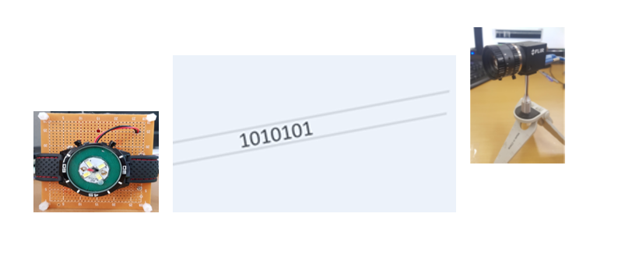
Introduction
Optical Camera Communications (OCC)
A Pragmatic Form of Visible Light Communications
OCC is modulating an LED light with data bits that can be received by a camera, which then decodes the bits and extracts the data.
Today we have millions of mobile devices enabled to receive visible light communications via the camera.

Slide 3
The patients have wearable sensors/patches with LEDs or LED arrays. Sensors/patches measure the health data, e.g., electrocardiography (ECG), blood pressure, body temperature whereas LEDs or LED arrays transmit the information.
The OCC systems receive the medical information using camera and forward it to the desired destination (Server). OCC system can receive real-time medical information from patents.
OCC system can provide a reliable and safe communication for many applications and address the major challenges for healthcare environment.

Slide 4
Comparison between OCC and Wireless
Wireless (BLE) | OCC
High interference | No interference
Less security, can be hacked | High security, can’t be hacked
Can penetrate through walls | Cannot penetrate through walls
Bluetooth only offers limited data rate. | Higher data rate
Communication range up to 100m. | High communication range up to 200m
Short life time | Communication can be done within long time
It can only connect limited devices at once | Smartphone cameras, CCTV can be used as receiver
It can lose connection in certain conditions | Can lose connection if light is blocked
Harmful for human body | Not harmful at all

Slide 5
OCC devices measure the sensor signal from the patent.
The OCC device will preprocess these data and use some modulation schemes to transmit the data via a single LED or LED array.
The camera uses as receiver to get signal from OCC devices.
eHealth gateway will process and store the data from the camera.
At the same time, eHealth Gateway receives the data. eHealth gateway also transmits immediately these data to store in eHealth server via WiFi connection or 5G network.

