Slide 1
Project: IEEE P802.15 Working Group for Wireless Personal Area Networks (WPANs)
Submission Title: [Considerations Regarding UWB in 802.15]
Date Submitted: [6 November, 2020]
Source: [Frank Leong, Riku Pirhonen] Company [NXP Semiconductors]
Re: [Input to the Working Group]
Abstract: [Presentation, UWB in 802.15, ranging, localization, sensing]
Purpose: []
Notice: This document has been prepared to assist the IEEE P802.15. It is offered as a basis for discussion and is not binding on the contributing individual(s) or organization(s). The material in this document is subject to change in form and content after further study. The contributor(s) reserve(s) the right to add, amend or withdraw material contained herein.
Release: The contributor acknowledges and accepts that this contribution becomes the property of IEEE and may be made publicly available by P802.15.

Slide 2
Considerations Regarding UWB in 802.15

Slide 3
Rationale
High-integrity RF ranging on the PHY layer requires many short pulses per measurement
Accurate ranging requires large signal bandwidth
UWB technology is uniquely suited to these demands
We reflect on how the market is recognizing this
QoS at application level is paramount → Aim to minimize impact of EIRP constraints → Mitigate overall impact of interference → Design PHY and MAC accordingly

Slide 4
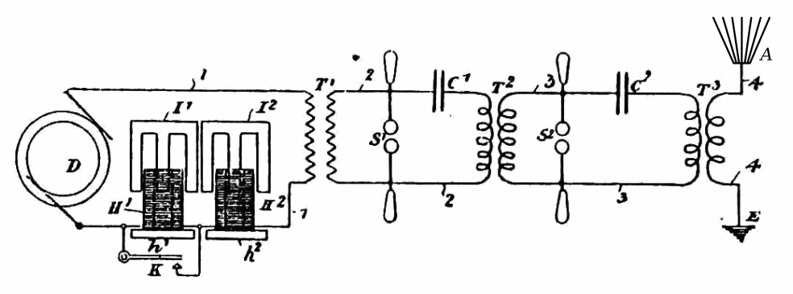
Looking Back (I)
UWB has been around for a long time:
Transatlantic (UK-Canada) spark-gap transmissions by Marconi [1]
Covert spread-spectrum communications
Win & Scholz [2] promoting UWB for wider use
FCC opening up 3.1–10.6 GHz spectrum for unlicensed UWB use
802.15.3a, DSSS vs. MB-OFDM, targeting wireless data transfer
802.{15.4a,15.4f,15.8} IR-UWB for accurate ranging
802.15.6 IR-UWB and FM-UWB for Body Area Networks
802.15.4z, IR-UWB featuring ranging with high integrity
[1] https://en.wikipedia.org/wiki/Kennelly%E2%80%93Heaviside_layer
[2] M. Z. Win and R. A. Scholtz, "Impulse radio: how it works," in IEEE Communications Letters, vol. 2, no. 2, pp. 36-38, Feb. 1998, doi: 10.1109/4234.660796.

Slide 5
Looking Back (II)
IEEE 802.15.4z HRP UWB as ecosystem focal point:
BMW Vehicles https://www.bmwusanews.com/newsrelease.do?id=3520
HID Seamless Access Control https://www.securityinfowatch.com/ces/news/21120348/hid-global-hid-global-makes-ces-debut-with-ultrawideband-uwb-technology
Samsung Smartphones, SmartThings https://youtu.be/-ks9mMZHWMc
Apple Smartdevices, Peripherals https://appleinsider.com/articles/20/10/18/everything-you-need-to-know-about-ultra-wideband-in-the-iphone-12-and-homepod-mini
CCC DK Rel3.0 – Handsfree Smart Car Access https://carconnectivity.org/press-release/car-connectivity-consortium-unveils-new-features-for-digital-key-specification
FiRa – Contactless/Handsfree Localization & Access Systems https://www.eetimes.com/fira-consortium-aims-to-revive-uwb-drive-interoperability https://www.firaconsortium.org/sites/default/files/2020-10/introduction-to-impulse-radio-uwb-seamless-access-systems-102820.pdf

Slide 6
Looking Back (III)
IEEE 802.15.4z-2020 HRP UWB:
PHY enhancements featuring the newly added Scrambled Timestamp Sequence (STS) field in packet formats associated with ranging: https://mentor.ieee.org/802.15/dcn/18/15-18-0286-01-004z-hrp-uwb-srdev-ppdu-text-contribution.docx https://mentor.ieee.org/802.15/dcn/18/15-18-0375-00-004z-srdev-phy-consensus.pptx https://mentor.ieee.org/802.15/dcn/18/15-18-0590-00-004z-hrp-uwb-phy-enhanced-mode-converged-consensus.pptx https://mentor.ieee.org/802.15/dcn/19/15-19-0053-01-004z-selecting-parameter-sets-in-the-revised-hrp-uwb-phy.pptx https://mentor.ieee.org/802.15/dcn/19/15-19-0134-00-004z-security-vs-sequence-length-considerations.pptx https://mentor.ieee.org/802.15/dcn/20/15-20-0003-02-004z-description-15-4z-hrp-uwb-phy-test-vectors.pdf
MAC concepts, IEs, PIBs to support the above: https://mentor.ieee.org/802.15/dcn/19/15-19-0034-02-004z-ieee-802-15-4z-mac.docx
Ultimately, higher layers (e.g., CCC, FiRa) make a selection among the wide range of options provided by the 15.4z amendment

Slide 7
Outlook
Recognize key functionalities to be provided by UWB:
Ranging with high integrity
Localization
Sensing
Coordination & scheduling to support the above
IEEE 802.15 suited to make associated PHY & MAC building blocks available for higher layers, supporting various applications
We see potential in concepts beyond the scope of 802.15.4
“Ranging with high integrity” naturally fits the 802.15 “Wireless Specialty Networks” theme
Existing body of experience to build upon
Looking forward to working towards an interoperable solution for ranging/localization/sensing

Slide 8
Associated Scope of Activity – Proposal
Focus on key functionalities to be provided by UWB:
Ranging with high integrity (handsfree access use cases)
Localization (indoor navigation use cases)
Sensing (presence detection use cases)
Coordination & scheduling to support the above
Provide accurate ranging via a low-cost, mass-market solution
Low energy-per-ranging
Low channel-occupancy-per-ranging a.k.a. spectral efficiency (many devices operating at the same time & place)
Re-use of hardware between use cases

Slide 9
In Appreciation of Bob Heile (March 27th, 1945 – September 24th, 2020)

