Slide 1
Project: IEEE P802.15 Working Group for Wireless Personal Area Networks (WPANs)
Submission Title: Security Requirements for 802.16t
Date Submitted: 2020-11-02
Source: Yael Luz, Ondas Networks
Abstract: Security Requirements for 802.16t
Purpose: Requirements Contribution for 802.16t Working Group
Notice: This document has been prepared to assist the IEEE P802.15. It is offered as a basis for discussion and is not binding on the contributing individual(s) or organization(s). The material in this document is subject to change in form and content after further study. The contributor(s) reserve(s) the right to add, amend or withdraw material contained herein.
Release: The contributor acknowledges and accepts that this contribution becomes the property of IEEE and may be made publicly available by P802.15.
Yael Luz – Ondas Networks

Slide 2
802.16t Security proposal
Agenda:
Overview of 802.16-2017 security
Recommendation for security components removal
Proposed changes and additions
November 2020
Yael Luz – Ondas Networks
Slide 2

Slide 3
Overview of 802.16-2017 security
Two main protocols:
  Encapsulation protocol for data encryption / decryption
    Ensuring privacy and confidentiality
    Authorization policy: no authorization, only RSA, only EAP, EAP after RSA
    Data encryption algorithms: no encryption, 56-bit DES-CBC, 128-bit AES-CCM, 128-bit AES-CBC, 128-bit AES-CTR
    Data authentication algorithms: no data authentication, 128-bit AES-CCM
    TEK encryption algorithm: none, 128-bit 3-DES-EDE, 1024-bits RSA, 128-bits AES
  PKM protocol
    Provides authorization, authentication and key exchange between BS and SSs.
    Two approved PKM versions:
      PKMv1 - one-way RSA authentication
      PKMv2 - one-way or mutual authentication methods: RSA, EAP, RSA + EAP
November 2020
Yael Luz – Ondas Networks
Slide 3

Slide 4
802.16-2017 Security Sublayer Components
RSA Authentication
Via X.509 certificate
SA Control
State machine of authorization and traffic encryption key
EAP Authentication
Via AAA server
PKM Key Management
Traffic Data
Encryption / Decryption
Control message processing
Message authentication processing
November 2020
Yael Luz – Ondas Networks
Slide 4

Slide 5
802.16-2017 PKM protocol
SS
BS
Authentication Information
Authorization Request
Authorization Reply
Key Request
Key Reply
Data Encryption / Decryption
November 2020
Yael Luz – Ondas Networks
Slide 5

Slide 6
Recommended 802.16-2017 Security Components Removal
November 2020
Yael Luz – Ondas Networks
Slide 6

Slide 7
Security capabilities downgrade
802.16t is focused on infrastructure and mission critical applications. As such, strong security is required.
802.16-2007 supports security options that are not suitable for 802.16t and are not within minimal requirements of relevant regulations.
An SS attacker can send a forge message to BS containing weaker capabilities in order to induce the BS to agree on an unconfident cryptographic suite.
The following options should be removed:
  PKMv1 (no mutual authentication, ineffective nonce)
  Capabilities options:
    no authorization, all DES related data encryption and TEK encryption algorithms, no data authentication, no TEK encryption
November 2020
Yael Luz – Ondas Networks
Slide 7

Slide 8
Authentication
In 802.16-2017 one-way authentication protects service provider from theft of service, and mutual authentication is optional
In 802.16-t, mutual authentication is required to protect the network from rogue BS and rogue SS attacks.
One-way authentication should be removed from standard.
Required by regulations:
  IEC-62443, CR 1.2
  CIP 005-5, R-1.2
  DO-377 SER-08, SER-16, SER-17
November 2020
Yael Luz – Ondas Networks
Slide 8

Slide 9
Recommended additions to 802.16-t
November 2020
Yael Luz – Ondas Networks
Slide 9

Slide 10
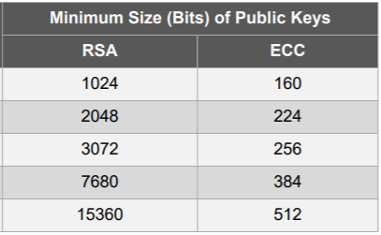
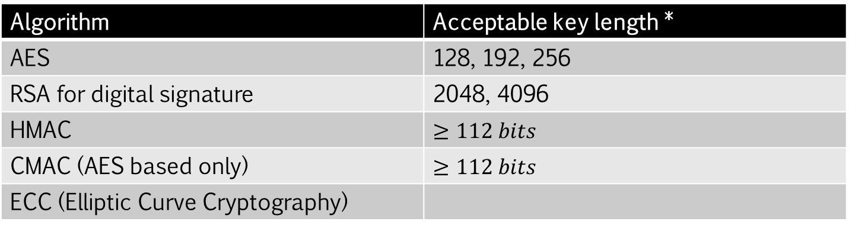
Stronger cryptographic suite
Algorithm | Acceptable key length *
AES | 128, 192, 256
RSA for digital signature | 2048, 4096
HMAC | $$≥112 bits$$
CMAC (AES based only) | $$≥112 bits$$
ECC (Elliptic Curve Cryptography)
* Acceptable by NIST SP 800-131A
Add ECC algorithm as alternative to RSA
ECC can provide the same cryptographic strength as an RSA-based system with much smaller key sizes
November 2020
Yael Luz – Ondas Networks
Slide 10

Slide 11
MAC Messages Protection
In 802.16-2007 the basic and the primary management connections are not mapped to an SA
Management traffic is not protected from eavesdropping and is being exposed to 'man in the middle' attack
Management traffic should be protected
Associate the primary management to the primary SA immediately after both sides established the AK key
Required by:
  CIP-005-5 R-2.2
  DO-377 SER-11
November 2020
Yael Luz – Ondas Networks
Slide 11

