Slide 1
Project: IEEE P802.15 Working Group for Wireless Personal Area Networks (WPANs)
Submission Title: SUN-OFDM PHR MCS Ambiguity Problem and the Resolution
Date Submitted: 2 Oct. 31, 2020
Source: Jeng-Shiann Jiang, Vertexcom Technologies, Taiwan
Address: 3F-9, No. 1, Taiyuan 2nd ST., Zhubei City, Hsinchu County, Taiwan 30288
E-Mail: js.jiang@vertexcom.com
Re:
Abstract: Proposed resolution for IEEE802.15.4-2020 OFDM PHR MCS ambiguity problems
Purpose: Resolve PHR MCS ambiguity issue for IEEE802.15.4-2020 OFDM low rate modes
Notice: This document has been prepared to assist the IEEE P802.15. It is offered as a basis for discussion and is not binding on the contributing individual(s) or organization(s). The material in this document is subject to change in form and content after further study. The contributor(s) reserve(s) the right to add, amend or withdraw material contained herein.
Release: The contributor acknowledges and accepts that this contribution becomes the property of IEEE and may be made publicly available by P802.15.

Slide 2
SUN-OFDM PHR MCS Ambiguity Problem and the Resolution
Jeng-Shiann Jiang, Vertexcom

Slide 3
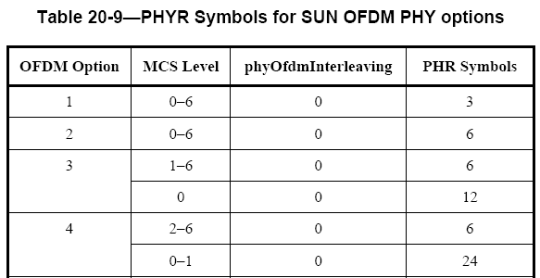
Problem Description
In Table 20-9 on page 571, PHR symbols of Option 3 is 6 for PAYLOAD MCS1~6, and 12 for MCS0. For Option4, PHR symbols is 6 for PAYLOAD MCS2~6, and 24 for MCS0~1.
  The decoding of PHR depends on the PAYLOAD MCS, while the PAYLOAD MCS is unknown until PHR is successfully decoded, which results in a deadlock.
  The approach is not backward compatible, which might cause higher probability of collision and throughput reduction
PAYLOAD MCS is unknown here
STF
LTF
PHR
PHY Payload

Slide 4
Proposed Resolution (1/3)
Keep original PHR and append PHR2 using MCS0 for PAYLOAD MCS0 in Option3 and PAYLOAD MCS0~1 in Option4
  Pros:
    For legacy devices, the PHR can be successfully decoded since original PHR is kept, so it’s backward compatible
    For new device, if PHR decode fail, the device continues to decode PHR2 using MCS0, so the sensitivity of new low data rate is not blocked by PHR
  Cons:
    Additional 12 and 24 symbols of PHR2 is required for Option3 and 4, respectively. However, the packet length is usually very long when new load data rate is used, in these cases 12 or 24 symbols is minor.
802.15.4g
802.15.4x new low data rate
STF
LTF
PHR
PHY Payload
STF
LTF
PHR
PHR2
PHY Payload

Slide 5
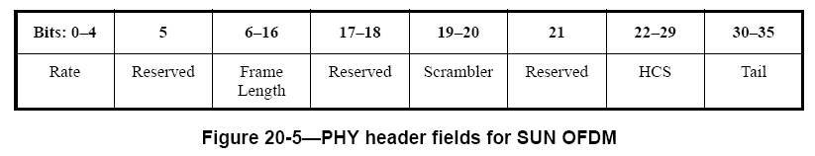
Proposed Resolution (2/3)
PHR content modification for low data rate
  The purpose of PHR in these cases is to let the legacy devices calculate correct packet length, in order to avoid collision and throughput reduction
  Original PHR
  Modified PHR
    Rate(b0-b4): Set to MCS1 for Option3, and MCS2 for Option4. The behavior is unpredictable for legacy devices if the field is set to low rate.
    Frame Length(b6-b16): calculate corresponding length with MCS1 in Option3 and MCS2 in Option4. The length must be larger than or equal to real payload length
      Option3: additional 12 symbols is included in payload.
        MCS0: FL = 2*(FL0+ 5.5), FL0 < 1019 octets, FL0 is payload frame length using MCS0
      Option4: addition 24 symbols is included in payload
        MCS0: FL = 4*(FL0+ 5.25), FL0 < 507 octets , FL0 is payload frame length using MCS0
        MCS1: FL = 2*(FL1+ 9.375), FL1 < 1015 octets , FL1 is payload frame length using MCS1
    Is_MCS0: set to 1 if the payload is MCS0, otherwise set to 0
    Is_MCS1: set to 1 if the payload is MCS1, otherwise set to 0
Bits:0-4 | 5 | 6-16 | 17 | 18 | 19-20 | 21 | 22-29 | 30-35
Rate | Reserved | Frame Length | Is_MCS0 | Is_MCS1 | Scrambler | Reserved | HCS | Tail

Slide 6
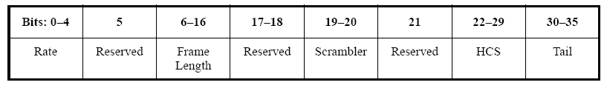
Proposed Resolution (3/3)
PHR2 format is the same with original PHR defined in Figure 20-5

Slide 7
Simulation Result
Pass criterion: PER < 10%
Payload length = 20B
Ideal time and frequency synchronization and channel estimation
Option | MCS | PHR only | PHR+PHR2 | Diff
3 | 0 | -119.9 dBm | -121.6 dBm | 1.7 dB
3 | 1 | -118.4 dBm
4 | 0 | -119.1 dBm | -123.5 dBm | 4.4 dB
4 | 1 | -118.7 dBm | -120.8 dBm | 2.1dB
4 | 2 | -117.3 dBm

Slide 8
Conclusions
Proposed resolution
  Backward compatible by keeping original PHR
  Avoid sensitivity degradation by appending PHR2 with MCS0.
  Additional symbols is minor for long packet with new low data rate.

