Slide 1
Project: IEEE P802.15 Working Group for Wireless Personal Area Networks (WPANs)
Submission Title: [TG4aa JRE Technical Proposal]
Date Submitted: [23 October,2020]
Source: [Takamitsu Hafuka,Takashi Kuramochi] Company [LAPIS Technology]
Address [2-4-8 Shinyokohama,Kouhoku-ku,Yokohama 222-8575 Japan]
Voice:[+81-45-476-9295], FAX: [], E-Mail:[kuramochi722@lapis-tech.com]
Re: []
Abstract: [This document includes Technical Proposal toward the development the amendment of IEEE Std 802.15.4-2020]
Purpose: [Technical Proposal for TG4aa JRE.]
Notice: This document has been prepared to assist the IEEE P802.15. It is offered as a basis for discussion and is not binding on the contributing individual(s) or organization(s). The material in this document is subject to change in form and content after further study. The contributor(s) reserve(s) the right to add, amend or withdraw material contained herein.
Release: The contributor acknowledges and accepts that this contribution becomes the property of IEEE and may be made publicly available by P802.15.

Slide 2
Technical Proposal for JRE
Proposed FSK parameters are as follows.
- Channel spacing : 1000kHz
- TX power : 13dBm( + 20mW)
- Rx Sensitivity : -80dBm (-86dBm with FEC)
- Modulation : 2FSK
- Modulation index : m=0.4
- Data rate : 600kbps

Slide 3
Proposed FSK extension
Frequency band (MHz) | Parameter | Operating mode
 |  | #1 | #2 | #3 | #4 | #5
920-928 MHz | Data rate (kb/s) | 50 | 100 | 200 | 400 | 600
 | Modulation | 2-FSK | 2-FSK | 2-FSK | 4-FSK | 2-FSK
 | Modulation index | 1.0 | 1.0 | 1.0 | 0.33 | 0.4
 | Channel spacing (kHz) | 200 | 400 | 600 | 600 | 1000
 | Standard | IEEE Std 802.15.4-2020 |  |  |  | Proposed

Slide 4
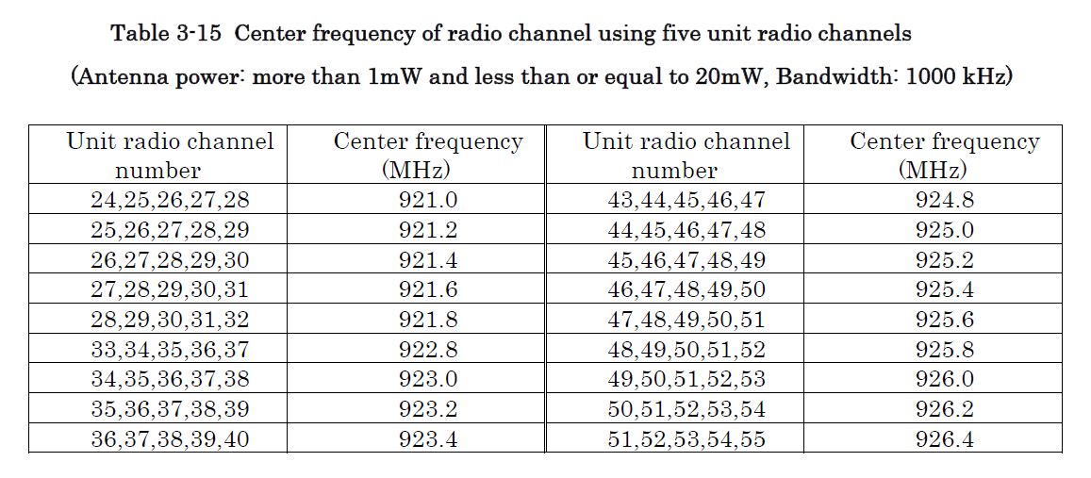
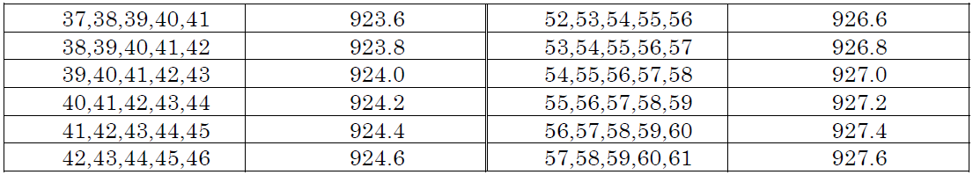
Proposed Channel Plan[1]

Slide 5
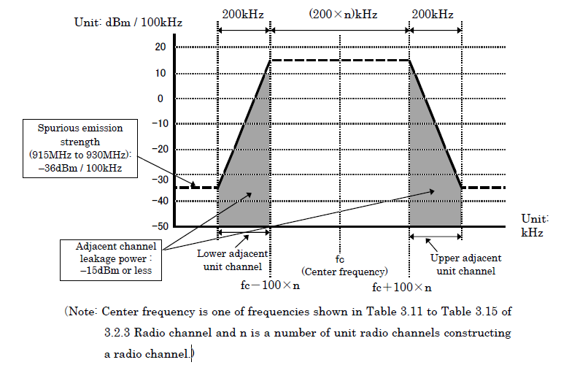
Spurious emission strength requirement from ARIB-T108[1]
MOST Stringent requirement : -36dBm at BW 700-800kHz for n=5(BW=1000kHz) case

Slide 6
Spurious Emission Strength measurement by TELEC-T245
(Purple portion in slide5)
Condition:
Data rate= 600kbps, Gaussian BT= 0.5, BW=1000kHz, Pout =13dBm, Spurious band = 700-800kHz
Signal Generator : Keysight E4438C
ARIB-T108 Spurious Emission Strength
requirement ≦ -36dBm
Proposed
modulation index 0.4 :9dB margin
modulation index 0.5: 3dB margin

Slide 7
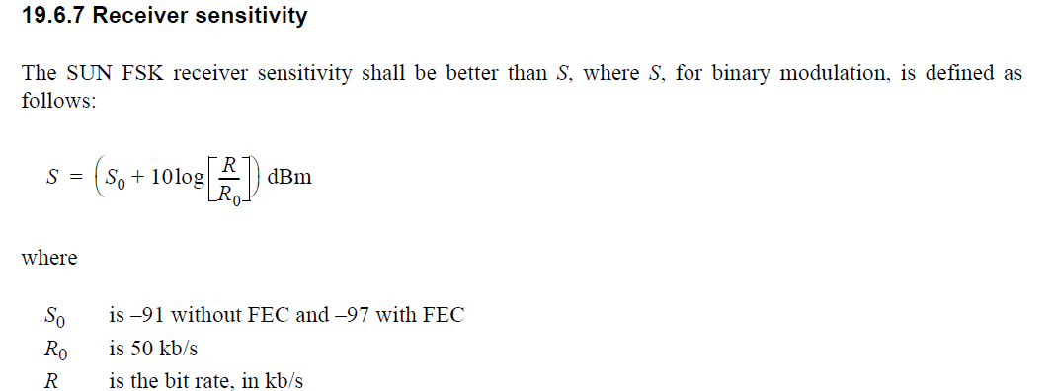
Proposed RX Sensitivity
Based on IEEE802.15.4-2020[2], Receiver sensitivity can be calculated as follows.
Rate [kbps] | MR-FSK [dBm] | MR-FSK (FEC ON) [dBm] | Note
25 | -94.0 | -100.0
50 | -91.0 | -97.0
100 | -88.0 | -94.0
200 | -85.0 | -91.0
300 | -83.2 | -89.2
400 | -82.0 | -88.0
600 | -80.2 | -86.2 | Proposed

Slide 8
Proposed RX Sensitivity
Required C/N
Sensitivity = Required C/N + 20LOG(BW)+ NF + N
Required C/N = Sensitivity – { 20 LOG(BW) + NF + N}
= -80 – { 60 + 10 -174 } = 24dB (Enough Margin)
Where,
Noise level N: -174dBm
Receiver Noise Figure NF(Relaxed):10dB
BW : 1000kHz
Sensitivity : -80dBm

Slide 9
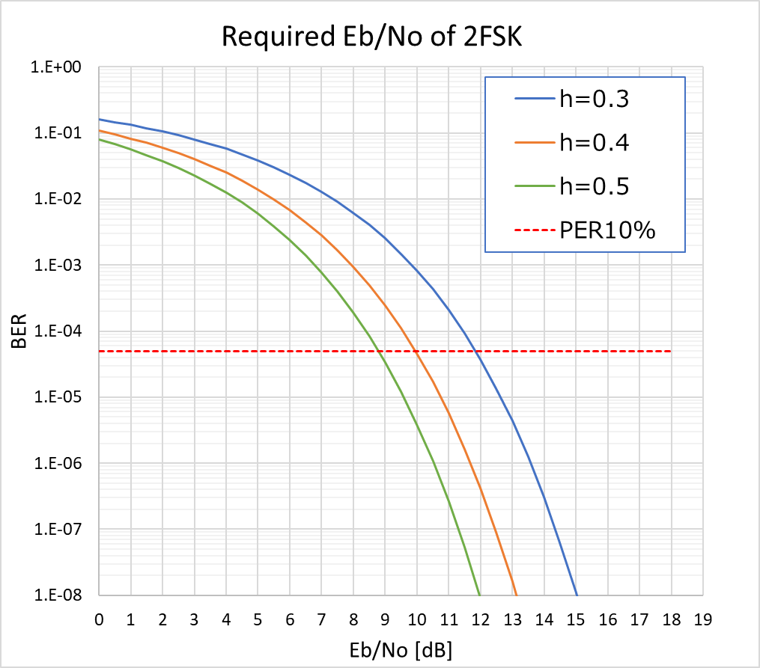
Theoretical Required C/N for RX Sensitivity
10% PER is approximately 0.005% BER.
Proposed
Eb/No = 10dB
for Proposed FSK mode(600kbps, modulation index(h) = 0.4)

Slide 10
Reference
[1] ARIB-STD-T108 “920 MHz Band Telemeter, Telecontrol and Data Transmission Radio Equipment”
[2]IEEE Std 802.15.4-2020

