Slide 1
Project: IEEE P802.15 Working Group for Wireless Personal Area Networks (WPANs)
Submission Title : Vehicular localization scheme based on optical camera communication (OCC) using single camera.
Date Submitted : [September, 2020]
Source : Md. Osman Ali, Md. Faisal Ahmed, and Yeong Min Jang
Company : [Kookmin University]
Address : [Seoul, Korea]
Voice : [+82-2-910-5068], E-Mail: [yjang@kookmin.ac.kr]
Re :
Abstract : This document focuses on the localization of vehicles from its LED shapes.
Purpose : To apply OCC for vehicular localization.
Notice: This document has been prepared to assist the IEEE P802.15. It is offered as a basis for discussion and is not binding on the contributing individual(s) or organization(s). The material in this document is subject to change in form and content after further study. The contributor(s) reserve(s) the right to add, amend or withdraw material contained herein.
Release : The contributor acknowledges and accepts that this contribution becomes the property of IEEE and may be made publicly available by P802.15.
Slide 1

Slide 2
Introduction
Wide use of camera in modern vehicles have made OCC a promising candidate for vehicular communication.
Localization technique can play a significant role to reduce the number of accidents.
If the object size is known, distance can be calculated.
Therefore, OCC can be used to transmit the vehicle size or type which can be used to localize the vehicle.
OCC uses camera receiver that can both track the vehicle and decode data transmitted in the from modulated light.

Slide 3
Region of Interest (RoI) Detection
Vehicles are differentiated based on their IDs. Vehicular IDs are prerequisite for vehicular localization and communication using OCC.
CNN based detection has the ability to classify and recognize LEDs.
It takes comparatively higher computational time.
Figure 1. Selection of RoI in the street at night.

Slide 4
System Architecture
Figure 2. Proposed system architecture for vehicle localization using OCC.

Slide 5
Variation of LED Size with Distance
The size of the pair of tail LEDs of FV decreases with the increasing distance. The more is the distance, the smaller the size of the LEDs on image sensor.
Figure 3. The size of the pair of tail LEDs of FV decreases with the increase in distance between vehicles. (a) FV is at a minimum distance. (b) FV is at a safe distance. (c) FV is at a long distance.

Slide 6
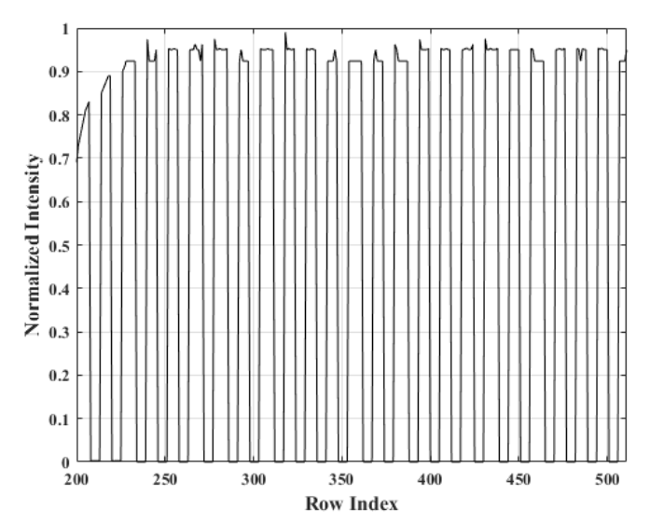

Modulated Data decoding using OCC
If the size or type of the vehicle is known, then the distance can be calculated.
OCC can be used to send the vehicle size to the receiver.
From the LED ON and OFF states, data can be decoded as shown in Figure 4.
Figure 4. Data decoding from captured LED states.

Slide 7
Technical Considerations
Single camera based OCC technique can reduce the overall cost for vehicular OCC system that uses two camera.
The accurate position can be obtained if we know the size of the rear LEDs or the size of the vehicle.
To achieve high resolution, more accurate RoI detection techniques can be more time consuming.

