Slide 1
Project: IEEE P802.15 Working Group for Wireless Personal Area Networks (WPANs)
Submission Title : Vehicular localization scheme based on optical camera communication (OCC) using single camera.
Date Submitted : [September, 2020]
Source : Md. Osman Ali, Md. Faisal Ahmed, and Yeong Min Jang
Company : [Kookmin University]
Address : [Seoul, Korea]
Voice : [+82-2-910-5068], E-Mail: [yjang@kookmin.ac.kr]
Re :
Abstract : This document focuses on the localization of vehicles both accurately and economically. Purpose : To localize vehicles from the images of its either front or rear LEDs.
Notice: This document has been prepared to assist the IEEE P802.15. It is offered as a basis for discussion and is not binding on the contributing individual(s) or organization(s). The material in this document is subject to change in form and content after further study. The contributor(s) reserve(s) the right to add, amend or withdraw material contained herein.
Release : The contributor acknowledges and accepts that this contribution becomes the property of IEEE and may be made publicly available by P802.15.
Slide 1

Slide 2
Introduction
At present, light-emitting diodes (LEDs) and cameras are used almost everywhere. Optical camera communication (OCC) can utilize existing lighting sources as transmitters with minimum cost and cameras as receivers.
Camera can track objects as well as decode data from modulated light.
OCC is one of the most promising technologies for vehicular communication and localization.
Vehicle to vehicle distance measurement will play a key role to ensure safe road.
Vehicular front and rear light-emitting diodes (LEDs), traffic LEDs, traffic signage, and lamp post LEDs have the potential to enormously contribute to intelligent transportation system (ITS).

Slide 3
System Architecture
Figure 1. Proposed system architecture for vehicle localization using OCC.

Slide 4
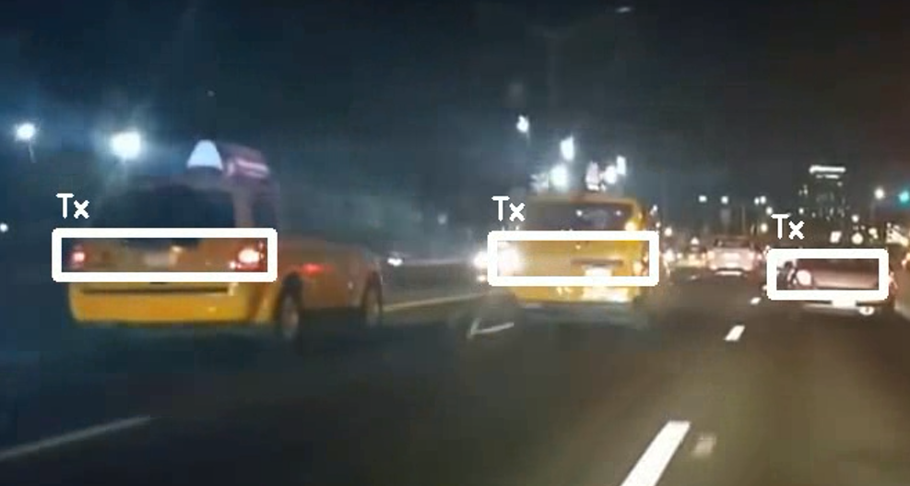
Region of Interest (RoI) Detection
Camera captures the pair of tail LEDs of FVs and CNN detects the proper region of interest.
Vehicles are differentiated based on their IDs. Vehicular IDs are prerequisite for vehicular localization and communication using OCC.
Figure 2. Selection of RoI in the street at night.

Slide 5
Variation of LED Size with Distance
The size of the pair of tail LEDs of FV decreases with the increasing distance. The more is the distance, the smaller the size of the LEDs on image sensor.
Figure 3. The size of the pair of tail LEDs of FV decreases with the increase in distance between vehicles. (a) FV is at a minimum distance. (b) FV is at a safe distance. (c) FV is at a long distance.

Slide 6
Alternation of LED Co-ordinates on Image Sensor
When the front vehicle changes its lane, the co-ordinates of the tail LEDs on the image sensor are also changed.
Figure 4. Change of co-ordinates of a pair of tail LEDs of front vehicle (FV) moving from left to right on image sensor. (a) FV at the left side (b) FV straight at the front (c) FV at the right side

Slide 7
Technical Considerations
A novel vehicle localization technique has been proposed based on the LED size and co-ordinate on the image sensor.
Surrounding vehicles on the street will be detected using RoI signaling.
The size and co-ordinates of the tail LEDs of FV on the image sensor varies with its distance and angular positions.
Accurate position of the FV from the host vehicle will be calculated from this information.

