Slide 1
Project: IEEE P802.15 Interest Group for Wireless Personal Area Networks (WPANs)
Submission Title: Monitoring System Using Optical Camera Communications for Smart Factory
Date Submitted: September 2020
Source: Cong Hoan Nguyen and Yeong Min Jang [Kookmin University].
Contact: +82-2-910-5068 E-Mail: yjang@kookmin.ac.kr
Re:
Abstract : Monitoring System Using Optical Camera Communications for Smart Factory
Purpose: To Monitoring System Using Optical Camera Communications for Smart Factory.
Notice: This document has been prepared to assist the IEEE P802.15. It is offered as a basis for discussion and is not binding on the contributing individual(s) or organization(s). The material in this document is subject to change in form and content after further study. The contributor(s) reserve(s) the right to add, amend or withdraw material contained herein.
Release: The contributor acknowledges and accepts that this contribution becomes the property of IEEE and may be made publicly available by P802.15.

Slide 2
Monitoring System Using Optical
Camera Communications for Smart Factory

Slide 3
Introduction
Wireless technologies that are based on radio frequencies are currently widely used, with numerous applications around the world.
However, they pose some disadvantages to human health. High frequencies can have potentially harmful effects on children, hospital patients, and even healthy people if the signal power exceeds the permitted standard.
Conversely, the use of visible light for data transmission is a trend that presents new options, including optical wireless communication, optical camera communication, and visible light communication.
Yeong Min Jang (Kookmin University)

Slide 4
Scenario
Yeong Min Jang (Kookmin University)

Slide 5
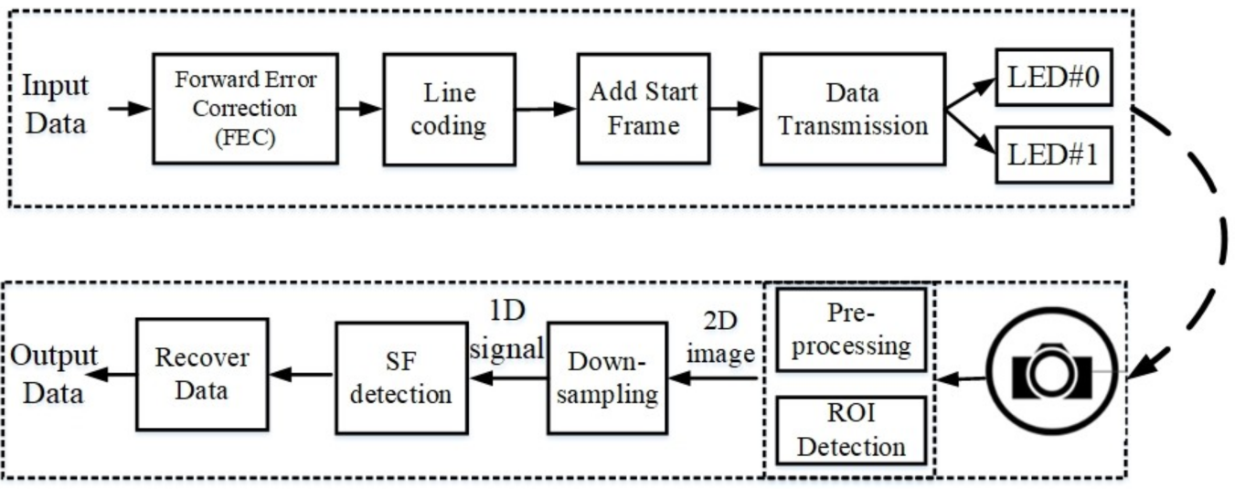
System Architecture
<System architecture>
Yeong Min Jang (Kookmin University)

Slide 6

Data Frame Structure
Figure illustrates the proposed data frame structure for the MIMO-OOK scheme. To access many users, we added the node ID part to each frame. Each user will be defined by a unique ID so that the receiver can categorize the signal from different users.
Yeong Min Jang (Kookmin University)

Slide 7
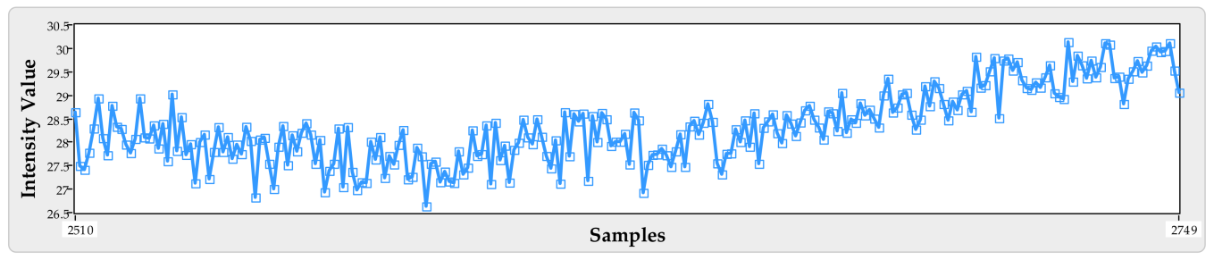
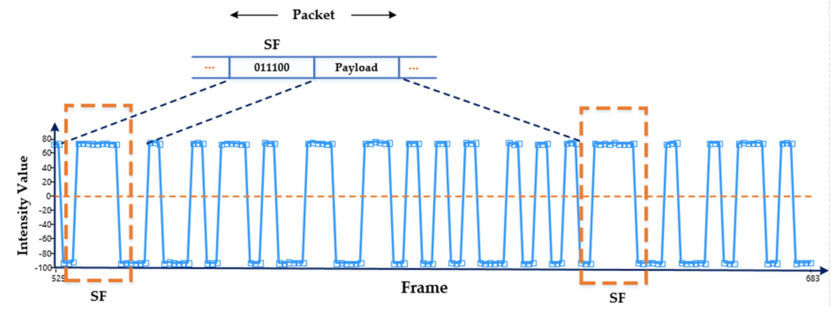
Detect Signal
<The intensity of the noise signal>
<The intensity of the expected signal>
Kookmin University

Slide 8
Conclusion
We proposed a monitoring system that uses a MIMO-OOK scheme that is based on an OCC system.
The proposed scheme uses a RoI method, which can detect dozens of users with high accuracy, making it compatible with almost all types of commercially available cameras, including the rolling-shutter camera and global-shutter camera.

