Slide 1
Project: IEEE P802.15 Interest Group for Wireless Personal Area Networks (WPANs)
Title: LED Matrix based Transmitter Device using Optical Camera Communication Technology for Smart Factory Applications
Date Submitted: September 2020
Source: Van Hoa Nguyen, Yeong Min Jang [Kookmin University].
Contact: +82-2-910-5068 E-Mail: yjang@kookmin.ac.kr
Re:
Abstract: A potential design of transmitter device for optical camera communication system
Purpose: To introduce promising application for smart factory using optical camera communication system
Notice: This document has been prepared to assist the IEEE P802.15. It is offered as a basis for discussion and is not binding on the contributing individual(s) or organization(s). The material in this document is subject to change in form and content after further study. The contributor(s) reserve(s) the right to add, amend or withdraw material contained herein.
Release: The contributor acknowledges and accepts that this contribution becomes the property of IEEE and may be made publicly available by P802.15.

Slide 2
LED Matrix based Transmitter Device using Optical Camera Communication Technology for Smart Factory Applications

Slide 3
Introduction
OOC as a subsystem of optical wireless communication (OWC), uses light-emitting diodes (LEDs) or LED arrays as the transmitter and a camera or image sensor (IS) as the receiver.
LED matrix is well-known and have various applications in real life. However, the use of this device for Optical Camera Communication (OCC) system is novel and under research and development.
[1] has been discussed the implementation of using LED to transmit data in Optical Camera Communication system for smart factory application. These advantages of using LED matrix in OCC system can be summarized as follow.

Slide 4
Advantages of using LED matrix based optical camera communication
LED matrix based transmitter device is a promising module that offers cost-effectiveness and useful features such as easy to implement, high data rate, human safety and has great potential in the monitoring system in the factory.
LED array can support high-speed data, long distance communication for Optical Camera Communication system.

Slide 5
A proposed design using LED matrix based communication for smart factory
The above sensing module are connected with the microcontroller (Arduino Board) via different protocol: 1-Wire for DHT22 module and I2C for CCS811 module. For the power supply, we used a adapter for supplying all devices. Sensing values from three sensors are processed to present in LED matrix (via Wire connected) follows the OCC scheme.

Slide 6
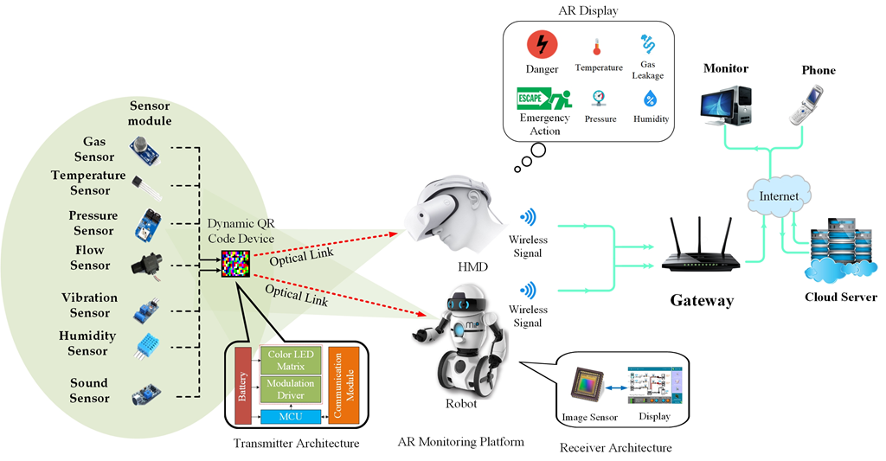
Scenario of implementing LED array for smart factory application

