Slide 1
Project: IEEE P802.15 Interest Group for Wireless Personal Area Networks (WPANs)
Submission Title: Potential of Optical Camera Communication technique for Smart Factory Monitoring System
Date Submitted: September 2020
Source: Huy Nguyen, Yeong Min Jang [Kookmin University].
Contact: +82-2-910-5068 E-Mail: yjang@kookmin.ac.kr
Re:
Abstract: Potential of Optical Camera Communication technique for Smart Factory Monitoring System
Purpose: To introduce the feasibility of OCC technique in smart factory monitoring system
Notice: This document has been prepared to assist the IEEE P802.15. It is offered as a basis for discussion and is not binding on the contributing individual(s) or organization(s). The material in this document is subject to change in form and content after further study. The contributor(s) reserve(s) the right to add, amend or withdraw material contained herein.
Release: The contributor acknowledges and accepts that this contribution becomes the property of IEEE and may be made publicly available by P802.15.

Slide 2
Potential of Optical Camera Communication technique for Smart Factory Monitoring System

Slide 3
Introduction
Unlike VLC or Li-Fi communications that use PDs as receivers, the OCC technique uses an image sensor as the detector to receive data.
Compare with VLC/LiFi, OCC shows some advantages:
The camera lens can spatially separate light sources, and thus OCC technique can implement MIMO.
Camera available everywhere, particularly smartphone cameras and CCTV. Thus, OCC may be a promising solution for market acceptance.

Slide 4
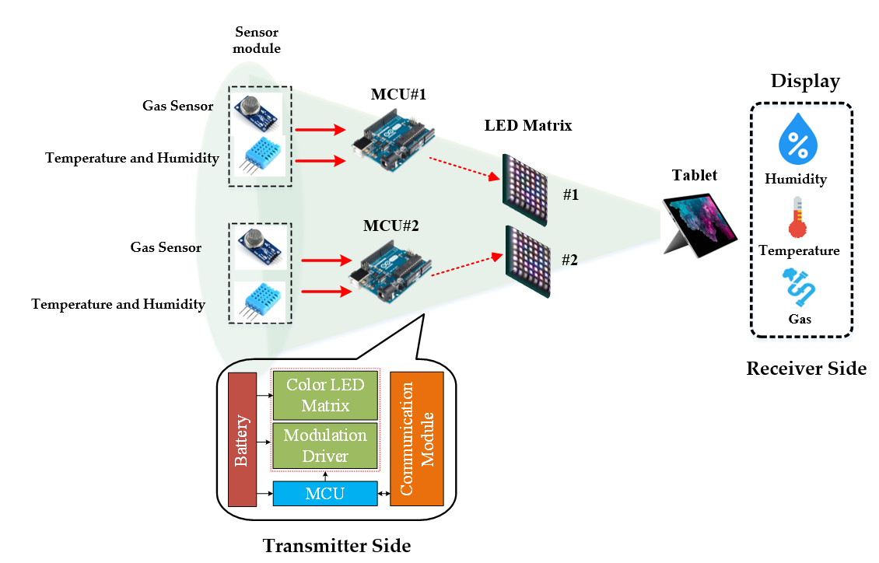
Introduction
Scenario of Optical Camera Communication technique for Monitoring system

Slide 5
Technical consideration for Smart Factory Monitoring System based OCC
Despite the potential of a massive industrial market for monitoring system, OCC technology still a few challenge by the environment requirements:
Camera should be able to detect the interesting links among thousands of possible artificial lights.
The asynchronous communication mode must support in OCC system.
Flicker should be support. Optical clock rate should be at least 200Hz for no flicker-free
Power consumption should be consider in transmitter side.

Slide 6
Potential of Optical Camera Communication technique for Smart Factory Monitoring system
By using the camera focal length, the communication distance is higher (up to 200m) than VLC/LiFi technique (maximum communication system of 10m)
Multi-users detection support: the camera with an RoI algorithm is permitted to set up the communication link for better quality with a shorter time delay.
Depending on the modulation scheme, we can apply OCC technique with all types of commercially available camera (Smartphone, CCTV, Tablet, webcam, …).
Mobility support: By apply RoI detection or Computer Vision algorithms for image processing, we can reduce the mobility support in OCC system.

