Slide 1
Project: IEEE P802.15 Interest Group for Wireless Personal Area Networks (WPANs)
Submission Title: Overview of High Data Rate Optical Camera Communication Task Group
Date Submitted: September 2020
Source: Huy Nguyen, Yeong Min Jang [Kookmin University].
Contact: +82-2-910-5068 E-Mail: yjang@kookmin.ac.kr
Re:
Abstract: Overview of High Data Rate Optical Camera Communication Task Group
Purpose: To introduce purpose of IEEE 802.15.7a Task Group
Notice: This document has been prepared to assist the IEEE P802.15. It is offered as a basis for discussion and is not binding on the contributing individual(s) or organization(s). The material in this document is subject to change in form and content after further study. The contributor(s) reserve(s) the right to add, amend or withdraw material contained herein.
Release: The contributor acknowledges and accepts that this contribution becomes the property of IEEE and may be made publicly available by P802.15.

Slide 2
Introduction
Unlike VLC or Li-Fi communications that use PDs as receivers, the OCC technique uses an image sensor as the detector to receive data.
OCC aims to deliver data from the light sources to the camera.
Artificial lights (LED light) are available everywhere human being live, and cameras too.
The existing infrastructure shall be an advantage of OCC for the market acceptance.

Slide 3
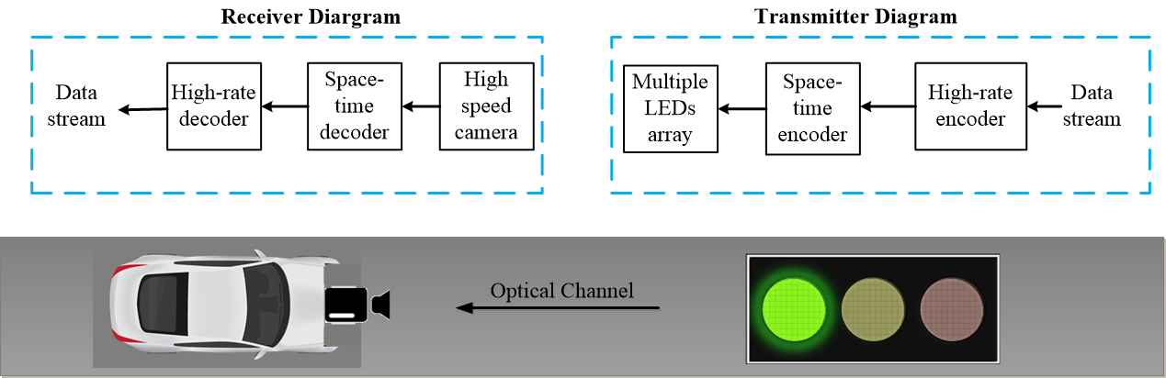
Classification of OCC Technologies
High Frame Rate Processing
High-speed camera-based transmission protocols are related to multiple-input-multiple-output (MIMO) technique, which achieves data rates of tens of kbps from LED arrays
Reference architecture using high-speed camera

Slide 4
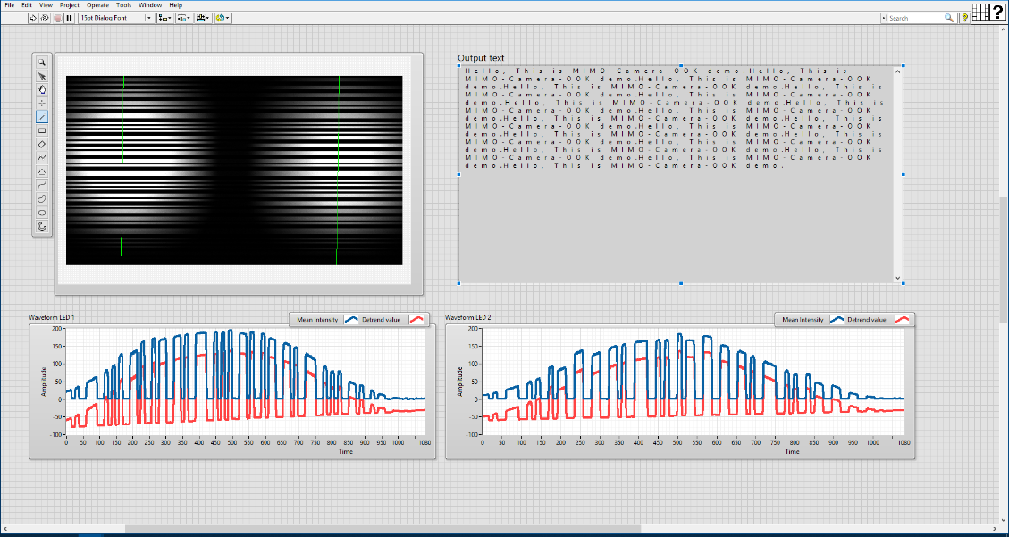
Classification of OCC Technologies
Rolling Shutter-based OCC
Despite having low frame rates, rolling-shutter cameras are beneficial for non-flicker systems, as the rolling shutter mechanism sequentially exposes the pixel lines to the incoming light at a high sampling rate.
Example of rolling shutter based OCC technique

Slide 5
Classification of OCC Technologies
Screen Modulation-based OCC
The data rate of these screen-camera systems can achieve up to Mbps by taking advantage of high spatial resolution at both Tx and Rx
Example of rolling shutter based OCC technique

Slide 6
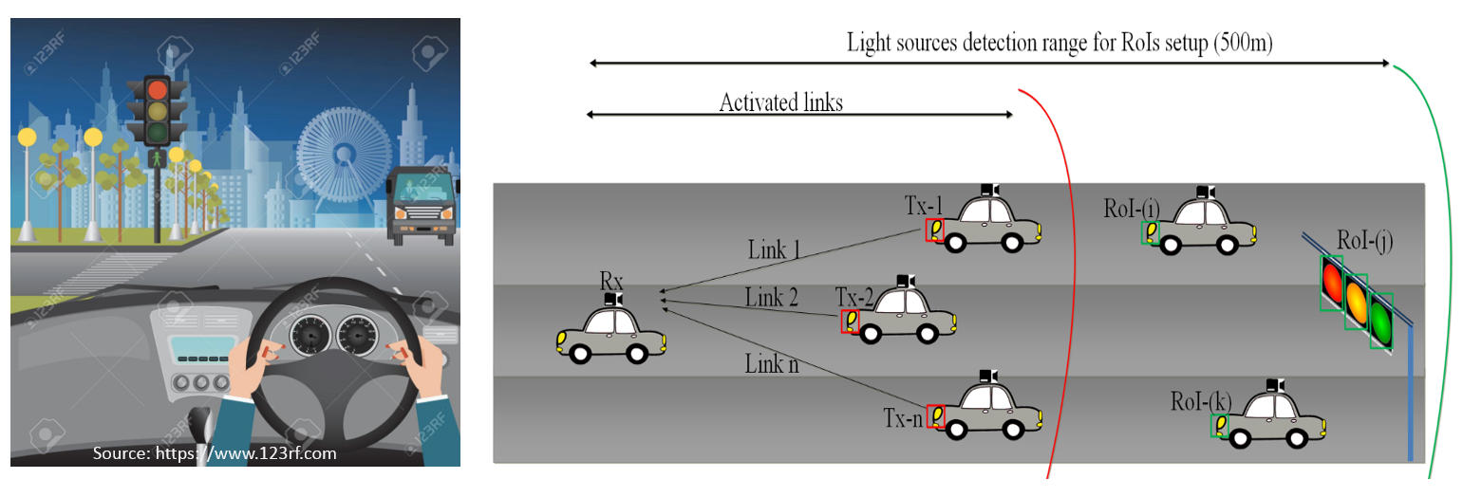
Classification of OCC Technologies
Region-of-Interest signaling
This technology is applied for detecting and tracking the light source.
Example of RoI signaling based OCC technique

Slide 7
Overview IEEE 802.15.7-2018
IEEE 802.15.8-2018 standard defines a physical layer (PHY) and medium access control (MAC) sublayer for short-range optical wireless communications (OWC) in optically transparent media using light wavelengths from 10.000 nm to 190 nm.
IEEE 802.15.7-2018 standard provides a global standard for short-range OWC.
The standard provides the following:
Access to several hundred terahertz of unlicensed spectrum.
Immunity to electromagnetic interference and non-interference with radio frequency systems.
For visible light systems, additional security by allowing the user to see the communication channel, Communication augmenting and complementing existing services (e.g., illumination, display, indication, decoration).

Slide 8
Purpose of IEEE 802.15.7a Task Group
Scope of task group
IEEE 802.15.7a Task Group amendment specifies a high-rate Optical Camera Communications (OCC) Physical Layer (PHY) using light wavelengths from 10.000 nm to 190 nm in optically transparent media.
It is capable of delivering data rates up to 100 Mbit/s and is designed for point-to-point and point-to-multipoint communication.
Maintaining connectivity during high mobility (speeds up to 350 km/h),
Flicker mitigation.
Radio Frequency (RF) co-existence, and a communication range of up to 200 m.
Multiple-Input-Multiple-Output (MIMO) is utilized to deal with high-levels of optical interference while maintaining high-rate data transmission.

Slide 9
Purpose of IEEE 802.15.7a Task Group
Purpose of task group
IEEE 802.15.7a Task Group standard provides:
Access to unlicensed spectrum.
Inherent communication security due to inability to penetrate through optically opaque walls.
Data delivery without using RF spectrum.
Apply MIMO and Artificial intelligence (AI)-based PHY and MAC layers.
Communication augmenting and complementing existing services (such as illumination, indication, localization, etc.)

