Slide 1
IEEE 802.15 TG22 Motion
Apurva N. Mody
Task Group Chair, IEEE 802.15.22
apurva.mody@ieee.org, apurva.mody@A5Systems.com
+1-404-819-0314

Slide 2
Unconditional Approval to forward 802.15.22.3 Draft 8 to RevCom

Slide 3
Requirements
Recirculation ballot is completed. Generally, the recirculation ballot and resolution should occur in accordance with the schedule presented at the time of conditional approval.
After resolution of the recirculation ballot is completed, the approval percentage is at least 75% and there are no new valid DISAPPROVE votes.
No technical changes, as determined by the WG Chair, were made as a result of the recirculation ballot.
No new valid DISAPPROVE comments on new issues that are not resolved to the satisfaction of the submitter from existing DISAPPROVE voters.
If the WG Chair determines that there is a new invalid DISAPPROVE comment or vote, the WG Chair shall promptly provide details to the Sponsor.
The WG Chair shall immediately report the results of the ballot to the Sponsor including: the date the ballot closed, vote tally and comments associated with any remaining disapproves (valid and invalid), the WG responses and the rationale for ruling any vote invalid.

Slide 4
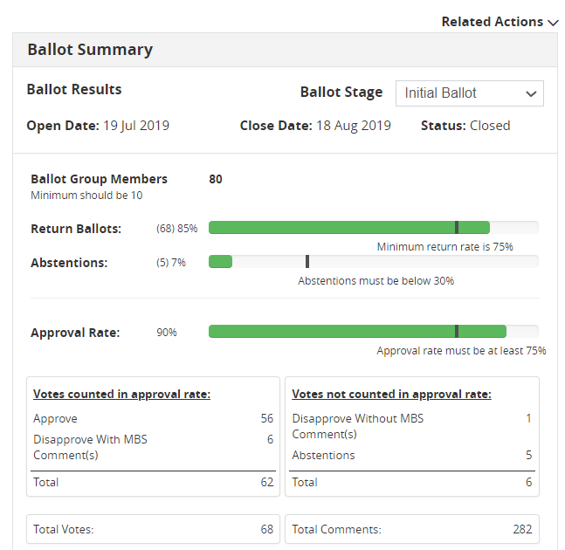
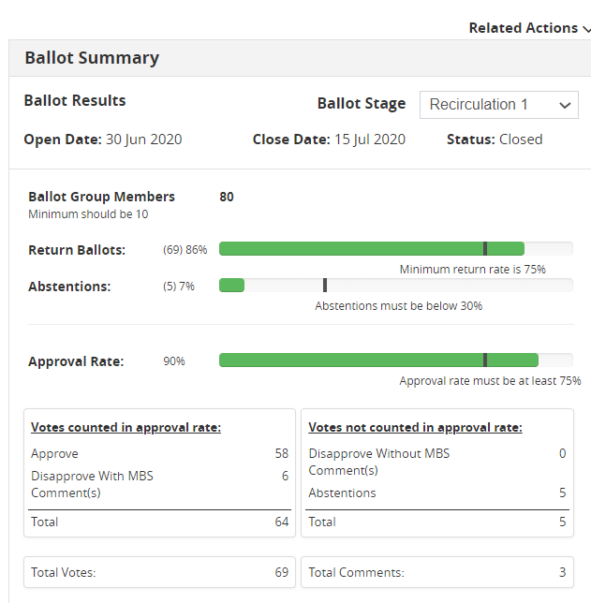
Motion for Unconditional Approval to Forward IEEE P802.15.22.3 Draft 8.0 to RevCom
INITIAL BALLOT – DRAFT 5.0
RE-CIRC 1: DRAFT 6.0

Slide 5
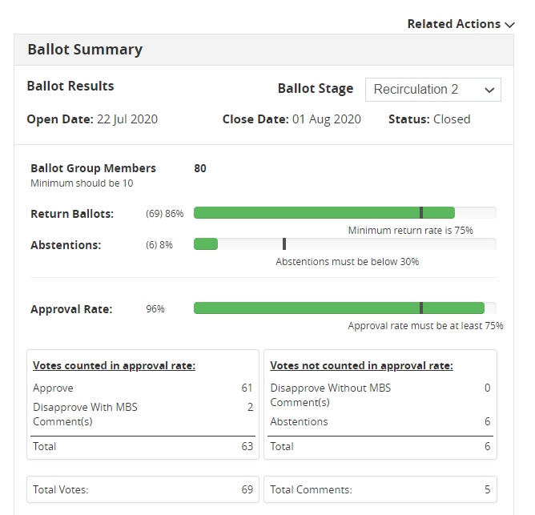
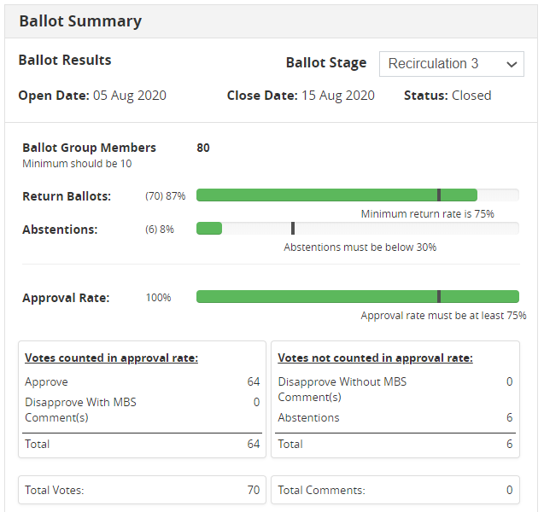
Motion for Unconditional Approval to Forward IEEE P802.15.22.3 Draft 8.0 to RevCom
ALL CONDITIONS SATISFIED
RE-CIRC 2 – DRAFT 7.0
RE-CIRC 3: DRAFT 8.0

Slide 6
Motion for Unconditional Approval to Forward IEEE P802.15.22.3 Draft 8.0 to RevCom
 | SB #1 (Draft D5.0) |  |  | SB Re-circ #1 (Draft D6.0) |  |  | SB Re-circ #2 (Draft D7.0) |  |  | SB Re-circ #3 (Draft D8.0) |  |  | Req %
 | # | % | Status | # | % | Status | # | % | Status | # | % | Status
Abstain | 5 | 7 | - | 5 | 7 | - | 6 | 8 | - | 6 | 8 |  | N/A
Disapprove with comments | 6 | 10 | - | 6 | 10 | - | 2 | 0 | - | 0 | 0 |  | -
Disapprove w/o comment | 1 | 0 | - | 0 | 0 | - | 0 | 0 | - | 0 | 0 |  | -
Approve | 56 | 90 | PASS | 58 | 90 | PASS | 61 | 96 | PASS | 64 | 100 | PASS | ≥ 75
Ballots returned | 68 | 85 | PASS | 69 | 86 | PASS | 69 | 86 | PASS | 70 | 87 | PASS | ≥ 50
Voters | 80 | - | - | 80 | - | - | 80 | - | - | 80 |  |  | -
Comments | 282 | - | - | 3 | - | - | 5 | - | - | 0 |  |  | -

Slide 7
Motion for Unconditional Approval to Forward IEEE P802.15.22.3 Draft 8.0 to RevCom
IEEE 802.15.22.3 Timelines:
Actions | Schedule
Sponsor Ballot Pool formed. 80 people in the Pool. Pool is balanced | Completed – July 2019
P802.15.22.3 Co-existence Assurance Document | N/A This is a Receive Only System
P802.15.22.3 Criteria for Standards Development Revised | July 2019
Sent the Draft to IEEE MEC and Review Completed | June 2019
Draft 5.0 – Initial Ballot | July 19th 2019
Draft 6.0 – Sponsor Ballot Re-circ 1 | June 30th 2020
Draft 7.0 – Sponsor Ballot Re-circ 2 | July 22nd 2020
Draft 8.0 – Sponsor Ballot Re-circ 3 | August 5th 2020
Motion for Conditional Approval to Forward to RevCom | September 2020

Slide 8
Motion for Unconditional Approval to Forward IEEE P802.15.22.3 Draft 8.0 to RevCom
Motion Text (include) | Approve sending P802.15.22.3 Draft 8.0 to RevCom. Approve CSD documentation in https://mentor.ieee.org/802.22/dcn/19/22-19-0028-01-0003-updated-csd-for-p802-22-3-transfer-of-project-to-ieee-802-15-wg.docx M: Bob Heile S:
Other Info (include) | P802.15.22.3 Draft 8.0 has 100% approval at the end of the last sponsor recirculation ballot. No comments received. No technical changes. In the WG, forwarding draft to RevCom (y/n/a): Working Group Voted to Approve with Unanimous Consent CSD (y/n/a): Working Group Voted to Approve with Unanimous Consent
Background | Applies to: A project that has passed sponsor ballot with at least 75% approval and has completed any necessary recirculation ballots.
Rules Reference | LMSC OM – “The IEEE 802 LMSC EC” Clause 12 Working Group P&P – Clause 7
Field Definitions | Scope of proposed standard: This Standard defines a Spectrum Characterization and Occupancy Sensing (SCOS) System. It defines the formats for system configuration and spectrum measurement parameters. It includes protocols for reporting measurement information that allow the coalescing of results from multiple systems. The standard leverages interfaces and primitives that are derived from IEEE Std. 802.22-2011. It uses any available transport mechanism to control and manage the system, and to share sensing data. The standard provides means for conveying value added sensing information to various spectrum database services.

