Slide 1
IEEE 802.15 TG22 Motion
Apurva N. Mody
Task Group Chair, IEEE 802.15.22
apurva.mody@ieee.org, +1-404-819-0314

Slide 2
Conditional Approval to forward 802.15.22.3 Draft 8 to RevCom

Slide 3
Conditional Approval Requirements
Conditions:
Recirculation ballot is completed. Generally, the recirculation ballot and resolution should occur in accordance with the schedule presented at the time of conditional approval.
After resolution of the recirculation ballot is completed, the approval percentage is at least 75% and there are no new valid DISAPPROVE votes.
No technical changes, as determined by the WG Chair, were made as a result of the recirculation ballot.
No new valid DISAPPROVE comments on new issues that are not resolved to the satisfaction of the submitter from existing DISAPPROVE voters.
If the WG Chair determines that there is a new invalid DISAPPROVE comment or vote, the WG Chair shall promptly provide details to the Sponsor.
The WG Chair shall immediately report the results of the ballot to the Sponsor including: the date the ballot closed, vote tally and comments associated with any remaining disapproves (valid and invalid), the WG responses and the rationale for ruling any vote invalid.

Slide 4
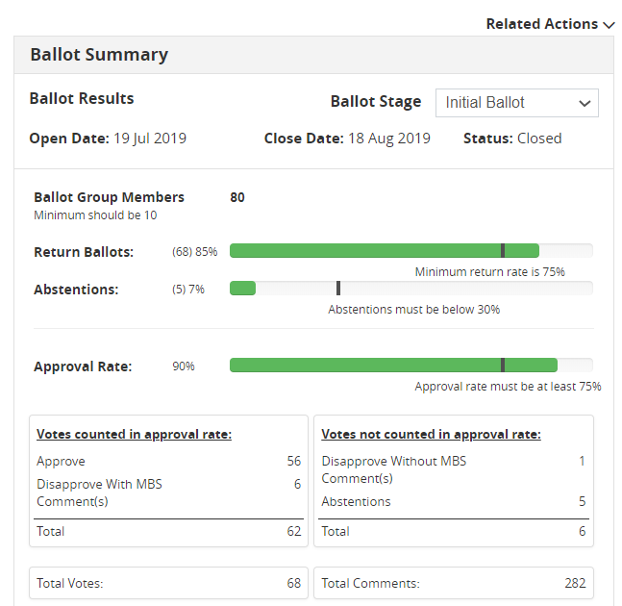
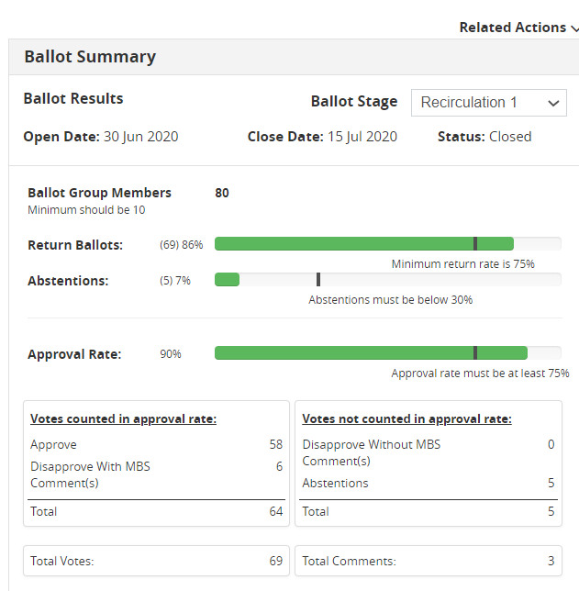
Motion for Conditional Approval to Forward IEEE P802.15.22.3 Draft 8.0 to RevCom
INITIAL BALLOT – DRAFT 5.0
RE-CIRC 1: DRAFT 6.0

Slide 5
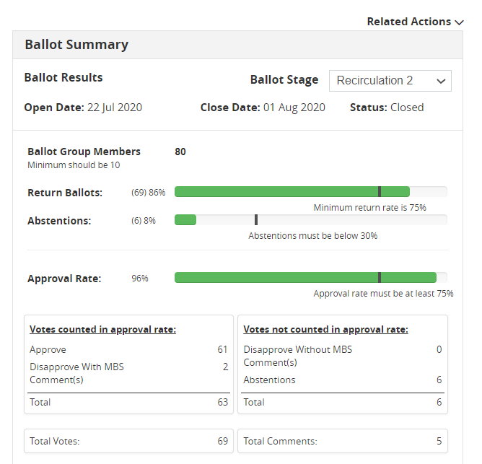
Motion for Conditional Approval to Forward IEEE P802.15.22.3 Draft 8.0 to RevCom
CONDITION (a) SATISFIED
RE-CIRC 2 – DRAFT 7.0
RE-CIRC 3: STARTING 8/5/2020

Slide 6
Motion for Conditional Approval to Forward IEEE P802.15.22.3 Draft 8.0 to RevCom
Item 3: Clause 12 Conditions
Two remaining disapprove voters (Todor Cooklev and Ben Rolfe) have agreed to change their Vote (E-mails attached at the end)
5 comments received on Draft 7.0 Sponsor Ballot Re-circ.
None of the Comments are ‘Must be Satisfied’. Four Comments were received from the IEEE Editorial Staff. They recommend another round of Re-circ based on their comments. One comment is on the unchanged portion of the Draft but we would like to accommodate the Commenter.
Hence Draft 8.0 will likely go to the RevCom.
Conditions
b) After resolution of the recirculation ballot is completed, the approval percentage is at least 75% and there are no new valid DISAPPROVE votes.
CONDITION SATISFIED
c) No technical changes, as determined by the WG Chair, were made as a result of the recirculation ballot.
CONDITION SATISFIED
d) No new valid DISAPPROVE comments on new issues that are not resolved to the satisfaction of the submitter from existing DISAPPROVE voters.
CONDITION SATISFIED
CONDITIONS (b), (c) and (d) SATISFIED

Slide 7
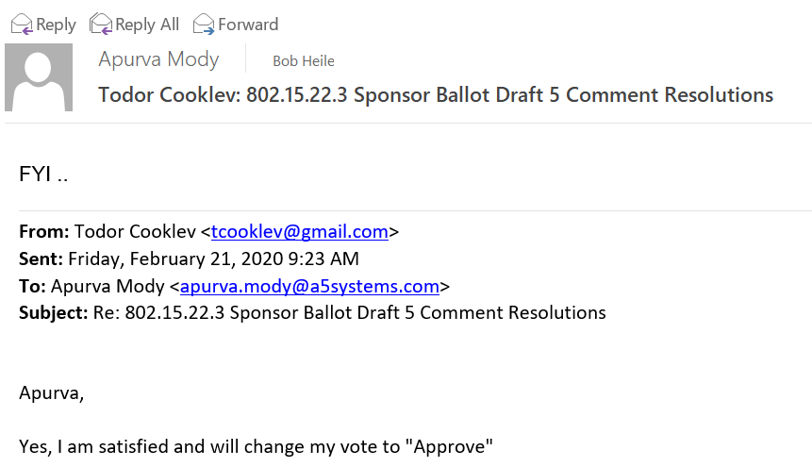
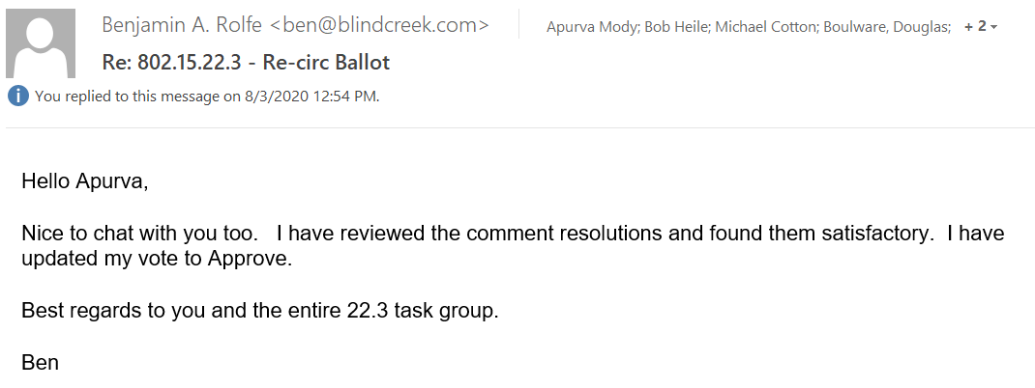
Motion for Conditional Approval to Forward IEEE P802.15.22.3 Draft 8.0 to RevCom

Slide 8
Motion for Conditional Approval to Forward IEEE P802.15.22.3 Draft 8.0 to RevCom
Item (d): IEEE 802.15.22.3 Timelines:
Actions | Schedule
Sponsor Ballot Pool formed. 80 people in the Pool. Pool is balanced | Completed – July 2019
P802.15.22.3 Co-existence Assurance Document | N/A This is a Receive Only System
P802.15.22.3 Criteria for Standards Development Revised | April 15th 2019
Sent the Draft to IEEE MEC and Review Completed | June 2019
Draft 5.0 – Initial Ballot | July 19th 2019
Draft 6.0 – Sponsor Ballot Re-circ 1 | June 30th 2020
Draft 7.0 – Sponsor Ballot Re-circ 2 | July 22nd 2020
Draft 8.0 – Sponsor Ballot Re-circ 3 | August 5th 2020
Motion for Conditional Approval to Forward to RevCom | August 4th 2020

Slide 9
Motion for Conditional Approval to Forward IEEE P802.15.22.3 Draft 8.0 to RevCom
Motion Text (include) | Conditionally approve sending P802.15.22.3 Draft 8.0 to RevCom. Approve CSD documentation in https://mentor.ieee.org/802.22/dcn/19/22-19-0028-01-0003-updated-csd-for-p802-22-3-transfer-of-project-to-ieee-802-15-wg.docx M: Bob Heile S:
Other Info (include) | P802.15.22.3 Draft 7.0 has 96% approval at the end of the last sponsor recirculation ballot. Received 5 Comments. Four were from the IEEE Editorial Staff. One comment on an un-changed portion of the standard. IEEE Editorial Staff recommends another round of Re-circ. In the WG, forwarding draft to RevCom (y/n/a): ___, ___, ___; CSD (y/n/a): ___, ___, ___.
Background | Applies to: A project that has passed sponsor ballot with at least 75% approval and has completed any necessary recirculation ballots.
Rules Reference | LMSC OM – “The IEEE 802 LMSC EC” Clause 12 Working Group P&P – Clause 7
Field Definitions | Scope of proposed standard: This Standard defines a Spectrum Characterization and Occupancy Sensing (SCOS) System. It defines the formats for system configuration and spectrum measurement parameters. It includes protocols for reporting measurement information that allow the coalescing of results from multiple systems. The standard leverages interfaces and primitives that are derived from IEEE Std. 802.22-2011. It uses any available transport mechanism to control and manage the system, and to share sensing data. The standard provides means for conveying value added sensing information to various spectrum database services.

Slide 10
BACKUPS

Slide 11
Motion for Conditional Approval to Forward IEEE P802.15.22.3 Draft 8.0 to RevCom
STARTING: 8/5/2020
 | SB #1 (Draft D5.0) |  |  | SB Re-circ #1 (Draft D6.0) |  |  | SB Re-circ #2 (Draft D7.0) |  |  | SB Re-circ #3 (Draft D8.0) |  |  | Req %
 | # | % | Status | # | % | Status | # | % | Status | # | % | Status
Abstain | 5 | 7 | - | 5 | 7 | - | 6 | 8 | - |  |  |  | N/A
Disapprove with comments | 6 | 10 | - | 6 | 10 | - | 2 | 0 | - |  |  |  | -
Disapprove w/o comment | 1 | 0 | - | 0 | 0 | - | 0 | 0 | - |  |  |  | -
Approve | 56 | 90 | PASS | 58 | 90 | PASS | 61 | 96 | PASS |  |  |  | ≥ 75
Ballots returned | 68 | 85 | PASS | 69 | 86 | PASS | 69 | 86 | PASS |  |  |  | ≥ 50
Voters | 80 | - | - | 80 | - | - | 80 | - | - |  |  |  | -
Comments | 282 | - | - | 3 | - | - | 5 | - | - |  |  |  | -
CONDITION (a) SATISFIED

