Slide 1
125th Session of meetings of the IEEE 802.15 Working Group for Wireless Specialty Networks
Closing Report
July 13-17, 2020
Held Virtually via Webex

Slide 2
802.15 Organization Chart
802.15WG Chair
Bob Heile, Wireless Communication Consulting
802.15 Vice Chairs
Rick Alfvin, Linespeed
Pat Kinney, Kinney Consulting
To add your name
to the WG/TG/SG/IG reflectors
please go to www.ieee802.org/15
Secretary
Pat Kinney, Kinney Consulting
STUDY GROUPS:
INTEREST GROUPS
IG Dependability (of Radio Links)
Chair: Ryuji Kohno,
IG Profiles
Chair: Don Sturek, Itron
IG Vehicular Assistive Technology
ChairYeong Min Jang, Kookmin Uni
IG Japanese Rate Extension
Chair: Takashi Kuramochi, Lapis Semi
IG 15.4 Guide
Chair: TBD
STANDING COMMITTEES
SC IETF
Chair: Pat Kinney, Kinney Consulting
SC WNG
Chair: Pat Kinney, Kinney Consulting
SC Maintenance / Rules
Chair: Pat Kinney, Kinney Consulting
TAGs
TeraHertz (THZ)
Chair: Thomas Kürner,
Technische Universität Braunschweig
Working Group Technical Editor
James Gilb
Task Groups
TG4md 15.4 Revision
Chair: Gary Stuebing, Cisco
TG12 Consolidated 15.4 ULI
Chair: Pat Kinney, Kinney Consulting
TG4y Security Next Gen (SECN)
Chair: Don Sturek, Itron
TG13 Gigbit OWC
Chair: Volker Jungnickel
Fraunhofer Heinrich Hertz Institute
xxx
TG16t Spectrum Characterization
and Occupancy Sensing
Chair: Tim Godfrey, EPRI
TG9ma 802.15.9 Revision 1
Chair: Tero Kivinen, Self
TG22 Spectrum Characterization
and Occupancy Sensing
Chair: Apurva Mody, BAE
xxx

Slide 3
Session Objectives July 13-17, 2020
TASK GROUP 4y –Security Next Generation (SECN)
Continue comment resolution
Create CRG for continued comment resolution
TASK GROUP 15.4md –Revision 4 (not meeting)
SASB: approved
Publication: SA Editor looking to merge 15.4w and 15.4z into revision 4 to save time
TASK GROUP 4w –LPWA Enhancements to LECIM PHYs (not meeting)
SASB: Approved
Publication: see 15.4md
TASK GROUP 4z –Enhanced Impulse Radio (EIR) (not meeting)
SASB: Approved
Publication: see 15.4md

Slide 4
Session Objectives July 13-17, 2020
TASK GROUP-9ma 15.9 Revision 1
Start letter ballot.
Form CRG
TASK GROUP 12 -15.4 Upper Layer Interface (ULI)
(Not meeting this session)
TASK GROUP 13 –Multi Gigabit/sec OWC
Review comment resolution
Decide if draft is ready for SA ballot
Move draft to the SA ballot if read
TASK GROUP 16t –Licensed Narrowband
Continue development of System Requirements document
Amend the PAR of 802.15.16t to remove the limitation to TDD spectrum

Slide 5
Session Objectives July 13-17, 2020
TASK GROUP 22 -15.22.3 Spectrum Characterization and Occupancy Sensing (SCOC):
Comment Resolution on Draft 6 and Issue Draft 7 for Re-circulation
Motion for conditional approval to forward Draft 7 to the RevCom
IG Japanese Rate Extension (JRE):
Finalize PAR and CSD
IG JRE ballot to approve PAR and CSD to take WG for approval
THz Technical Advisory Group:
Hear 3 presentations
MAINTENANCE STANDING COMMITTEE :
Corrigendum for 802.15.4-2020
Current text in SUN OFDM PHY PHR is vague, leading to incorrect understanding

Slide 6
Session Objectives July 13-17, 2020
RULES STANDING COMMITTEE
Discussion on rules and procedures that are contrary to virtual meetings
Profiles Interest Group (Not meeting this session):
IG Dependability (DEP):(Not meeting this session)
IG Vehicular Assistive Technology (VAT): (Not meeting this session)
IETF Standing Committee: (Not meeting this session)
NEW PROJECTS STANDING COMMITTEE (WNG): (Not meeting this session)

Slide 7
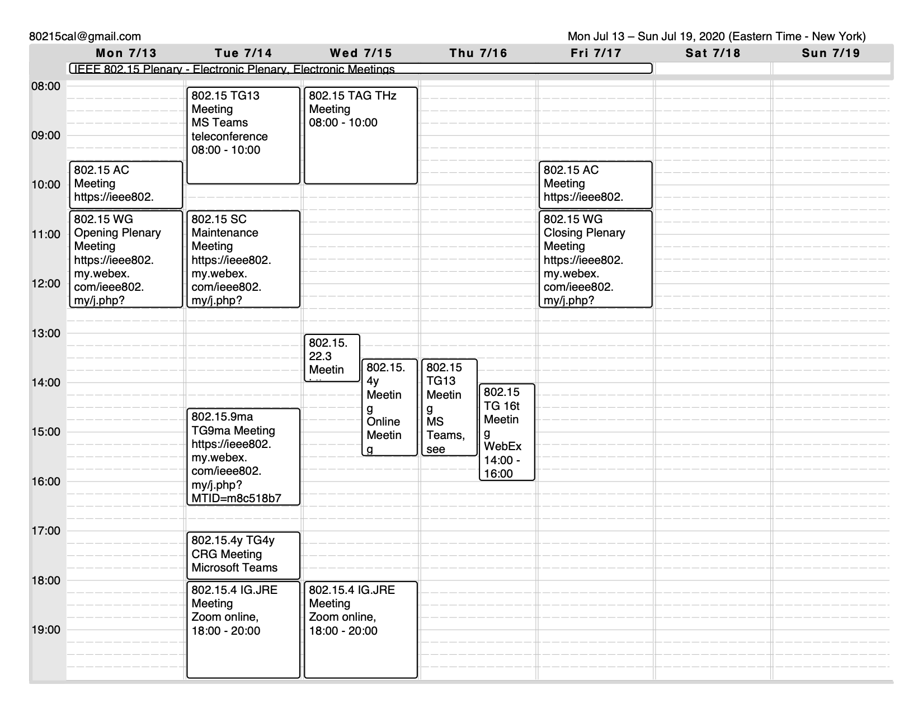

Slide 8
IEEE 802.15.4y SECN Closing report
July 17, 2020
Don Sturek
IEEE 802.15.4y SECN Chair

Slide 9
Work Plan for July 2020 Plenary
Continue comment resolution
Create CRG for continued comment resolution
Notes:
Jul 12, 2010
Page 9

Slide 10
Work Plan for 4y to next IEEE 802 meeting
Complete comment resolution from LB167
Make edits from comment resolution spreadsheet (15-20-0103)
Need a stable version of IEEE 802.15.4-2020!!!
Re-circulate draft
WG ballot on the amendment
Continue comment resolution on re-circulation.
Notes:
Jul 12, 2010
Page 10

Slide 11
Progress at July 2020 virtual plenary
Updated Timeline
Work Group Ballot – August 2020
SA Ballot – When IEEE 802.15.4-2020 publishes (SA ballot pool forms when?)
Expect around 2 re-circulations of sponsor ballot (send to REVCOM around early 2021)
Notes:
Jul 12, 2010
Page 11

Slide 12
Agenda for next IEEE 802 meeting
Comment resolution on WG re-circulation
Form CRG
Notes:
Jul 12, 2010
Page 12

Slide 13
TG Motion
TG Motion for TG4y Letter Ballot
Move that TG4y formally request that the 802.15 WG start a WG Recirculation Letter Ballot requesting approval of document P802.15.4y-D1, as edited in accordance with the instructions in document 15-20-0103 to Standards Association ballot pending the completion and inclusion of the edits in the draft.
Moved: Kunal Shah
Second: Chris Hett
Motion passed unanimously
Notes:
Jul 12, 2010
Page 13

Slide 14
WG Motion
WG Motion for TG4y Letter Ballot
Move that 802.15 WG start a WG Recirculation Letter Ballot requesting approval of document P802-15-4y_D1 and to forward document P802-15-4y_D1, as edited in accordance with the instructions in document 15-20-0103 to Standards Association ballot pending the completion and inclusion of the edits in the draft.
Moved:
Second:
Motion passes by unanimous consent
Notes:
Jul 12, 2010
Page 14

Slide 15
TG Motion
TG CRG Motion
Move that TG4y requests 802.15 WG approve the formation of a Comment Resolution Group (CRG) for the WG balloting of the P802.15.4y-D1 with the following membership: Don Sturek (As Chair), Tero Kivinen, Peter Yee, Ruben Salazar. The 802.15.4y CRG is authorized to approve comment resolutions and to approve the start of recirculation ballots of the revised draft on behalf of 802.15 WG. Comment resolution on ballots between sessions will be conducted via reflector email and via teleconferences announced to the reflector as per the LMSC 802 WG P&P
Moved By: Kunal Shah
Seconded By: Tero Kivinen
Motion passed unanimously
Notes:
Jul 12, 2010
Page 15

Slide 16
WG Motion
WG CRG Motion
Move that TG4y requests 802.15 WG approve the formation of a Comment Resolution Group (CRG) for the WG balloting of the P802.15.4y-D1 with the following membership: Don Sturek (As Chair), Tero Kivinen, Peter Yee, Ruben Salazar. The 802.15.4y CRG is authorized to approve comment resolutions and to approve the start of recirculation ballots of the revised draft on behalf of 802.15 WG. Comment resolution on ballots between sessions will be conducted via reflector email and via teleconferences announced to the reflector as per the LMSC 802 WG P&P
Moved By:
Seconded By:
Motion passes by unanimous consent
Notes:
Jul 12, 2010
Page 16

Slide 17
TG9ma July 2020 Closing Report

Slide 18
TG9ma Work Plan
Approve agenda and minutes
Finish the draft
Start Letter Ballot
Form CRG

Slide 19
TG9ma Scope
This standard defines security key management extensions to address session key generation (both 128-bit and 256-bit key lengths), the creation and/or transport of broadcast/multicast keys, and security algorithm agility. This standard maintains backwards compatibility with IEEE Std 802.15.9-2016.

Slide 20
TG9ma Meeting Achievements
Made sure draft is ready for letter ballot

Slide 21
TG9ma Motion for Letter Ballot
Move that TG9ma formally request that the 802.15 WG start a WG Letter Ballot requesting approval of document P802.15.9ma-DF1 and to forward document P802.15.9ma-DF1, to Standards Association ballot
Moved by: Ben Rolfe
Seconded by: Harry Bims
Motion passed unanimously

Slide 22
WG Motion for Letter Ballot
Move that 802.15 WG start a WG Letter Ballot requesting approval of document P802.15.9ma-DF1 and to forward document P802.15.9ma-DF1, to Standards Association ballot

Slide 23
TG9ma Motion for CRG
Move that TG9ma formally requests that the 802.15 WG forms of a Comment Resolution Group (CRG) for the WG balloting of the P802.15.9ma-DF1 with the following membership: Tero Kivinen(Chair), Ben Rolfe, Don Sturek, Pat Kinney, and Peter Yee. The 802.15.9ma CRG is authorized to approve comment resolutions, edit the draft according to the comment resolutions, and to approve the start of recirculation ballots of the revised draft on behalf of the 802.15 WG. Comment resolution on recirculation ballots between sessions will be conducted via reflector email and via teleconferences announced to the reflector as per the LMSC 802 WG P&P.
Moved by: Don Sturek
Seconded by: Ben Rolfe
Motion passed unanimously

Slide 24
WG Motion for CRG
Move that 802.15 WG approve the formation of a Comment Resolution Group (CRG) for the WG balloting of the P802.15.9ma-DF1 with the following membership: Tero Kivinen(Chair), Ben Rolfe, Don Sturek, Pat Kinney, and Peter Yee. The 802.15.9ma CRG is authorized to approve comment resolutions, edit the draft according to the comment resolutions, and to approve the start of recirculation ballots of the revised draft on behalf of the 802.15 WG. Comment resolution on recirculation ballots between sessions will be conducted via reflector email and via teleconferences announced to the reflector as per the LMSC 802 WG P&P.

Slide 25
TG9ma CRG Calls
CRG Will be having weekly teleconferences every Tuesday 16:00 EDT starting at Tuesday 25th of August.
https://www.timeanddate.com/worldclock/fixedtime.html?msg=IEEE+802.15.9ma&iso=20200714T1430&p1=179&ah=2

Slide 26
TG9ma Agenda for Next Meeting
Finish letter ballot, and processing comments received

Slide 27
TG13 July 2020 Closing Report

Slide 28
Abstract
This presentation contains the IEEE 802.15 TG13 Multi- Gbit/s Optical Wireless Communication Closing slides for the July 2020 virtual plenary meeting.

Slide 29
TG13 schedule for Irvine
 | MON | TUE | WED | THU | FRI
AM1 |  | TG13#1
AM2 | WG15 Opening // TGbb#1
PM1 |  |  |  | TG13#2 | WG15 closing
PM2 |  |  | LB175 ends at 6 p.m.EDT

Slide 30
TG13 activities this week
Agenda in doc. 15-20/0174r2
Slot1: TUESDAY AM1
Discuss open issues in D3
2nd recirculation ended Wed 18:00 EDT
THURSDAY PM1
Thanks for incoming comments from recirculation
They are considered valuable to improve the draft
After consultation with WG Chair it is suggested that
TG13 will do another recirc before the SA ballot

Slide 31
TG13 Motion #75
Move that 802.15 WG approve the formation of a Comment Resolution Group (CRG) for the Standards Association balloting of the P802.15.13_D3 with the following membership: Volker Jungnickel as Chair, Nikola Serafimovski, Tuncer Baykas, Sang-Kyu Lim, Jörg Robert, Tero Kivinen. The 802.15.13 CRG is authorized to approve comment resolutions, edit the draft according to the comment resolutions, and to approve the start of recirculation ballots of the revised draft on behalf of the 802.15 WG. Comment resolution on recirculation ballots between sessions will be conducted via reflector email and via teleconferences announced to the reflector as per the LMSC 802 WG P&P.
Moved by Tuncer Baykas
Seconded by Tero Kivinen
Motion passed unanimously.

Slide 32
WG Motion
Move that 802.15 WG approve the formation of a Comment Resolution Group (CRG) for the Standards Association balloting of the P802.15.13_D3 with the following membership: Volker Jungnickel as Chair, Nikola Serafimovski, Tuncer Baykas, Sang-Kyu Lim, Jörg Robert, Tero Kivinen. The 802.15.13 CRG is authorized to approve comment resolutions, edit the draft according to the comment resolutions, and to approve the start of recirculation ballots of the revised draft on behalf of the 802.15 WG. Comment resolution on recirculation ballots between sessions will be conducted via reflector email and via teleconferences announced to the reflector as per the LMSC 802 WG P&P.
Moved by
Seconded by
Motion passed unanimously.

Slide 33
Plan for finalization of TG13 Spec
after July
Resolve comments from 2nd recirculation
Include comments from MEC review
Start 3rd (and hopefully last) recirculation in WG
Form SA ballot pool

Slide 34
TG16t July 2020 Closing Report

Slide 35
Call for Contributions – Updated July 13, 2020
The IEEE 802.15.16t Task Group is developing an amendment to 802.16-2017. Project 802.16t “Amendment - Fixed and Mobile Wireless Access in Narrowband Channels”
This project specifies operation in licensed spectrum with channel bandwidths greater than or equal to 5 kHz and less than 100 kHz. A new PHY will be specified, with changes to the MAC as necessary. The amendment is frequency independent but focuses on spectrum less than 2 GHz. Aggregated operation in adjacent and non-adjacent channels will be supported.
This Call for Contributions solicits input documentation toward the development the amendment.
Contributions are sought on the following topics;
Presentations on use cases, scenarios, and applications: Please use document IEEE 802.15-20-0070r0 as a template to describe your use cases.
Contributions toward the System Requirements Document: Please structure text contributions per the outline posted as IEEE 802.15-20-0182r0
The Task Group is meeting virtually. Meetings and teleconferences are announced on the TG16t reflector and the 802.15 calendar.
This call for contributions will remain open until (at least) the November 2020 electronic plenary meeting.
Documents should be uploaded to https://mentor.ieee.org/802.15, to the TG16t task group.
For more information contact the TG16t chair Tim Godfrey tim.godfrey@ieee.org
This Call for Contributions is available as document IEEE 802.15-20-0079r3
Updated CFC Document Link

Slide 36
Review of Use Cases & Frequency Band Layout
Frequency Band Layout Document IEEE802.15-20-0055r3
Consider this mostly complete.
Discussion on applicability of HF as a fallback.

Slide 37
Development of the SRD
Create a new call for contributions for the System Requirements Document
Uploaded as IEEE802.15-20-0079r3
Create an outline for SRD
Uploaded as IEEE802.15-20-0182r0
Includes some content from document IEEE 802.15-20-0015r1 by Menashe Shahar

Slide 38
Motion on PAR Modification
Move to amend the PAR of 802.15.16t to remove the limitation to TDD spectrum, based on the identification of bands and use cases requiring support of paired spectrum.
Move: Guy Simpson
Second: Harry Bims
Approved with Unanimous Consent
Action to coordinate with Bob Heile to get on EC agenda for November
PAR with amended scope text strike out uploaded as IEEE802.15-20-0196r0
CSD is unchanged.

Slide 39
WG Motion
Motion to amend the scope of the 16t PAR:
Request that the PAR and CSD contained in documents 802.15-20-0195r0 and 802.24-19-0030r0, respectively, be approved by the IEEE 802.15 WG and that the EC be requested to forward the PAR to NesCom. The 802.15 working group chair and technical editor are authorized to make additional modifications to the PAR and CSD as needed to reflect EC discussion at its closing meeting.
Moved Tim Godfrey
Second Rick Alfvin

Slide 40
Discussion and development of SRD
Need text contributions for SRD sections.
Updated version after July 2020 meeting is IEEE802.15-20-0182r1
Need to merge the Use Case spreadsheets into a “final” version
Daoud Serang
Affirm document IEEE802.15-20-0055r3 as final frequency band layout (can include additional contributions if needed)
Notes on editing for draft – Harry has developed a process to use Word for the draft.

Slide 41
Revised Project Timeline
Milestone | Date
Task Group Start | January 2020
SRD Approval | Nov 2020
SDD Approval | May 2021
Informal TG review of draft | Sept 2021
Working Group Letter Ballot | Nov 2021
Working Group Recirculation Letter Ballot | Mar 2022
SA Ballot | Sept 2022
Forward to RevCom | March 2023
Assign Editor
Request PAR Extension

Slide 42
Teleconference Planning
Possible cadence through end of 2020?
August 13 11am Pacific, 2pm Eastern
Sept 17 11am Pacific, 2pm Eastern
Oct 15 11am Pacific, 2pm Eastern
Nov 12 (Week of IEEE 802 Electronic Plenary) time TBD
Can have more meetings in the week if needed
Dec 3 11am Pacific, 2pm Eastern

Slide 43
Upcoming Sessions
July 12-17, 2020, Sheraton Centre Montreal, Montreal Canada, 802 Plenary Session.
September 13-18, 2020, Grand Hyatt Atlanta in Buckhead, Atlanta, Georgia, 802 Wireless Interim Session.
November 18-13, 2020, Marriott Marquis Queen's Park, Bangkok, Thailand, 802 Plenary Session.
January 12-14, 2021, Hotel Irvine, Irvine, California 802 Wireless Interim Session.
802.16t meets on Tuesday-Thursday during face to face meeting sessions.
Cancelled
Cancelled
Cancelled

Slide 44
TG22 Spectrum Sharing Closing Report
Accomplishments:
Sponsor Ballot on Draft 5 Completed
Addressed and Resolved the Comments
Started the Sponsor Ballot Re-circ on Draft 6 – The Sponsor Ballot Re-circ on Draft 6 ended on July 15th 2020.

Slide 45
TG22 Spectrum Sharing Closing Report CRG for IEEE P802.15.22.3 Sponsor Ballot
Move that 802.15 WG approve the formation of a Comment Resolution Group (CRG) for the SA balloting of the P802.15.22.3 D06 with the following membership: Apurva Mody (Chair), Oliver Holland, Roger Hislop, Gianfranco Miele, Ranga Reddy, Mike Cotton, Harry Bims, Douglas Boulware. The 802.15.22.3 CRG is authorized to approve comment resolutions, edit the draft according to the comment resolutions, and to approve the start of recirculation ballots of the revised draft on behalf of the 802.15 WG. Comment resolution on recirculation ballots between sessions will be conducted via reflector email and via teleconferences announced to the reflector as per the LMSC 802 WG P&P.
Mover: Mike Cotton
Second: Oliver Holland
Working Group Stats: Approve / Disapprove / Abstain
Task Group Stats: Approve 5 / Disapprove 0 / Abstain 1

Slide 46
TG22 Spectrum Sharing Closing Report Goals for the Meeting
Comment Resolution on Draft 6 and Issue Draft 7 for Re-circ
Motion for conditional approval to forward Draft 7 to the RevCom

Slide 47
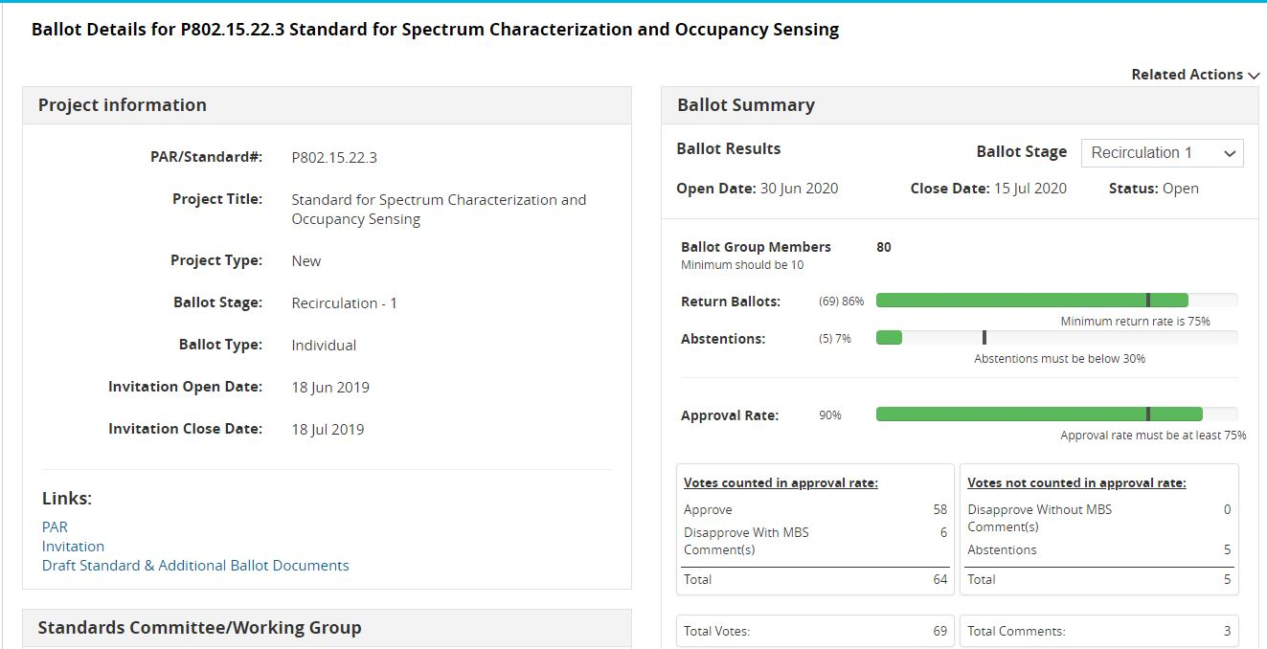
Status of the 802.15.22.3 Sponsor Ballot Re-circ on Draft 6 – Ended on July 15th 2020
The Ballot Resolution Committee addressed and resolved the three new comments from the Sponsor Ballot Re-circ on Draft 6. There is one MBS Comment. Draft 7 is being prepared for a 10 Day Sponsor Ballot Re-circ #2.

Slide 48
802.15.22.3 Sponsor Ballot History
Ballot Group Members: 80
IEEE Sponsor Ballot | Launch Date | # of Comments Received | Comment Resolution Status | Response Ratio | Approval Ratio | Abstentions | Draft Status
Sponsor Ballot 1 (P802.15.22.3 Draft v5.0) | July 19th 2019 | 282 | Comments were addressed and Resolved | 85% | 90% | 7% | P802.15.22.3 Draft v6.0 was Prepared
Sponsor Ballot Re-circ #1 (P802.15.22.3 Draft v6.0) | June 30th 2020 | 3 | Comments were addressed and Resolved | 86% | 90% | 7% | P802.15.22.3 Draft v7.0 is being Prepared

Slide 49
IEEE P802.15.22.3 Spectrum Characterization and Occupancy Sensing Conditional Approval to Forward to RevCom
Motion
Conditional Approval to send 802.15.22.3 D07 to SA RevCom Confirm the CSD for 802.15.22.3 in https://mentor.ieee.org/802.22/dcn/19/22-19-0028-01-0003-updated-csd-for-p802-22-3-transfer-of-project-to-ieee-802-15-wg.docx
Mover: Mike Cotton
Second: Oliver Holland
Working Group Stats: Approve / Disapprove / Abstain
Task Group Stats: Approve 5 / Disapprove 0 / Abstain 1

Slide 50
IEEE P802.15.22.3 Spectrum Characterization and Occupancy Sensing One Year PAR Extension
Motion
Approve One Year PAR Extension on 802.15.22.3 https://mentor.ieee.org/802.15/dcn/20/15-20-0197-00-0022-802-15-22-3-par-extension.pdf
Mover: Mike Cotton
Second: Oliver Holland
Working Group Stats: Approve / Disapprove / Abstain

Slide 51
IEEE 802.15 IG JRE Virtual July Plenary Closing report on July 17th,2020

Slide 52
Administrative Items
Required notices
Affiliation FAQ - http://standards.ieee.org/faqs/affiliationFAQ.html
Anti-Trust FAQ - http://standards.ieee.org/resources/antitrust-guidelines.pdf
Ethics - http://www.ieee.org/portal/cms_docs/about/CoE_poster.pdf
Chair and Secretary
Chair is Takashi Kuramochi(LAPIS Semiconductor)
Acting secretary is Kunal Shah/Phil Beecher

Slide 53
IG JRE sessions in July Plenary
 | Monday 13th July | Tuesday 14th July | Wednesday 15th July | Thursday 16th July | Friday 17th July
AM1 |  |  | IG-JRE (Cancelled)
AM2
PM1
PM2
PM3 |  | IG-JRE | IG-JRE
We had 2 sessions and cancelled 1 session as it was unnecessary.

Slide 54
Accomplishments:
Resolved the final comments for the PAR and CSD.
The Motion was made and approved.
(See next slide)
Minutes posted
(Document15-20-0189-00-0jre)

Slide 55
Approved Motion by IG:
Request that PAR and CSD contained in document PAR (15-20-0158-04-0jre) and CSD (15-20-0159-04-0jre) , respectively, be approved for submission to the WG for its approval and that EC be requested to forward PAR to NesCom.
Moved : Kunal Shah (Itron)
Second: Hiroshi Harada (Kyoto University)
Approved by unanimous consent

Slide 56
Motion to WG:
Request that the PAR and CSD contained in documents [15-20-0158-04-0jre] and [15-20-0159-04-0jre], respectively, be updated to the correct PAR form for amendments and, be approved by the IEEE 802.15 WG and that the EC be requested to forward the PAR to NesCom. The 802.15 working group chair and technical editor are authorized to make additional modifications to the PAR and CSD as needed to reflect EC discussion at its closing meeting.
Moved : Takashi Kuramochi (Lapis Semiconductor)
Second:
Approve / Disapprove / Abstain

Slide 57
Next steps
Start Technical Discussion

Slide 58
JRE conference call provisionally scheduled
Japan (JST) | London (BST) | Atlanta (EDT) | Austin (CDT) | San Diego (PDT)
Friday July 31th 7:00 | Thursday July 30th 23:00 | Thursday July 30th 18:00 | Thursday July 30th 17:00 | Thursday July 30th 15:00

Slide 59
TAG THz July 2020 Closing Report

Slide 60
Meetings/Contributions
1 meeting on Wed AM1
21 participants
3 contributions:
Contribution #1
Hiroyo Ogawa (NICT) “Possible allocation of the frequency bands 275-296 GHz, 306-313 GHz, 318-333 GHz and 356-450 GHz” (20/0167r1)
Contribution #2
Hiroyo Ogawa (NICT) “Future IEEE 802.15 standard in the frequency band 356-450 GHz” (20/0168)
Contribution #3
Josep Jornet (Northeastern University) Exploiting 100 GHz of Bandwidth: Physical and Link Layer Solutions, “Integration of high-data rate THz-wireless systems into fiber-optical networks” (20/0172)

Slide 61
Next Meetings
Next Meetings of the TAG THz
Online September (date/time tbd) brainstorming on future THz standards / amendments:
create 3 discussion threats: Regulatory, Application, Widely open discussion)
Online November 11, 2020, 2-4 pm GMT+2 (during next Electronic Plenary)

Slide 62
Standing Committee July 2020 Closing Report
SC WNG, SC IETF did not meet this session

Slide 63
SC Meeting Goals
SC Maintenance Tuesday 14 Mar, AM2
Discuss requested changes with Existing Standards
Discuss requested changes with Operations Manual
SC WNG Not being held
SC IETF Not Being held
Slide 63
Notes:
July 20
Page 63

Slide 64
SC Maintenance
Discussion on issues with published standards
Corrigendum for 802.15.4-2020
SUN OFDM PHY PHR
Current text is vague, leading to incorrect understanding
Same text was also published in amendment 802.15.4x
To the sentence ending in: “using MCS1 and MCS2 respectively”, add the following: “when the packets are transmitted with MCS1 or higher for OFDM option 3 and MCS 2 or higher for OFDM Option 4 is used”
Should be classified as Urgent due to silicon currently being developed
PAR needs to be written with sufficient latitude to correct other faults
PAR should be approved by WG this week
Slide 64
Notes:
July 20
Page 64

Slide 65
SC Maintenance
Discussion on any changes to the Operations Manual? (15-10-0235-25)
Discussion on rules and procedures contrary to virtual meetings
Simple changes that will make 802.15 virtual meetings easier and more functional without waiting for IEEE AudCom and IEEE 802 EC to come to agreement
Slide 65
Notes:
July 20
Page 65

Slide 66
SC Maintenance
Operations Manual issues
Taking votes during a meeting/call
Unanimous consent is still the best way if there are votes against
Roll call is possible for small meetings like TG, CRG, etc. But not for large groups like WG, or close votes.
Voting tools are being developed, but wait for other groups to evaluate them
Suggestion to use Webex’s chat window, e.g. “I, yourname, vote yes”
What qualifies as sufficient attendance to merit credit for a session?
Right now the only meetings required for attendance are the two plenaries, opening and closing
Look at relaxing wording requiring 75% attendance at each meeting slot
What about hybrid meetings with some physically present but others “attending” virtually?
Virtual attendees don’t get credit?
In the OM leave current wording specifically for face to face meetings but add new text for virtual meetings
Slide 66
Notes:
July 20
Page 66

Slide 67
SC Accomplishments
Maintenance
Changes with Existing Standards:
Corrigendum for 802.15.4-2020, SUN OFDM PHY PHR, PAR has been written for WG approval
Changes with Operations Manual:
Discussed simple changes that will make 802.15 virtual meetings easier and more functional without waiting for IEEE AudCom and IEEE 802 EC to come to agreement
Agreed to monitor progress of voting tools by other WGs
Until then, use of unanimous consent approval works if no objections, else electronic ballot.
During Webex meetings, use of chat window to show a roll call vote seems possible
Need to look at somehow rewording the requirement for 75% attendance during a Webex meeting to get credit for that time slot, e.g. use the “honor” system
OM needs to delineate rules for face to face meetings versus virtual meetings
Slide 67
Notes:
July 20
Page 67

Slide 68
Future Efforts
These are the planned activities for the November plenary session
Maintenance
Review any change requests with Existing Standards
Review any issues with Operations Manual
SC WNG
Entertain requests made for presentation time
IETF
Discuss IETF WG agendas for next meetings
Develop SCHC strategy for 802.15.4, with a focus on 802.15.4w
Slide 68
Notes:
July 20
Page 68

