Slide 1
TG22 Spectrum Sharing Closing Report Virtual Meeting Apurva N. Mody Chair, TG22

Slide 2
TG22 Spectrum Sharing Opening Report
Accomplishments:
Sponsor Ballot on Draft 5 Completed
Addressed and Resolved the Comments
Started the Sponsor Ballot Re-circ on Draft 6 – The Sponsor Ballot Re-circ on Draft 6 ended on July 15th 2020.

Slide 3
TG22 Spectrum Sharing Closing Report CRG for IEEE P802.15.22.3 Sponsor Ballot
Move that 802.15 WG approve the formation of a Comment Resolution Group (CRG) for the SA balloting of the P802.15.22.3 D06 with the following membership: Apurva Mody (Chair), Oliver Holland, Roger Hislop, Gianfranco Miele, Ranga Reddy, Mike Cotton, Harry Bims, Douglas Boulware. The 802.15.22.3 CRG is authorized to approve comment resolutions, edit the draft according to the comment resolutions, and to approve the start of recirculation ballots of the revised draft on behalf of the 802.15 WG. Comment resolution on recirculation ballots between sessions will be conducted via reflector email and via teleconferences announced to the reflector as per the LMSC 802 WG P&P.
Mover: Mike Cotton
Second: Oliver Holland
Working Group Stats: Approve / Disapprove / Abstain
Task Group Stats: Approve 5 / Disapprove 0 / Abstain 1

Slide 4
TG22 Spectrum Sharing Closing Report Goals for the Meeting
Comment Resolution on Draft 6 and Issue Draft 7 for Re-circ
Motion for conditional approval to forward Draft 7 to the RevCom

Slide 5
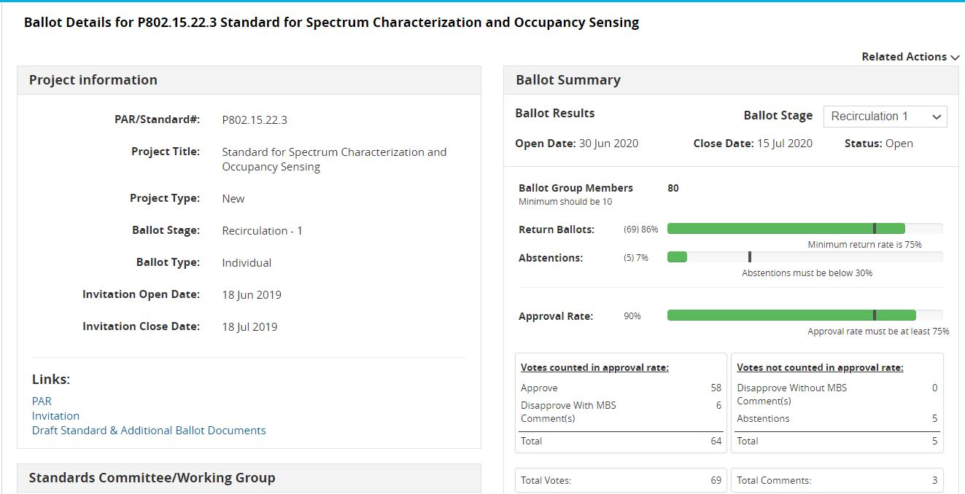
Status of the 802.15.22.3 Sponsor Ballot Re-circ on Draft 6 – Ended on July 15th 2020
The Ballot Resolution Committee addressed and resolved the three new comments from the Sponsor Ballot Re-circ on Draft 6. There is one MBS Comment. Draft 7 is being prepared for a 10 Day Sponsor Ballot Re-circ #2.

Slide 6
802.15.22.3 Sponsor Ballot History
Ballot Group Members: 80
IEEE Sponsor Ballot | Launch Date | # of Comments Received | Comment Resolution Status | Response Ratio | Approval Ratio | Abstentions | Draft Status
Sponsor Ballot 1 (P802.15.22.3 Draft v5.0) | July 19th 2019 | 282 | Comments were addressed and Resolved | 85% | 90% | 7% | P802.15.22.3 Draft v6.0 was Prepared
Sponsor Ballot Re-circ #1 (P802.15.22.3 Draft v6.0) | June 30th 2020 | 3 | Comments were addressed and Resolved | 86% | 90% | 7% | P802.15.22.3 Draft v7.0 is being Prepared

Slide 7
IEEE P802.15.22.3 Spectrum Characterization and Occupancy Sensing Conditional Approval to Forward to RevCom
Motion
Conditional Approval to send 802.15.22.3 D07 to SA RevCom Confirm the CSD for 802.15.22.3 in https://mentor.ieee.org/802.22/dcn/19/22-19-0028-01-0003-updated-csd-for-p802-22-3-transfer-of-project-to-ieee-802-15-wg.docx
Mover: Mike Cotton
Second: Oliver Holland
Working Group Stats: Approve / Disapprove / Abstain
Task Group Stats: Approve 5 / Disapprove 0 / Abstain 1

Slide 8
IEEE P802.15.22.3 Spectrum Characterization and Occupancy Sensing One Year PAR Extension
Motion
Approve One Year PAR Extension on 802.15.22.3 https://mentor.ieee.org/802.15/dcn/20/15-20-0197-00-0022-802-15-22-3-par-extension.pdf
Mover: Mike Cotton
Second: Oliver Holland
Working Group Stats: Approve / Disapprove / Abstain

