Slide 1
TG22 Spectrum Sharing Opening Report Virtual Meeting Apurva N. Mody Chair, TG22

Slide 2
TG22 Spectrum Sharing Opening Report
Accomplishments:
Sponsor Ballot on Draft 5 Completed
Addressed and Resolved the Comments
Started the Sponsor Ballot Re-circ on Draft 6 – The Sponsor Ballot Re-circ on Draft 6 ends on July 15th 2020.
Actions
Please go to imat.ieee.org and fill in your attendance for this session.

Slide 3
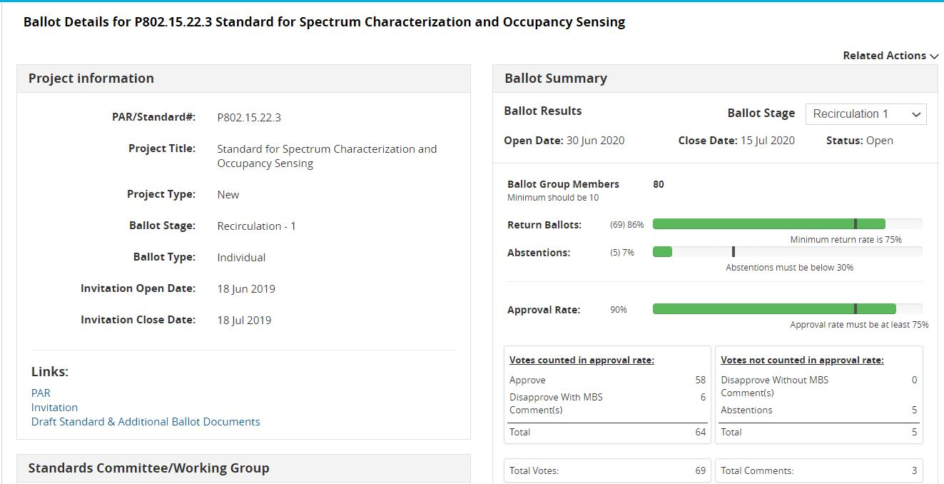
Status of the 802.15.22.3 Sponsor Ballot Re-circ on Draft 6 – Ends on July 15th 2020

Slide 4
TG22 Spectrum Sharing Closing Report CRG for IEEE P802.22.3 Sponsor Ballot
Move that 802.15 WG approve the formation of a Comment Resolution Group (CRG) for the SA balloting of the P802.15.22.3 D06 with the following membership: Apurva Mody (Chair), Oliver Holland, Roger Hislop, Gianfranco Miele, Ranga Reddy, Mike Cotton, Harry Bims, Douglas Boulware. The 802.15.22.3 CRG is authorized to approve comment resolutions, edit the draft according to the comment resolutions, and to approve the start of recirculation ballots of the revised draft on behalf of the 802.15 WG. Comment resolution on recirculation ballots between sessions will be conducted via reflector email and via teleconferences announced to the reflector as per the LMSC 802 WG P&P.
Mover: Mike Cotton
Second: Oliver Holland
Approve 5 / Disapprove 0 / Abstain 1

Slide 5
TG22 Spectrum Sharing Closing Report Goals for the Meeting
Comment Resolution on Draft 6 and Issue Draft 7 for Re-circ
Motion for conditional approval to forward Draft 7 to the RevCom

Slide 6
TG22 Spectrum Sharing Closing Report IEEE P802.22.3 Spectrum Characterization and Occupancy to Sponsor Ballot
Motion
Conditional Approval to send 802.15.22.3 D07 to SA RevCom Confirm the CSD for 802.15.22.3 in https://mentor.ieee.org/802.22/dcn/19/22-19-0028-01-0003-updated-csd-for-p802-22-3-transfer-of-project-to-ieee-802-15-wg.docx
Mover: Mike Cotton
Second: Oliver Holland
Approve 5 / Disapprove 0 / Abstain 1

