Slide 1
Project: IEEE P802.15 Working Group for Wireless Personal Area Networks (WPANs)
Submission Title: [IG JRE July 3rd 2020 Teleconference Opening report]
Date Submitted: [3rd July,2020]
Source: [Takashi Kuramochi] Company [LAPIS SEMICONDUCTOR]
Address [2-4-8 Shinyokohama,Kouhoku-ku,Yokohama 222-8575 Japan]
Voice:[+81-45-476-9295], FAX: [], E-Mail:[kuramochi722@dsn.lapis-semi.com]
Re: [] Abstract: [This document contains opening information and meeting agenda for the IG JRE Teleconference on 3rd July,2020] Purpose: [information]
Notice: This document has been prepared to assist the IEEE P802.15. It is offered as a basis for discussion and is not binding on the contributing individual(s) or organization(s). The material in this document is subject to change in form and content after further study. The contributor(s) reserve(s) the right to add, amend or withdraw material contained herein.
Release: The contributor acknowledges and accepts that this contribution becomes the property of IEEE and may be made publicly available by P802.15.

Slide 2
IEEE 802.15 IG JRE Teleconference Opening report on 7:00(JST), July 3rd,2020

Slide 3
Administrative Items
Required notices
Affiliation FAQ - http://standards.ieee.org/faqs/affiliationFAQ.html
Anti-Trust FAQ - http://standards.ieee.org/resources/antitrust-guidelines.pdf
Ethics - http://www.ieee.org/portal/cms_docs/about/CoE_poster.pdf
Chair and Secretary
Chair is Takashi Kuramochi(LAPIS Semiconductor)
Acting secretary is Phil Beecher

Slide 4
Participants have a duty to inform the IEEE
Participants shall inform the IEEE (or cause the IEEE to be informed) of the identity of each holder of any potential Essential Patent Claims of which they are personally aware if the claims are owned or controlled by the participant or the entity the participant is from, employed by, or otherwise represents
Participants should inform the IEEE (or cause the IEEE to be informed) of the identity of any other holders of potential Essential Patent Claims
Early identification of holders of potential Essential Patent Claims is encouraged

Slide 5
Ways to inform IEEE
Cause an LOA to be submitted to the IEEE-SA (patcom@ieee.org); or
Provide the chair of this group with the identity of the holder(s) of any and all such claims as soon as possible; or
Speak up now and respond to this Call for Potentially Essential Patents
If anyone in this meeting is personally aware of the holder of any patent claims that are potentially essential to implementation of the proposed standard(s) under consideration by this group and that are not already the subject of an Accepted Letter of Assurance, please respond at this time by providing relevant information to the WG Chair

Slide 6
Other guidelines for IEEE WG meetings
All IEEE-SA standards meetings shall be conducted in compliance with all applicable laws, including antitrust and competition laws.
Don’t discuss the interpretation, validity, or essentiality of patents/patent claims.
Don’t discuss specific license rates, terms, or conditions.
Relative costs of different technical approaches that include relative costs of patent licensing terms may be discussed in standards development meetings.
Technical considerations remain the primary focus
Don’t discuss or engage in the fixing of product prices, allocation of customers, or division of sales markets.
Don’t discuss the status or substance of ongoing or threatened litigation.
Don’t be silent if inappropriate topics are discussed … do formally object.
---------------------------------------------------------------
For more details, see IEEE-SA Standards Board Operations Manual, clause 5.3.10 and Antitrust and Competition Policy: What You Need to Know at http://standards.ieee.org/develop/policies/antitrust.pdf

Slide 7
Patent-related information
The patent policy and the procedures used to execute that policy are documented in the:
IEEE-SA Standards Board Bylaws
https://standards.ieee.org/about/policies/bylaws/sect6-7.html#6
IEEE-SA Standards Board Operations Manual
https://standards.ieee.org/about/policies/bylaws/sect6-7.html#6.3
Material about the patent policy is available at
http://standards.ieee.org/about/sasb/patcom/materials.html
If you have questions, contact the IEEE-SA Standards Board Patent Committee Administrator at patcom@ieee.org

Slide 8
Attendance
Name | Affiliation | Role

Slide 9
Agenda
Japan (JST) | London (BST) | Atlanta (EDT) | Austin (CDT) | San Diego (PDT)
Friday July 3rd 7:00-8:00 | Thursday July 2nd 23:00-24:00 | Thursday July 2nd 18:00-19:00 | Thursday July 2nd 17:00-18:00 | Thursday July 2nd 15:00-16:00
Contents | Who | Period | Accumulated time
OPEN/Patent Policy | Phil Beecher | 5 | 5
Attendance | Kuramochi | 5 | 10
Approval of the previous meeting minutes | Kuramochi | 5 | 15
Agenda | Kuramochi | 5 | 20
PAR/CSD Comment Resolutions | Kuramochi | 20 | 40
Next steps | Kuramochi | 5 | 45
Next meeting information | Kuramochi | 5 | 50
Recess | Kuramochi | 5 | 55

Slide 10
Presentation
Presentation slides of the group (IG JRE) is available at https://mentor.ieee.org/802.15/documents

Slide 11
Next steps
IG JRE votes to approve PAR and CSD and agrees to take to the WG for approval.

Slide 12
Schedule for IG JRE (Japanese Rate Extension)
June 21 | June 22 | June 23 | June 24 | June 25 | June 26 | June 27
June 28 | June 29 | June 30 | July 1 | July 2 | July 3 | July 4
July 05 | July 06 | July 07 | July 08 | July 09 | July 10 | July 11
July 12 | July 13 | July 14 | July 15 | July 16 | July 17 | July 18
 | Opening plenary |  | Midweekplenary |  | Closing plenary
July 19 | July 20 | July 21 | July 22 | July 23 | July 24 | July 25
Call for comments of PAR/CSD
Dead line
of Call for
Comments
JRE Meeting
(Today)
Slide 12

Slide 13
IG JRE proposed teleconference in July plenary
Could you tell us your preference from followings?
Japan (JST) | London (BST) | Atlanta (EDT) | Austin (CDT) | San Diego (PDT)
Wednesday July 15th 21:00 | Wednesday July 15th 13:00 | Wednesday July 15th 8:00 | Wednesday July 15th 7:00 | Wednesday July 15th 5:00
Thursday July 16th 21:00 | Thursday July 16th 13:00 | Thursday July 16th 8:00 | Thursday July 16th 7:00 | Thursday July 16th 5:00

Slide 14
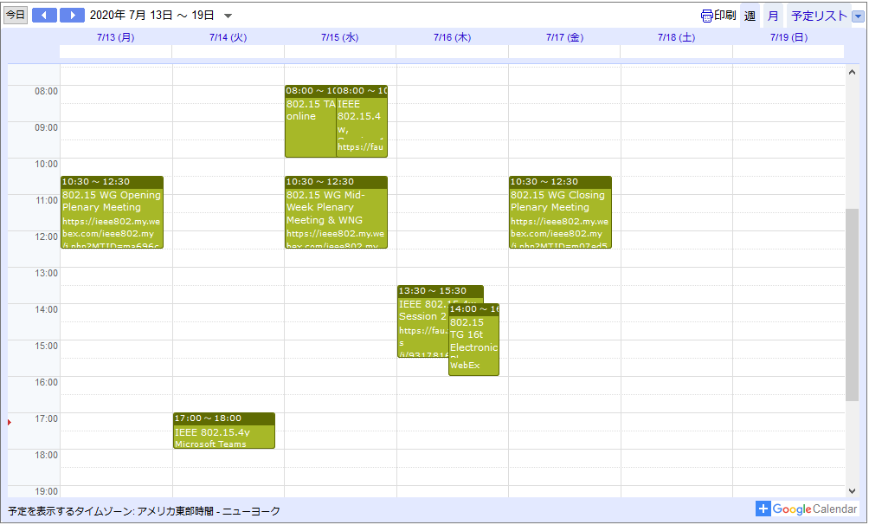
IG JRE proposed teleconference in July plenary （US:EDT)

Slide 15
Contacts
Takashi Kuramochi, LAPIS SEMICONDUCTOR
kuramochi722@dsn.lapis-semi.com

Slide 16
Reference
The IEEE802.15 meeting schedule can be found at http://grouper.ieee.org/groups/802/15/calendar.html
Document templates (MsWord and PowerPoint) and instructions for obtaining document numbers are located at http://grouper.ieee.org/groups/802/15/pub/Download.html
IG JRE reflector is (stds-802-15-jre@listserv.ieee.org)
Documents should be uploaded to https://mentor.ieee.org/802.15, to the “IG JRE” interest group.
For help with obtaining document numbers, document formatting, document uploading and contribution scheduling, please contract the 802.15 IG JRE chair, Takashi Kuramochi, at kuramochi722@dsn.lapis-semi.com
The draft objectives of the group (IG JRE) is available at SC WNG session in January 2020:
https://mentor.ieee.org/802.15/documents

