Slide 1
Project: IEEE P802.15 Working Group for Wireless Personal Area Networks (WPANs)
Submission Title: Licensed Narrowband 16t Teleconference – April 9, 2020
Date Submitted: 2020-04-08
Source: Tim Godfrey, EPRI
Abstract: Meeting Agenda and Presentation
Purpose: Chair’s presentation for task group meeting
Notice: This document has been prepared to assist the IEEE P802.15. It is offered as a basis for discussion and is not binding on the contributing individual(s) or organization(s). The material in this document is subject to change in form and content after further study. The contributor(s) reserve(s) the right to add, amend or withdraw material contained herein.
Release: The contributor acknowledges and accepts that this contribution becomes the property of IEEE and may be made publicly available by P802.15.

Slide 2
Agenda
Introductions, Secretary, Review and Approve Agenda
Policy Review
Presentations
Discussion
Tutorial on Mentor and Document Upload process
Scheduling Next Teleconference

Slide 3
Opening
Introductions
Secretary for teleconference
Agenda review and Approval

Slide 4
Reference material
Please refer to meeting presentation planned for March plenary for background information
802.15-20-0069r1 March 2020 TG16t Meeting Presentation Tim Godfrey (EPRI)

Slide 5
Participants have a duty to inform the IEEE
  Participants shall inform the IEEE (or cause the IEEE to be informed) of the identity of each holder of any potential Essential Patent Claims of which they are personally aware if the claims are owned or controlled by the participant or the entity the participant is from, employed by, or otherwise represents
  Participants should inform the IEEE (or cause the IEEE to be informed) of the identity of any other holders of potential Essential Patent Claims
  Early identification of holders of potential Essential Patent Claims is encouraged
Slide #1

Slide 6
Ways to inform IEEE
Cause an LOA to be submitted to the IEEE-SA (patcom@ieee.org); or
Provide the chair of this group with the identity of the holder(s) of any and all such claims as soon as possible; or
Speak up now and respond to this Call for Potentially Essential Patents
If anyone in this meeting is personally aware of the holder of any patent claims that are potentially essential to implementation of the proposed standard(s) under consideration by this group and that are not already the subject of an Accepted Letter of Assurance, please respond at this time by providing relevant information to the WG Chair
Slide #2

Slide 7
Other guidelines for IEEE WG meetings
All IEEE-SA standards meetings shall be conducted in compliance with all applicable laws, including antitrust and competition laws.
  Don’t discuss the interpretation, validity, or essentiality of patents/patent claims.
  Don’t discuss specific license rates, terms, or conditions.
    Relative costs of different technical approaches that include relative costs of patent licensing terms may be discussed in standards development meetings.
      Technical considerations remain the primary focus
  Don’t discuss or engage in the fixing of product prices, allocation of customers, or division of sales markets.
  Don’t discuss the status or substance of ongoing or threatened litigation.
  Don’t be silent if inappropriate topics are discussed … do formally object.
---------------------------------------------------------------
For more details, see IEEE-SA Standards Board Operations Manual, clause 5.3.10 and
Antitrust and Competition Policy: What You Need to Know at http://standards.ieee.org/develop/policies/antitrust.pdf
Slide #3

Slide 8
Patent-related information
  The patent policy and the procedures used to execute that policy are documented in the:
    IEEE-SA Standards Board Bylaws
    (http://standards.ieee.org/develop/policies/bylaws/sect6-7.html#6)
    IEEE-SA Standards Board Operations Manual (http://standards.ieee.org/develop/policies/opman/sect6.html#6.3)
  Material about the patent policy is available at
  http://standards.ieee.org/about/sasb/patcom/materials.html
  If you have questions, contact the IEEE-SA Standards Board Patent Committee Administrator at patcom@ieee.org
Slide #4

Slide 9
IEEE SA Copyright Policy
By participating in this activity, you agree to comply with the IEEE Code of Ethics, all applicable laws, and all IEEE policies and procedures including, but not limited to, the IEEE SA Copyright Policy.
  Previously Published material (copyright assertion indicated) shall not be presented/submitted to the Working Group nor incorporated into a Working Group draft unless permission is granted.
  Prior to presentation or submission, you shall notify the Working Group Chair of previously Published material and should assist the Chair in obtaining copyright permission acceptable to IEEE SA.
  For material that is not previously Published, IEEE is automatically granted a license to use any material that is presented or submitted.

Slide 10
IEEE SA Copyright Policy
    The IEEE SA Copyright Policy is described in the IEEE SA Standards Board Bylaws and IEEE SA Standards Board Operations Manual
      IEEE SA Copyright Policy, see
      Clause 7 of the IEEE SA Standards Board Bylaws
      https://standards.ieee.org/about/policies/bylaws/sect6-7.html#7
      Clause 6.1 of the IEEE SA Standards Board Operations Manual
      https://standards.ieee.org/about/policies/opman/sect6.html
    IEEE SA Copyright Permission
      https://standards.ieee.org/content/dam/ieee-standards/standards/web/documents/other/permissionltrs.zip
    IEEE SA Copyright FAQs
      http://standards.ieee.org/faqs/copyrights.html/
    IEEE SA Best Practices for IEEE Standards Development
      http://standards.ieee.org/develop/policies/best_practices_for_ieee_standards_development_051215.pdf
    Distribution of Draft Standards (see 6.1.3 of the SASB Operations Manual)
      https://standards.ieee.org/about/policies/opman/sect6.html

Slide 11
Participant behavior in IEEE-SA activities is guided by the IEEE Codes of Ethics & Conduct
All participants in IEEE-SA activities are expected to adhere to the core principles underlying the:
  IEEE Code of Ethics
  IEEE Code of Conduct
The core principles of the IEEE Codes of Ethics & Conduct are to:
  Uphold the highest standards of integrity, responsible behavior, and ethical and professional conduct
  Treat people fairly and with respect, to not engage in harassment, discrimination, or retaliation, and to protect people's privacy.
  Avoid injuring others, their property, reputation, or employment by false or malicious action
The most recent versions of these Codes are available at
  http://www.ieee.org/about/corporate/governance

Slide 12
Participants in the IEEE-SA “individual process” shall act independently of others, including employers
The IEEE-SA Standards Board Bylaws require that “participants in the IEEE standards development individual process shall act based on their qualifications and experience”
This means participants:
  Shall act & vote based on their personal & independent opinions derived from their expertise, knowledge, and qualifications
  Shall not act or vote based on any obligation to or any direction from any other person or organization, including an employer or client, regardless of any external commitments, agreements, contracts, or orders
  Shall not direct the actions or votes of other participants or retaliate against other participants for fulfilling their responsibility to act & vote based on their personal & independently developed opinions
By participating in standards activities using the “individual process”, you are deemed to accept these requirements; if you are unable to satisfy these requirements then you shall immediately cease any participation

Slide 13
IEEE-SA standards activities shall allow the fair & equitable consideration of all viewpoints
The IEEE-SA Standards Board Bylaws (clause 5.2.1.3) specifies that “the standards development process shall not be dominated by any single interest category, individual, or organization”
  This means no participant may exercise “authority, leadership, or influence by reason of superior leverage, strength, or representation to the exclusion of fair and equitable consideration of other viewpoints” or “to hinder the progress of the standards development activity”
This rule applies equally to those participating in a standards development project and to that project’s leadership group
Any person who reasonably suspects that dominance is occurring in a standards development project is encouraged to bring the issue to the attention of the Standards Committee or the project’s IEEE-SA Program Manager

Slide 14
Call for Contributions – issued Feb 14, 2020
The IEEE 802.15.16t Task Group is developing an amendment to 802.16-2017. Project 802.16t “Amendment - Fixed and Mobile Wireless Access in Narrowband Channels”
This project specifies operation in licensed spectrum with channel bandwidths greater than or equal to 5 kHz and less than 100 kHz. A new PHY will be specified, with changes to the MAC as necessary. The amendment is frequency independent but focuses on spectrum less than 2 GHz. Aggregated operation in adjacent and non-adjacent channels will be supported.
This Call for Contributions solicits input documentation toward the development the amendment.
Contributions are sought on the following topics;
  Presentations on use cases, scenarios, and applications
  Contributions toward the System Requirements Document
Please use document IEEE 802.15-20-0070r0 as a template to describe your use cases.
The next meeting of P802.16t is March 15-20, 2020, Hilton Atlanta, Atlanta Georgia, USA, 802 Plenary Session. The 802.16t task group will meet on Tuesday through Thursday.
The deadline for contributions to be considered the April 2020 plenary meeting is Friday, 13 April 2020, AOE (Anywhere On Earth)
Documents should be uploaded to https://mentor.ieee.org/802.15, to the TG16t task group.
For more information contact the TG16t chair Tim Godfrey tim.godfrey@ieee.org
The minutes of the January 2020 session are available in document IEEE 802.15-20-0067r0
This Call for Contributions is available as document IEEE 802.15-20-0079r0

Slide 15
Scheduling of Presentations
802.15-20-0xxxr0 802.16t Use Case Spreadsheet Derek Ellingsworth (GE)

Slide 16
Presentations

Slide 17
Discussion Notes and Action Items 4/9
Henk – is there a link to regulatory requirements for use case; Wireless FCC requirements.
  Need to document existing rules for each band.
  Plan to include in a different section on SRD.
Use cases:
  Action: Kathy will work with Nathan and Juha to merge rail use cases into Document 108 as the master use case spreadsheet.
  Rick Smith – need to include use case of transitioning leased lines (copper or otherwise) for utility.
Frequency bands: 952-953, and 928-929 MHz is Part 101
  Include 1.4 GHz band – there is 5 MHz available there
  Need document any restrictions on TDD operation.

Slide 18
Notes and actions 4/30

Slide 19
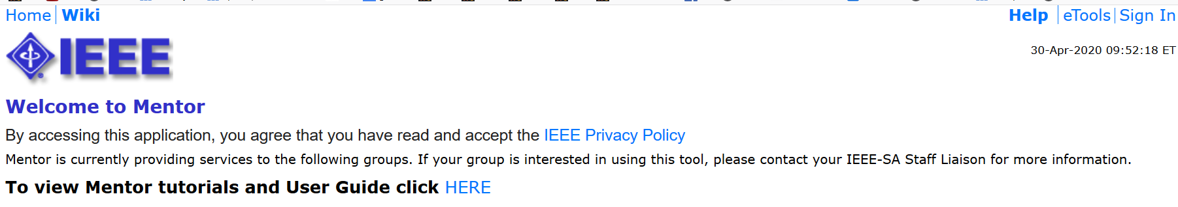
Mentor Document Upload Tutorial
Start here https://mentor.ieee.org/802.15/documents
Sign In with your IEEE credentials:

Slide 20
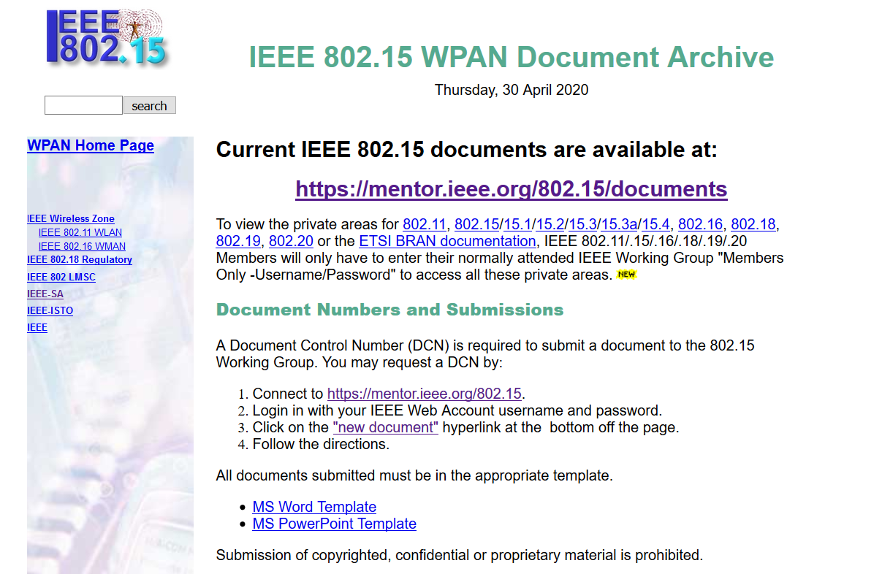
Templates
See the 802.15 home page for templates for Word and Powerpoint
  No template is used for Excel
http://grouper.ieee.org/groups/802/15/pub/Download.html

Slide 21
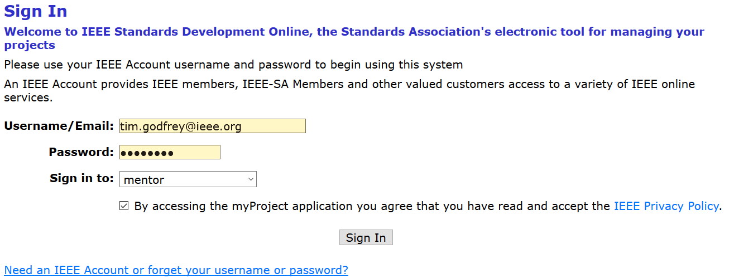
Sign In

Slide 22
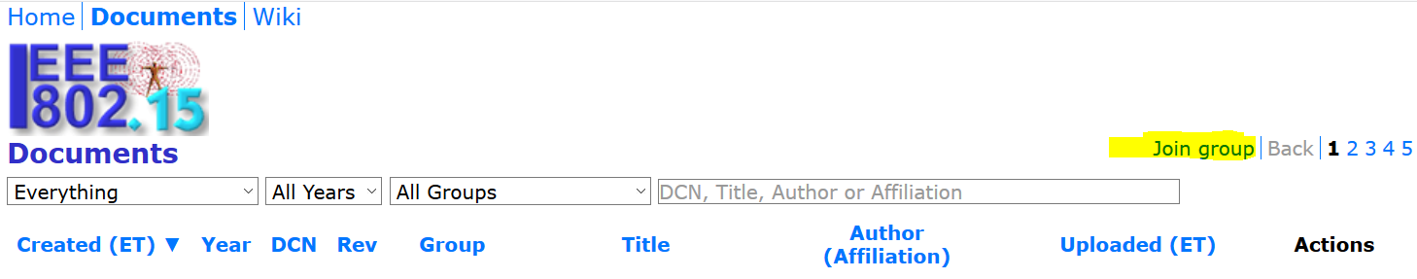
Join Group
If you see “Join Group” – click it and join. It may take a few hours

Slide 23
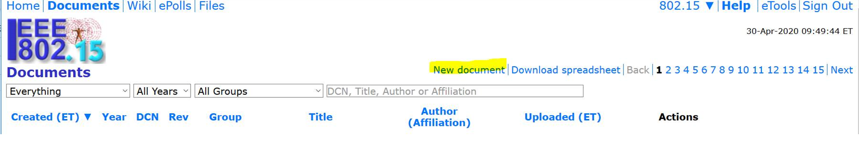
New Document
When you have joined the group, and have signed in, you will see the link for New Document

Slide 24
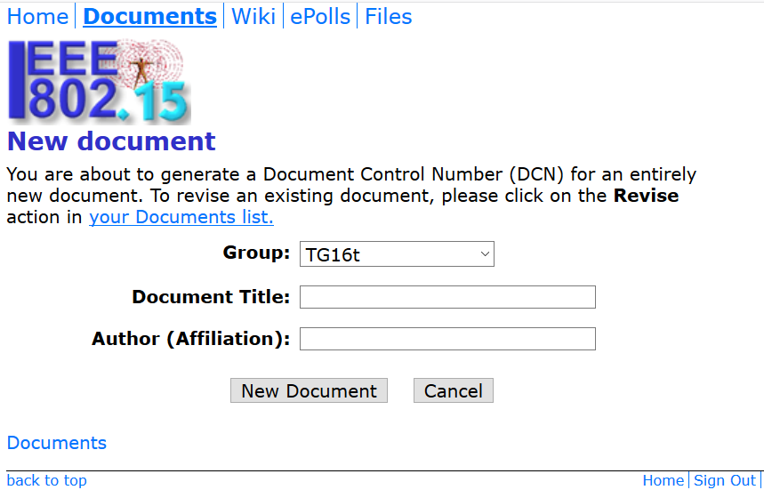
New Document details

Slide 25
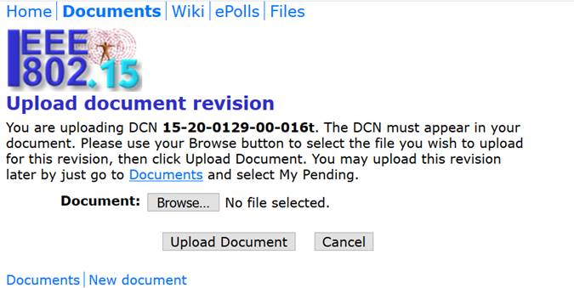
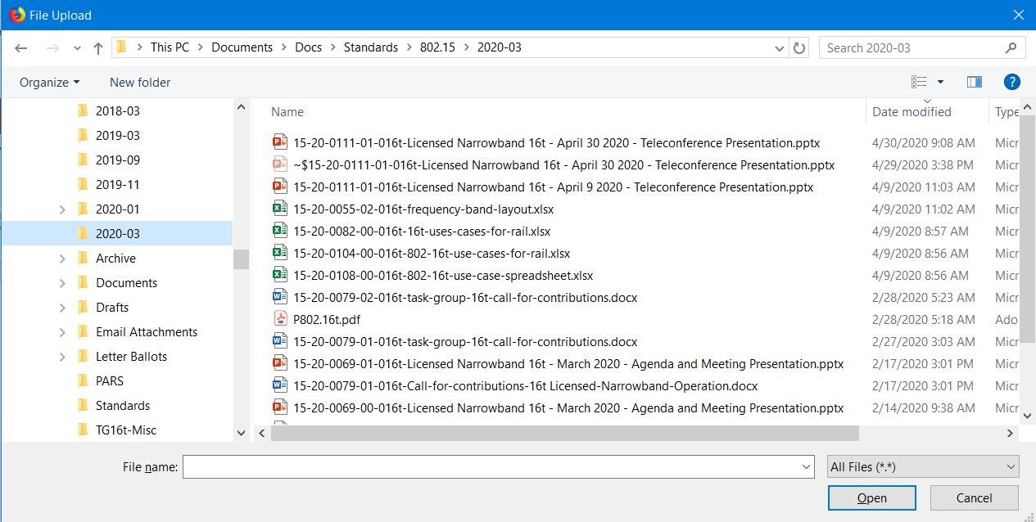
Edit Document filename with DCN provided
Pre-pend the DCN to your filename.
If your file is “My Contribution.pptx”, add the DCN so it looks like
“15-20-1234-00-016t My Contribution.pptx”
Edit the file name on your computer,
and click Browse. A standard file open dialog
appears. Select your file, click open.
Note – when you have the DCN, you can
choose to not upload at that time. Just click
Documents, and you go back to the main list

Slide 26
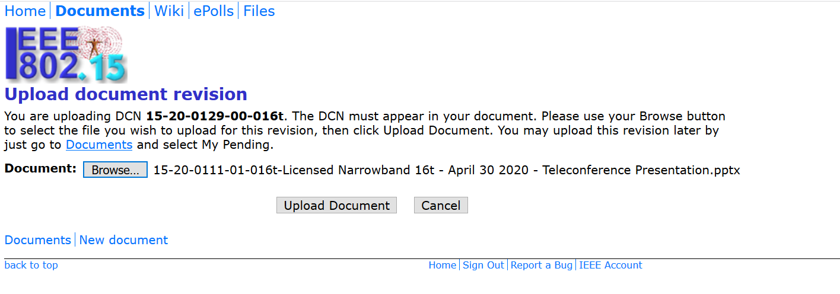
Now it is ready to upload
The correct file name is showing to the right of the Browse Button.
Now click “Upload Document”

Slide 27
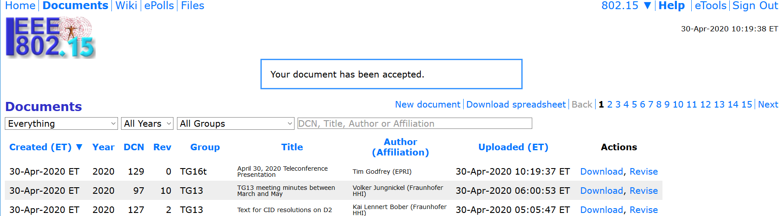
Completed
When the document uploads completes, you will see it in the listing

Slide 28
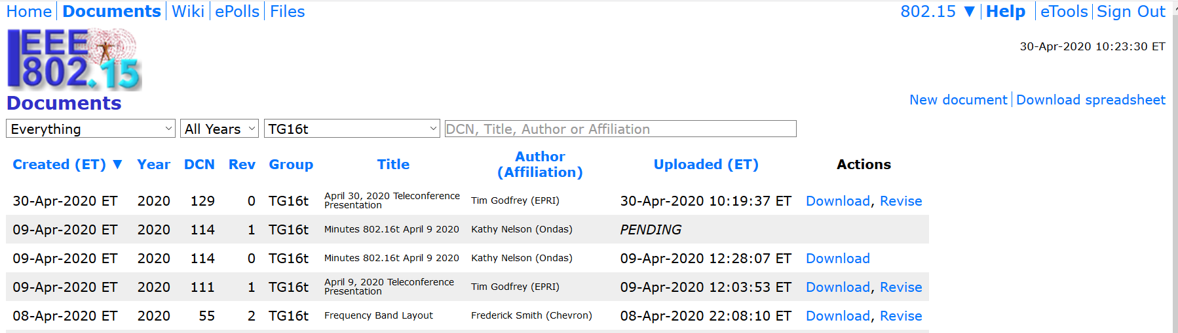
Filtering
The document listing shows all 802.15 documents by default.
You can filter to show only the TG16t task group

Slide 29
Pending
If you choose to obtain the DCN, but not upload immediately, your document will show as Pending.
Click the Upload link when you’re ready.

Slide 30
Revisions
Use the Revise link to upload a revised document
Prior versions remain available.
You may upload a revision of another person’s document

Slide 31
Next Teleconference
Frequency based on number of contributions.
Maintain pace of one every 3 weeks (can accelerate if needed).
May 21, same time (8am Pacific, 11am Eastern)

Slide 32
Upcoming Sessions
July 12-17, 2020, Sheraton Centre Montreal, Montreal Canada, 802 Plenary Session.
September 13-18, 2020, Grand Hyatt Atlanta in Buckhead, Atlanta, Georgia, 802 Wireless Interim Session.
November 18-13, 2020, Marriott Marquis Queen's Park, Bangkok, Thailand, 802 Plenary Session.
802.16t meets on Tuesday-Thursday during the meeting session.
Cancelled

