Slide 1
Project: IEEE P802.15 Working Group for Wireless Personal Area Networks (WPANs)
Submission Title : CNN-based optical camera communication for eHealth applications
Date Submitted : [April, 2020]
Source : Md Faisal Ahmed Moh. Khalid Hasan, and Yeong Min Jang
Company : [Kookmin University]
Address : [Seoul, Korea]
Voice : [+82-2-910-5068], E-Mail: [yjang@kookmin.ac.kr]
Re :
Abstract : This document discusses about the data transmission and image capturing in patients LED patch on OCC system.
Purpose : To communicate between mobile drone and LED patch artificially by capturing signal from LED using OCC.
Notice: This document has been prepared to assist the IEEE P802.15. It is offered as a basis for discussion and is not binding on the contributing individual(s) or organization(s). The material in this document is subject to change in form and content after further study. The contributor(s) reserve(s) the right to add, amend or withdraw material contained herein.
Release : The contributor acknowledges and accepts that this contribution becomes the property of IEEE and may be made publicly available by P802.15.

Slide 2
Introduction
Optical camera communication (OCC) aims to deliver data from the light sources to the camera. Artificial lights (LED light) are available everywhere human being live, and cameras too.
A patch is connected with a sensor network and a signal is modulated from the LED also send to the mobile drone.
The drone capture the signal simultaneously as well as capture the image using camera. Combining the signal and image it classify the problem and make a proper decision of the patients condition.
OCC is exceptionally secure, as it is almost negligibly affected by the reflected component of the light signal .Unlike RF-based technologies, OCC is less affected by interference in eHealth application.

Slide 3
Image sensor based data processing CNN architecture
Camera capture the signal and transmitted through the transmitted and CNN detect the proper region to collect data.
In server using the monitor data capture by the patch and camera are classified by using CNN in the patients internal image capture by image sensors.
The Data provide the condition of the patients in every time.

Slide 4
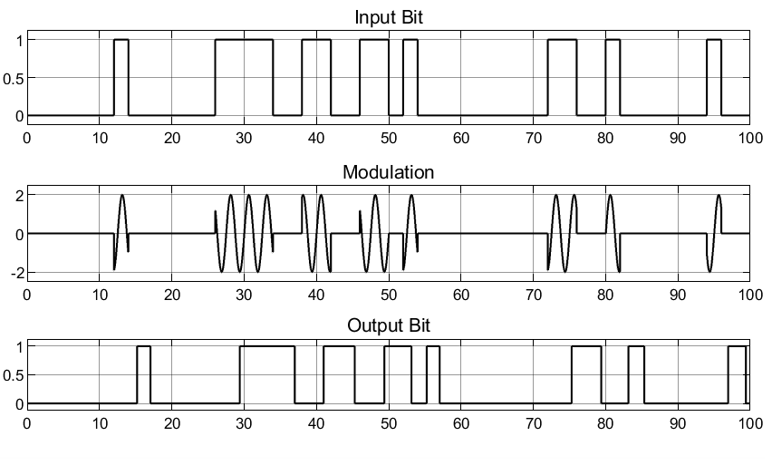
OOK modulation data transmission
Data transmission taken place by blinking the LED that provide on off signal it can transmitted and capture by the camera.
The transmitted bit provide the information of the observation of the patients and then modulated to the receiver side.

Slide 5
Technical considerations
It is interesting in the output that selected regions are not directly related to objects or low-level and high-level features but rather depend on the annotation output and thus depend on the subjective content of the image which is derived from the camera of the training set, so the selected region doesn’t have common visual or spatial features.
The patch is embedded in the patient’s arm. Because a direct LOS communication link must be developed between the patch and camera, the patch should be mounted to a completely uncovered part of the body
A system is focusing on low power, low cost, high security, and enhanced reliability needs to be developed for intensive-care environments.

Slide 6
Challenges
Region of interest detection.
Proper align with camera and patch
Synchronization between camera and LED
High resolution of image picture
Congruous cost support

Slide 7
Conclusions
Automatically monitoring of patient’ health condition by capturing image from the internal image sensor and transmit the emergency data to the LED can reduce the effect of checking every time.
Transmit signal using RF spectrum can cause effect on health so to reduce RF using LED in data transmission in optical camera communication can become more safe.
However Security and privacy of the system will be on a major concern as data can access in the server every time.

