Slide 1
Project: IEEE P802.15 Working Group for Wireless Personal Area Networks (WPANs)
Submission Title: Licensed Narrowband 16t Agenda and Meeting Presentation – January 2020
Date Submitted: 2020-02-14
Source: Tim Godfrey, EPRI
Abstract: Meeting Agenda and Presentation
Purpose: Chair’s presentation for task group meeting
Notice: This document has been prepared to assist the IEEE P802.15. It is offered as a basis for discussion and is not binding on the contributing individual(s) or organization(s). The material in this document is subject to change in form and content after further study. The contributor(s) reserve(s) the right to add, amend or withdraw material contained herein.
Release: The contributor acknowledges and accepts that this contribution becomes the property of IEEE and may be made publicly available by P802.15.

Slide 2
Agenda for week – March 2020
Introductions, Attendance, Patent Policy
Review and Approve Agenda for week
Scheduling of Presentations
Priority for contributions to SRD
Other presentations not related to SRD
Task Group Officers (permanent or interim secretary)
Any presentations or contributions for this week
Review Task Group Development Process, Key Documents
Review Task Group Timeline

Slide 3
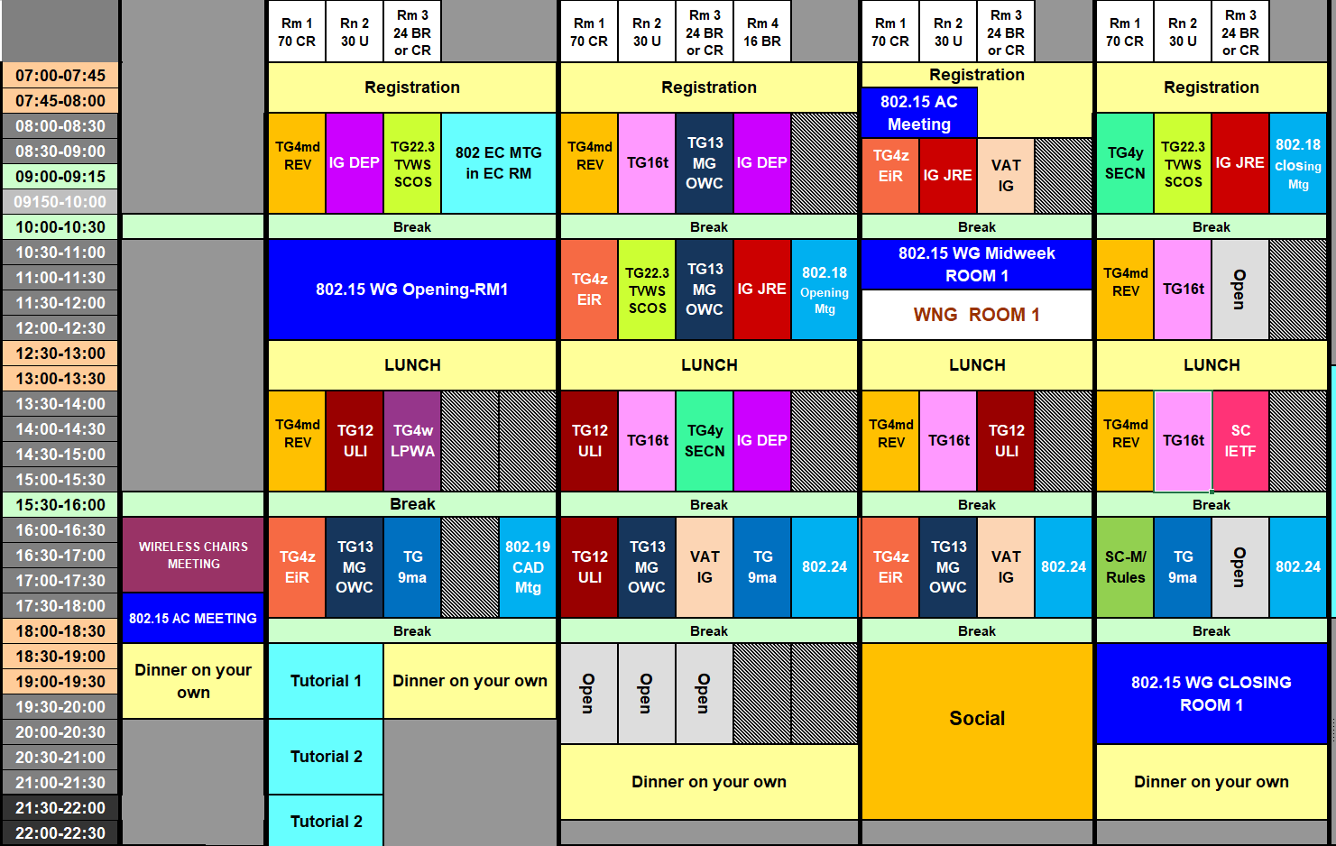
802.15 WG March 2020 Agenda Graphic from IEEE 802.15-20-0068r2

Slide 4
TG16t Schedule for the Week
 | Monday | Tuesday | Wednesday | Thursday
AM 1 | WG Plenary | TG16t |  | 802.18
AM 2 |  | 802.18 | WG Plenary | TG16t
PM 1 |  | TG16t | TG16t | TG16t
PM 2 |  | 802.24 | 802.24 | 802.24
PM 3 |  |  |  | WG Closing

Slide 5
16t Task Group Opening
Welcome, Introductions
Sign In for attendance
https://imat.ieee.org/my-site/home
Slide 5

Slide 6
Participants have a duty to inform the IEEE
Participants shall inform the IEEE (or cause the IEEE to be informed) of the identity of each holder of any potential Essential Patent Claims of which they are personally aware if the claims are owned or controlled by the participant or the entity the participant is from, employed by, or otherwise represents
Participants should inform the IEEE (or cause the IEEE to be informed) of the identity of any other holders of potential Essential Patent Claims
Early identification of holders of potential Essential Patent Claims is encouraged
Slide #1

Slide 7
Ways to inform IEEE
Cause an LOA to be submitted to the IEEE-SA (patcom@ieee.org); or
Provide the chair of this group with the identity of the holder(s) of any and all such claims as soon as possible; or
Speak up now and respond to this Call for Potentially Essential Patents
If anyone in this meeting is personally aware of the holder of any patent claims that are potentially essential to implementation of the proposed standard(s) under consideration by this group and that are not already the subject of an Accepted Letter of Assurance, please respond at this time by providing relevant information to the WG Chair
Slide #2

Slide 8
Other guidelines for IEEE WG meetings
All IEEE-SA standards meetings shall be conducted in compliance with all applicable laws, including antitrust and competition laws.
Don’t discuss the interpretation, validity, or essentiality of patents/patent claims.
Don’t discuss specific license rates, terms, or conditions.
Relative costs of different technical approaches that include relative costs of patent licensing terms may be discussed in standards development meetings.
Technical considerations remain the primary focus
Don’t discuss or engage in the fixing of product prices, allocation of customers, or division of sales markets.
Don’t discuss the status or substance of ongoing or threatened litigation.
Don’t be silent if inappropriate topics are discussed … do formally object.
---------------------------------------------------------------
For more details, see IEEE-SA Standards Board Operations Manual, clause 5.3.10 and Antitrust and Competition Policy: What You Need to Know at http://standards.ieee.org/develop/policies/antitrust.pdf
Slide #3

Slide 9
Patent-related information
The patent policy and the procedures used to execute that policy are documented in the:
IEEE-SA Standards Board Bylaws (http://standards.ieee.org/develop/policies/bylaws/sect6-7.html#6)
IEEE-SA Standards Board Operations Manual (http://standards.ieee.org/develop/policies/opman/sect6.html#6.3)
Material about the patent policy is available at
http://standards.ieee.org/about/sasb/patcom/materials.html
If you have questions, contact the IEEE-SA Standards Board Patent Committee Administrator at patcom@ieee.org
Slide #4

Slide 10
IEEE SA Copyright Policy
By participating in this activity, you agree to comply with the IEEE Code of Ethics, all applicable laws, and all IEEE policies and procedures including, but not limited to, the IEEE SA Copyright Policy.
Previously Published material (copyright assertion indicated) shall not be presented/submitted to the Working Group nor incorporated into a Working Group draft unless permission is granted.
Prior to presentation or submission, you shall notify the Working Group Chair of previously Published material and should assist the Chair in obtaining copyright permission acceptable to IEEE SA.
For material that is not previously Published, IEEE is automatically granted a license to use any material that is presented or submitted.

Slide 11
IEEE SA Copyright Policy
The IEEE SA Copyright Policy is described in the IEEE SA Standards Board Bylaws and IEEE SA Standards Board Operations Manual
IEEE SA Copyright Policy, see Clause 7 of the IEEE SA Standards Board Bylaws https://standards.ieee.org/about/policies/bylaws/sect6-7.html#7 Clause 6.1 of the IEEE SA Standards Board Operations Manual https://standards.ieee.org/about/policies/opman/sect6.html
IEEE SA Copyright Permission
https://standards.ieee.org/content/dam/ieee-standards/standards/web/documents/other/permissionltrs.zip
IEEE SA Copyright FAQs
http://standards.ieee.org/faqs/copyrights.html/
IEEE SA Best Practices for IEEE Standards Development
http://standards.ieee.org/develop/policies/best_practices_for_ieee_standards_development_051215.pdf
Distribution of Draft Standards (see 6.1.3 of the SASB Operations Manual)
https://standards.ieee.org/about/policies/opman/sect6.html

Slide 12
Participant behavior in IEEE-SA activities is guided by the IEEE Codes of Ethics & Conduct
All participants in IEEE-SA activities are expected to adhere to the core principles underlying the:
IEEE Code of Ethics
IEEE Code of Conduct
The core principles of the IEEE Codes of Ethics & Conduct are to:
Uphold the highest standards of integrity, responsible behavior, and ethical and professional conduct
Treat people fairly and with respect, to not engage in harassment, discrimination, or retaliation, and to protect people's privacy.
Avoid injuring others, their property, reputation, or employment by false or malicious action
The most recent versions of these Codes are available at
http://www.ieee.org/about/corporate/governance

Slide 13
Participants in the IEEE-SA “individual process” shall act independently of others, including employers
The IEEE-SA Standards Board Bylaws require that “participants in the IEEE standards development individual process shall act based on their qualifications and experience”
This means participants:
Shall act & vote based on their personal & independent opinions derived from their expertise, knowledge, and qualifications
Shall not act or vote based on any obligation to or any direction from any other person or organization, including an employer or client, regardless of any external commitments, agreements, contracts, or orders
Shall not direct the actions or votes of other participants or retaliate against other participants for fulfilling their responsibility to act & vote based on their personal & independently developed opinions
By participating in standards activities using the “individual process”, you are deemed to accept these requirements; if you are unable to satisfy these requirements then you shall immediately cease any participation

Slide 14
IEEE-SA standards activities shall allow the fair & equitable consideration of all viewpoints
The IEEE-SA Standards Board Bylaws (clause 5.2.1.3) specifies that “the standards development process shall not be dominated by any single interest category, individual, or organization”
This means no participant may exercise “authority, leadership, or influence by reason of superior leverage, strength, or representation to the exclusion of fair and equitable consideration of other viewpoints” or “to hinder the progress of the standards development activity”
This rule applies equally to those participating in a standards development project and to that project’s leadership group
Any person who reasonably suspects that dominance is occurring in a standards development project is encouraged to bring the issue to the attention of the Standards Committee or the project’s IEEE-SA Program Manager

Slide 15
16t Task Group
Attendance Reminder: https://imat.ieee.org/my-site/home
Approve Agenda For Week

Slide 16
Status Recap
Action Items
Release Call for Contributions when NESCOM informs us of PAR approval by Standards Board.
Completed 2020-02-14
Motion: The Task Group authorizes the chair to make editorial changes to the call for contributions.
Moved Allesandra, Second Guy. Approved with unanimous consent.
Tim: Create an 802.16t web page and provide to Rick Alfvin for posting.
Completed 2020-02-14
Roger will send a message to 802.16 reflector when Call for Contributions has gone out.
Teleconference
Thursday, January 30, 8am pacific, 11am eastern, for 1 hour
Minutes: IEEE 802.15-20-0070r0

Slide 17
Call for Contributions – issued Feb 14, 2020
The IEEE 802.15.16t Task Group is developing an amendment to 802.16-2017. Project 802.16t “Amendment - Fixed and Mobile Wireless Access in Narrowband Channels”
This project specifies operation in licensed spectrum with channel bandwidths greater than or equal to 5 kHz and less than 100 kHz. A new PHY will be specified, with changes to the MAC as necessary. The amendment is frequency independent but focuses on spectrum less than 2 GHz. Aggregated operation in adjacent and non-adjacent channels will be supported.
This Call for Contributions solicits input documentation toward the development the amendment.
Contributions are sought on the following topics;
Presentations on use cases, scenarios, and applications
Contributions toward the System Requirements Document
Please use document IEEE 802.15-20-0070r0 as a template to describe your use cases.
The next meeting of P802.16t is March 15-20, 2020, Hilton Atlanta, Atlanta Georgia, USA, 802 Plenary Session. The 802.16t task group will meet on Tuesday through Thursday.
The deadline for contributions to be considered the March 2020 plenary meeting is Friday, 13 March 2020, AOE (Anywhere On Earth)
Documents should be uploaded to https://mentor.ieee.org/802.15, to the TG16t task group.
For more information contact the TG16t chair Tim Godfrey tim.godfrey@ieee.org
The minutes of the January 2020 session are available in document IEEE 802.15-20-0067r0
This Call for Contributions is available as document IEEE 802.15-20-0079r0

Slide 18
Objectives for this meeting
Continue SRD development
Presentations of contributions towards SRD
Consider PAR amendment to add FDD operation

Slide 19
Scheduling of Presentations
Contributions to SRD
Other presentations not related to SRD

Slide 20
Presentations

Slide 21
Task Group Process

Slide 22
16t Task Group Leadership
16t Task Group Officers
Chair Tim Godfrey
Vice Chair
Secretary
Technical Editor

Slide 23
Task Group Development Process
Develop System Requirements Document (SRD)
Requirements for functionality to be added by the amendment
Develop System Description Document (SDD)
Technical description of how the functionality in the SRD is accomplished
Outline Draft
Using the base document (IEEE Std 802.16-2017), identify the affected clauses, mapping content from SDD into amendment structure
Draft Standard
Developed through contributions until ready for balloting

Slide 24
Discussion on process
Contribution Driven Process
Contributions of text proposals may be voted to be included in documents (SRD, SDD, Draft)
Adopting text proposals into SRD, SDD, or Draft is a technical motion requiring 75% approval.

Slide 25
Project Timeline - Milestones
Milestone | Date
Task Group Start | January 2020
SRD Approval | July 2020
SDD Approval | January 2021
Informal TG review of draft | May 2021
Working Group Letter Ballot | July 2021
Working Group Recirculation Letter Ballot | November 2021
SA Ballot | March 2022
Forward to RevCom | October 2022
Editor
From PAR

Slide 26
Closing
Action Items
Teleconferences?
Objectives for next meeting
Any Other Business
Adjourn

Slide 27
Upcoming Sessions
March 15-20, 2020, Hilton Atlanta, Atlanta Georgia, USA, 802 Plenary Session.
May 10-15, 2020, Marriott Hotel, Warsaw, Poland, 802 Wireless Interim Session.
July 12-17, 2020, Sheraton Centre Montreal, Montreal Canada, 802 Plenary Session.
September 13-18, 2020, Grand Hyatt Atlanta in Buckhead, Atlanta, Georgia, 802 Wireless Interim Session.
November 18-13, 2020, Marriott Marquis Queen's Park, Bangkok, Thailand, 802 Plenary Session.
802.16t meets on Tuesday-Thursday during the meeting session.

Slide 28
Backup
Discussion Notes from Prior Meetings

Slide 29
Discussion on TDD vs FDD
PAR now specifies TDD operation
Are there issues using TDD in existing channel pairs.
Half-duplex FDD would reduce efficient use of spectrum
Certain sites may require FDD due to adjacent channel users
Duplexing option requirements
TDD
FDD (base and remote)
FDD at base, half duplex FDD at remote
FDD half duplex at base and remote

Slide 30
Notes on Terminology
The ITU meaning of PMR - Professional Mobile Radio. It may also be referred to as “Public Mobile Radio”
We can use that to refer to that type of channelized spectrum.
We will have a section of the SRD to clarify the multiple meanings and terms used in various regulatory domains, and specify the terms to be used in the standard.

Slide 31
Notes
Follow up on PLMR as the proper terminology. Is it aligned with ITU-R?
The 16t PHY will specify the band (maximum and minimum frequencies)
The next level is the regulatory allocation (allocated to a spectrum owner – blocks or PLMR channels)
The 16t PHY will specify a maximum and minimum width (5KHz to 100KHz)
The smallest unit of bandwidth used by the PHY needs an unambiguous name - Basic Unit of Bandwidth (BUB)
The granularity of the frequency of the BUB (step size) may be smaller than the min width of the BUB

