Slide 1
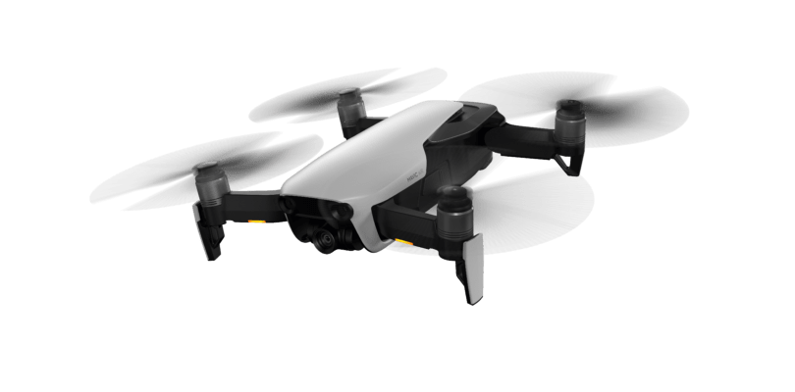
AURA Network Systems
Next Generation
Nationwide Air-to-Ground Communications Network Use Case
Doc.802.15-20-0059-00-016t
Michael Gagne – AURA Network Systems

Slide 2
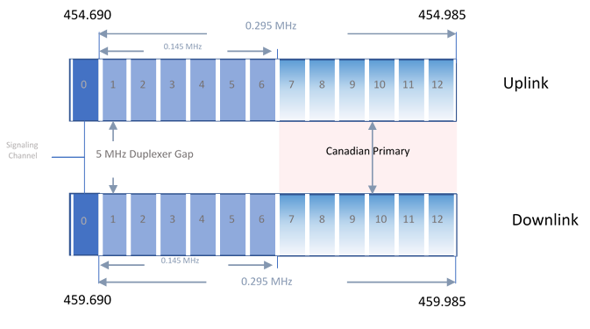
1. Introduction / Band Plan
Doc.802.15-20-0059-00-016t
Title 47 – Telecommunications
  Part 22 – Public Mobile Service
    Subpart G –Air-Ground Radiotelephone Service
General Aviation
Individual Site License
  Signal Channel (20KHz) and Traffic Channel (20KHz)
325KHz Paired (650KHz total)
497 Mile Co-Channel Protection
217 Mile Service Area
Power Requirements
  Ground Min 50 Watts, Max 100 Watts ERP
  Mobile Min 4 Watts, Max 25 Watts ERP
Spectrum utilization allows for spectrum to be used as a block
Michael Gagne – AURA Network Systems

Slide 3
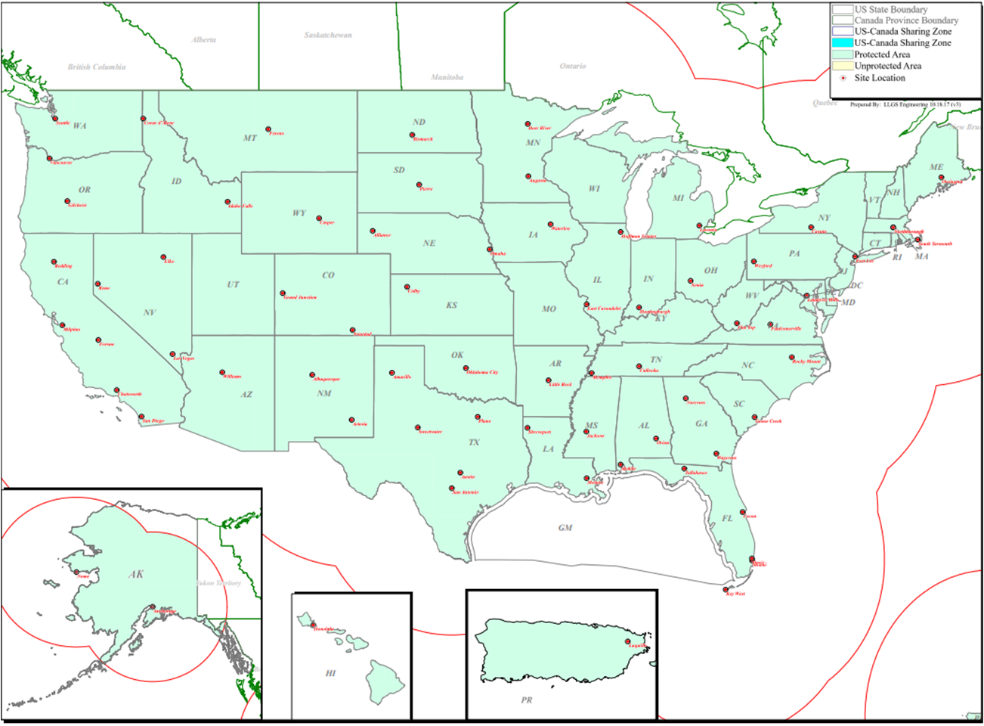
2. Site Licenses
Doc.802.15-20-0059-00-016t
67 licenses cover 69 transmitter locations
Secures all spectrum nationwide
  Including Alaska, Puerto Rico and Hawaii
The 450 MHz spectrum has strong propagation characteristics
Operation permitted at all elevation
Michael Gagne – AURA Network Systems

Slide 4
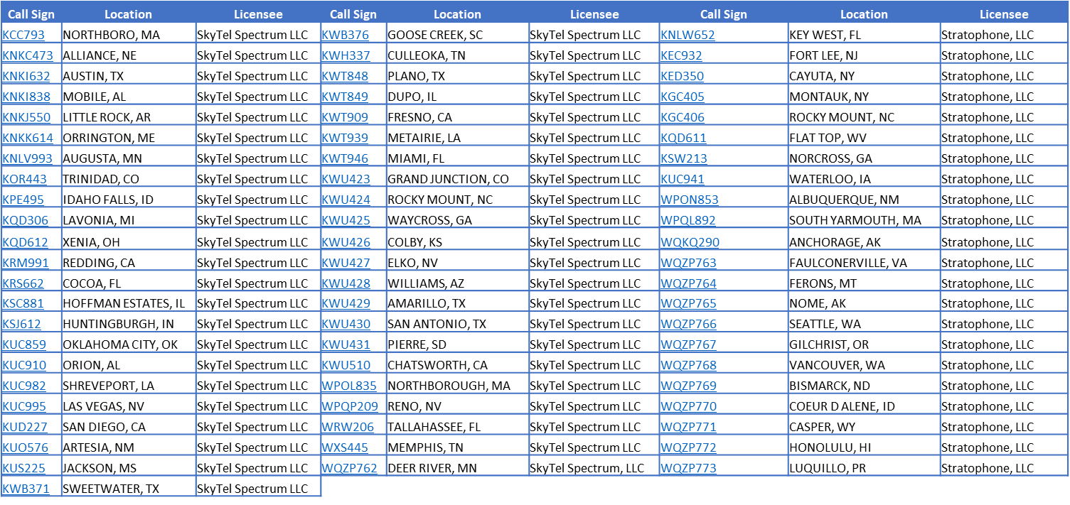
2. Site Licenses
Doc.802.15-20-0059-00-016t
Licensee of 67 General Aviation Air-Ground Radiotelephone Service licenses that together cover the entire United States and its territories, including Alaska, Hawaii and Puerto Rico
  The 67 licenses cover 69 transmitter site locations
Michael Gagne – AURA Network Systems

Slide 5
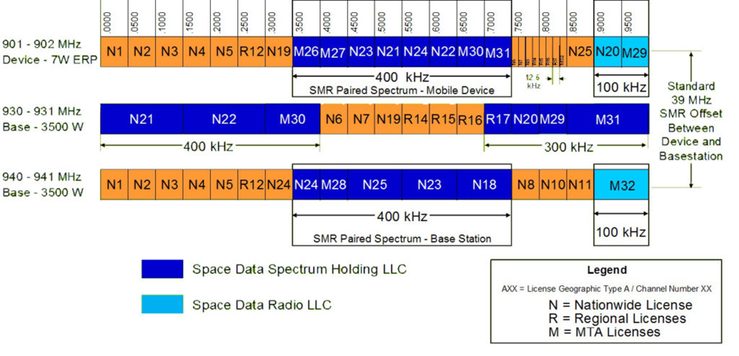
2. Site Licenses
Doc.802.15-20-0059-00-016t
TX - 12.5KHz 7W ERP
RX - 50KHz 3500 W ERP
Not Aviation - Alternative Use
Michael Gagne – AURA Network Systems

Slide 6
3. Critical Aviation and Unmanned Systems
Doc.802.15-20-0059-00-016t
Regulatory
  Managed under the FAA General Aviation Office
  Commercial Beyond Visual Line of Site (BVLOS)
    Part 107 – Visual Line of Site below 400’, not over people
    Part 87 - Pilots
    Part 90 – Certified Aviation
    Part 135 – Cargo for Hire/HEMS
  RTCA SC-228
    Working Group 1 – Detect and Avoid
    Working Group 2 – Command Non-Payload Communications
  ASTM F38
    Small UAS
  2018 FAA Reauthorization Act Section 373 (October 2019)
    UAS Spectrum Availability
    L – Band (960-1164MHz)
      Congested FAA, Military Use
      No Service Rules
    C – Band (5031-5090MHz)
      Unencumbered
      No Service Rules
Regulatory
  FCC Technological Advisory Counsel (TAC)
    Unmanned Aircraft System – Working Group (UAS-WG)
UAS CNPC Capacity on 450MHz (650KHz)
  Pilot to UAS Communication is done as needed to re-task Autopilot
  UAS to Pilot Communication is streaming data at 5kbps or less
  315KHz of return link spectrum offers 630kbps with a 2 b/Hz spectral efficiency
  Over 50 simultaneous UAS per site
  802.16 based/Slim LTE/Other Air Interface
UAS benefits to 450MHz spectrum
  FCC Designated Aviation Spectrum
  Aviation Service Rules
  Nationwide Footprint
  Low cost of deployment
  Large coverage area
  Highly Reliable
  Great Anchor Spectrum for higher bands to add capacity
  Available today
Michael Gagne – AURA Network Systems

Slide 7
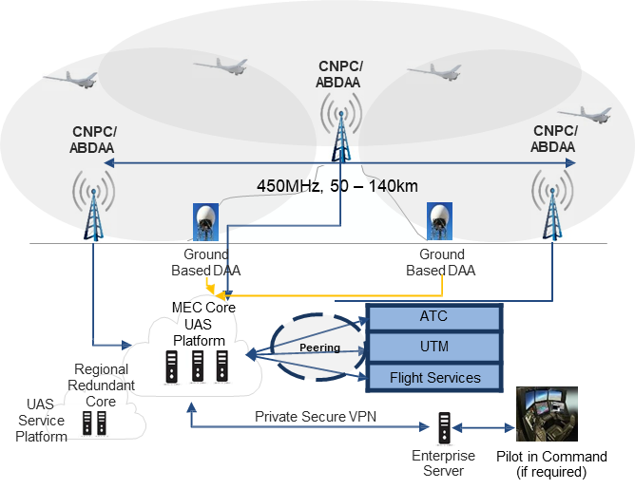
4. Air Interface Requirements and Use
Doc.802.15-20-0059-00-016t
Spectrum Utilization
  Spectrum efficiency of 2 bits/Hz or better
  Spectrum Bandwidth size of 15KHz Min to 325KHz Max
  Sub-carrier size of 5 KHz Minimum
  Physical sectorization of spectrum to increase Reuse and Capacity
Mobility
  Handovers
  Doppler (Speed of Sound)
  Elevation from Ground to 60,000 feet
  Distance up to 200 Miles
  Remote dynamic power control
Performance
  Availability, Reliability, Continuity, and Integrity
  How many 9’s.
  RTCA Standards still in development
  Latency – Base to Remote of less than 50ms
Data
  Messages delivered from Remote to Base at 1 Message per Second
    Message size from 5kb to 100kb
  Messages delivered from Base to Remote as needed
    Message size from 20kb to 1mb
Michael Gagne – AURA Network Systems

