Slide 1
Project: IEEE P802.15 Working Group for Wireless Personal Area Networks (WPANs)
Submission Title: Remote Smart House Door Access Control Using OCC Technology
Date Submitted: January 2020
Source: Jaesang Cha (VTASK Co., Ltd), Minwoo Lee (SNUST), Soonho Jung (Sunil Elecomm Co.,LTd) , Daeyoon Cha (VTASK Co., Ltd), Sung Hoon Yoon (Kogen Co., Ltd), Deokgun Woo (SNUST), Sooyoung Chang (SYCA), Vinayagam Mariappan (SNUST)
Address: Contact Information: +82-2-970-6431, FAX: +82-2-970-6123, E-Mail: chajaesang@gmail.com
Re:
Abstract: This document introduces the V2I optical camera communication link design consideration for VAT. This proposed OCC technology used for smart house automatic door access control system solution in remote areas. Also, this proposed VAT solutions can used to operate on the application services like ITS, IoT/IoL Service, Indoor positioning solutions ADAS, drone using watch security services, and etc.
Purpose: To provided concept models of OCC technology solution for Vehicular Assistant Technology (VAT) Interest Group
Notice: This document has been prepared to assist the IEEE P802.15. It is offered as a basis for discussion and is not binding on the contributing individual(s) or organization(s). The material in this document is subject to change in form and content after further study. The contributor(s) reserve(s) the right to add, amend or withdraw material contained herein.
Release: The contributor acknowledges and accepts that this contribution becomes the property of IEEE and may be made publicly available by P802.15.
Slide 1

Slide 2
Contents
Needs for Remote House Door Access Control Solution
OCC Technology on Door Access Control Automation
Conclusion
Slide 2

Slide 3
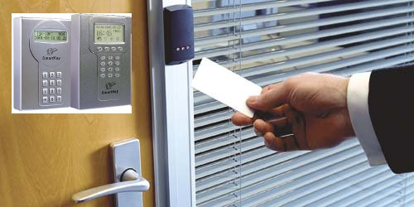
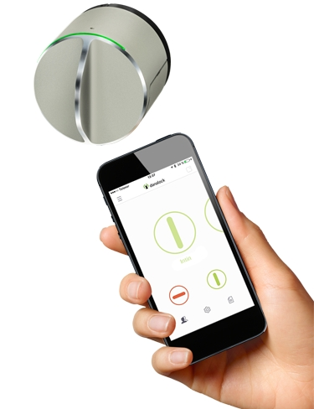
Needs for Remote House Door Access Control Solution
GOOGLE
Needs
  The safety and security in the remote homes are an important activity since there is one to check accessing remote area home.
  IoT based security system, and access control system allows remote smart house user to know who, when, how someone enter in the home that keep the data record of each occurrence and house user to know even when can’t be there in the house.
  The Key, access card, biometric, and RF based automatic door access control technologies are always easy breakable and vulnerable security threads.
  Need Smart device based flexible , secure, and safety access solution.
Basic Concept
  The optical camera communication (OCC) based door access control solution is the most feasible and more secure and reliable than RF communication interfaces and biometric solutions.
  Use the LED lights and Camera embedded on smart devices and digital door lock system to provide remote smart house door access control automation solution using smart device.
< Access Card Based Door Access Control System >
GOOGLE
< Smart Devices on Door Access Control Solutions >
Slide 3

Slide 4
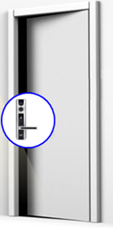

OCC Technology on Door Access Control Automation
OCC Link for Smart House Door Access Control Automation
  Tx : Smart Devices and Digital Door Lock LED Lights
  Rx : Smart Devices and Digital Door Lock CMOS Camera on
  Day-Night Communication Mode
  Modulations :
    OOK, VPPM, Offset-VPWM, Multilevel PPM, Inverted PPM, Subcarrier PPM, DSSS SIK etc.
  Data Rate : 1K ~ 1Mb/s
  Supported LoS (Line of Sight)
  Available Distance : 1m ~ 20m
OCC Down Link
OCC Up Link
  < OCC Technology on Door Access Control Automation Solution >
※ Use the smart devices and digital door lock built-in LED lights and CMOS Camera to enable OCC Service Link for door access control solution.
※ Does not required to install any additional hardware to collect authentication information from the remote house users.
※ Provides secured and safe door access control service to the smart house users.
Slide 4

Slide 5
Conclusion
Proposed the OCC Technology based smart door access control solution for remote area installed smart house safety and security.
Use the smart devices and digital door lock built-in LED lights and CMOS Camera to enable OCC Service Link for door access control solution.
Proposed solution does not required to install any additional hardware to gather authentication information from the remote house users and provides secured and safe door access control service to the smart house users.
Slide 5

