Slide 1
Project: IEEE P802.15 Working Group for Wireless Personal Area Networks (WPANs)
Submission Title: OWC Lights for Network Services in Remote Areas Located IoT Microhouse
Date Submitted: January 2020
Source: Jaesang Cha (VTASK Co., Ltd), Minwoo Lee (SNUST), Seongkweon Kim (SNUST), Soonho Jung (Sunil Elecomm Co.,LTd) , Daeyoon Cha (VTASK Co., Ltd), Sung Hoon Yoon (Kogen Co., Ltd), Deokgun Woo (SNUST), Soo-Young Chang (SYCA), Vinayagam Mariappan (SNUST)
Address: Contact Information: +82-2-970-6431, FAX: +82-2-970-6123, E-Mail: chajaesang@gmail.com
Re:
Abstract: This document introduces the V2X optical wireless communication (OWC) link design consideration for VAT. This proposed OWC link used for network access service in remote area located IoT Microhouse. Also, this proposed VAT solutions can used to operate on the application services like ITS, IoT/IoL Service, Indoor positioning solutions ADAS, drone using watch security services, and etc.
Purpose: To provided concept models of OWC technology solution for Vehicular Assistant Technology (VAT) Interest Group
Notice: This document has been prepared to assist the IEEE P802.15. It is offered as a basis for discussion and is not binding on the contributing individual(s) or organization(s). The material in this document is subject to change in form and content after further study. The contributor(s) reserve(s) the right to add, amend or withdraw material contained herein.
Release: The contributor acknowledges and accepts that this contribution becomes the property of IEEE and may be made publicly available by P802.15.
Slide 1

Slide 2
Contents
Needs for Network Services in Remote Areas Located IoT Microhouse
OWC Lights for IoT Microhouse Network Services
Conclusion
Slide 2

Slide 3
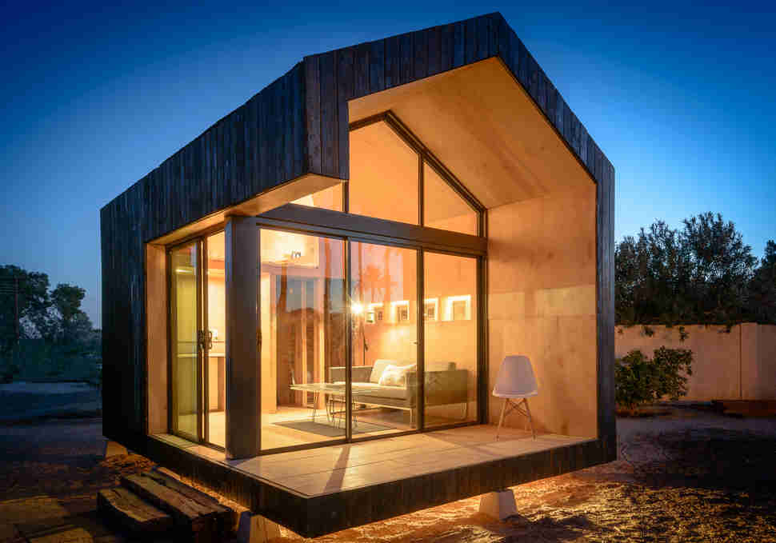
Needs for Network Services in Microhouse
Needs
  Microhouse movement is an architectural and social movement for camping lovers that advocates living simply in small homes.
  Provide the private and quite space for nature lovers to spent time on weekends, vacation, summer/winter holidays to extend the leisure and recreation with peace of mind.
  Major issue is network availability to enable smart home features for security and safety indoor or outdoor area of the Microhouse.
  Need dynamic network access and adaptive IoT features in Microhouse.
Basic Concept
  Use the LTE services to provide connectivity dynamically in the Microhouse with IoT lights.
  IoT lights connected with gateway controller and provide the network access through lights built-in with OWC functional feature.
  Use the smart device or laptop or smart TV connected cameras to act as receiver to create OWC link for network access and the OWC links are more secure and reliable than RF network services.
GOOGLE
< Modern Micro House Design Model >
Slide 3

Slide 4
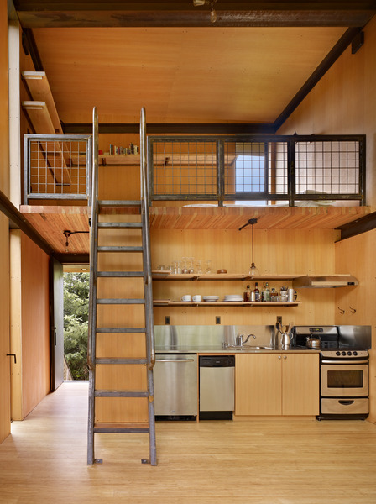


OWC Lights for IoT Microhouse Network Services
OWC Down Link for Network Services
  Tx : Microhouse Installed Networked IoT Lights
  Rx : Smart Devices / Laptop / Smart TV connected CMOS Camera
  Day-Night Communication Mode
  Modulations :
    OOK, VPPM, Offset-VPWM, Multilevel PPM, Inverted PPM, Subcarrier PPM, DSSS SIK etc.
  Data Rate : 1K ~ 1Mb/s
  Supported LoS (Line of Sight)
  Available Distance : 1m ~ 20m
OCC Down Link
  < OWC Link for IoT Microhouse Network Services >
※ Uses the Microhouse Installed Networked IoT Lights and Smart Devices / Laptop / Smart TV connected CMOS Cameras to enable network services in Microhouse using OWC network service link for internet service access.
※ Does not required to install any additional hardware for OWC receiver to provide network service in IoT Microhouse
※ Provides secured and safe internet access in the remote area located Microhouse.
Slide 4

Slide 5
Conclusion
Proposed the OWC network link for the remote area located IoT Microhouse network work services.
Use the Microhouse installed networked IoT Lights and smart devices/laptop/smart TV connected CMOS cameras to enable network services in Microhouse using OWC network link for internet service access.
No need to install any additional hardware for OWC receiver to provide network service in IoT Microhouse.
Provide the secured and safe internet access in the remote area located Microhouse.
Slide 5

