Slide 1
Project: IEEE P802.15 Working Group for Wireless Personal Area Networks (WPANs)
Submission Title: IoT/IoL Technology for Automatic Navigation Solution in Airport Indoor Service Vehicle
Date Submitted: January 2020
Source: Seongkwon Kim (SNUST), Jaesang Cha (SNUST), Minwoo Lee (SNUST), Seongkweon Kim (SNUST), Sangwoon Lee (Namseoul Univ.), Jintae Kim (Fivetek Co., Ltd.), Sangil Lim (Signtelecom Co. Ltd.), Deokgun Woo (SNUST), Soo-Young Chang (SYCA) , Vinayagam Mariappan (SNUST)
Address: Contact Information: +82-2-970-6431, FAX: +82-2-970-6123, E-Mail: chajs@seoultech.ac.kr
Re:
Abstract: This document introduces the V2X OCC Link design consideration for VAT. This proposed OCC technology used in automatic navigation solution for Airport indoor service vehicle. This proposed VAT solutions can used to operate on the application services like ITS, ADAS, drone using watch security services, and etc.
Purpose: To provided concept models of optical camera communication based IoT/IoL technology for Vehicular Assistant Technology (VAT) Interest Group
Notice: This document has been prepared to assist the IEEE P802.15. It is offered as a basis for discussion and is not binding on the contributing individual(s) or organization(s). The material in this document is subject to change in form and content after further study. The contributor(s) reserve(s) the right to add, amend or withdraw material contained herein.
Release: The contributor acknowledges and accepts that this contribution becomes the property of IEEE and may be made publicly available by P802.15.
Slide 1

Slide 2
Contents
Needs for Automatic Navigation Solution in Airport Indoor Service Vehicle
IoT/IoL Technology based Airport Indoor Vehicle Navigation Solution
Conclusion
Slide 2

Slide 3
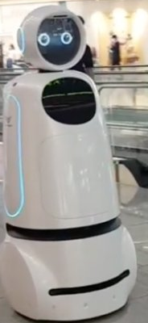
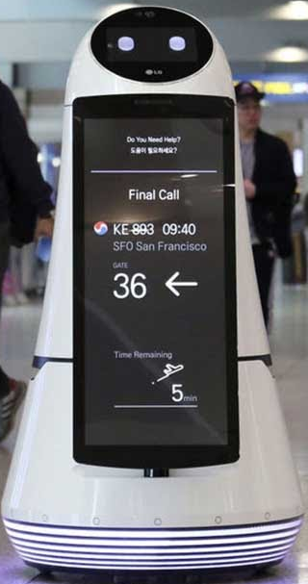
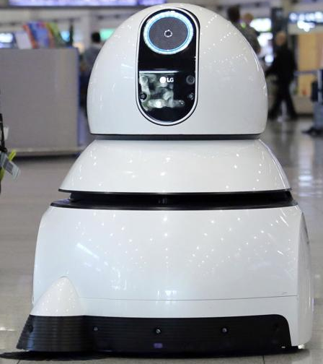
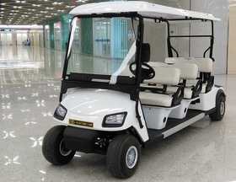
Needs for Automatic Navigation Solution in Airport Indoor Service Vehicle
Needs
  Balancing technology automation and human customer service at the airport is modernization trends nowadays.
  There are congestion, delays, operational inefficiencies, and a general feeling of stress and chaos can arise at any time for travelers in Airport.
  Navigation of the airport indoor service vehicles like guide robot, floor cleaning robot, passengers electric golf cart to provide the perfect travel experience to the travelers.
  Automatic navigation of airport indoor services vehicles need to consider many factors and needs more attention and effective auto navigation methods that creates the new opportunities for automation and self-service.
Basic Concept
  Use the airport lighting system and the camera connected on the airport indoor services vehicles to enable OCC Link for communication to get position and navigation informations.
  IoT/IoL technology provides the navigation and location information for the airport indoor services vehicles.
  OCC Links provides more secure and precise location Information.
GOOGLE
GOOGLE
< Airport Guide Robot >
< Floor Cleaning Robot >
GOOGLE
< Airport Passengers Electric Golf Cart >
Slide 3

Slide 4
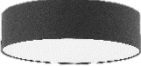
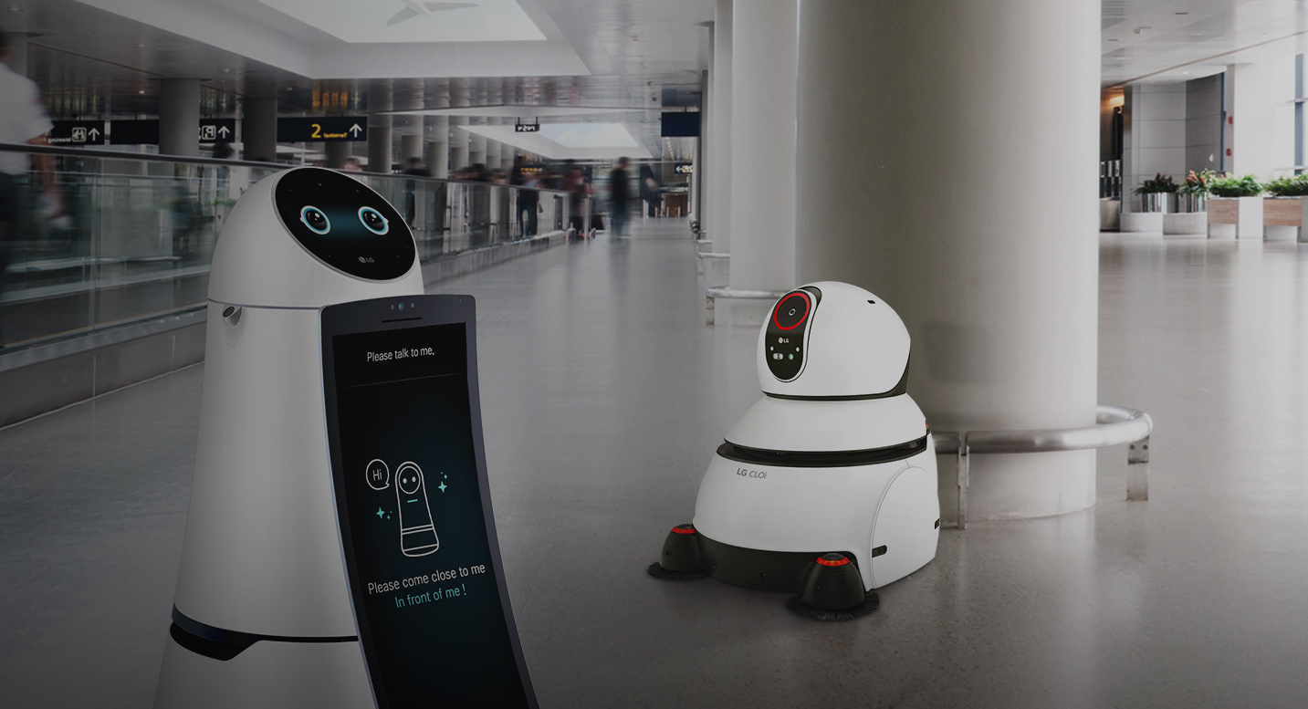
IoT/IoL Technology based Airport Indoor Vehicle Navigation Solution
IoT/IoL Technology Based OCC Link for Airport Indoor Vehicle Navigation
  Tx : Airport Terminal Indoor Lighting Infrastructure System
  Rx : Airport Indoor Vehicles CMOS Image Sensor
  Day-Night Communication Mode
  Modulations :
    OOK, VPPM, Offset-VPWM, Multilevel PPM, Inverted PPM, Subcarrier PPM, DSSS SIK etc.
  Data Rate : 1K ~ 1Mb/s
  Supported LoS (Line of Sight)
  Available Distance : 2m ~ 100m
OCC Link
OCC Link
  < IoT/IoL Technology based OCC Link for Airport Indoor Vehicle Navigation >
※ Use the Existing Airport lighting Infrastructure and Vehicles built-in Cameras to Enable OCC Service.
※ Provide the precise airport location and routing path informations to airport indoor vehicle for automatic navigation and vehicle control.
Slide 4

Slide 5
Conclusion
Proposed the automatic navigation solution based on IoT/IoL technology for Airport indoor vehicles.
Proposed system uses the Airport terminal lighting infrastructure and the CMOS Cameras connected on the Airport indoor vehicles to enable OCC link to get navigation informations to move on automatically.
Proposed solution provides precise airport location and routing path informations to airport indoor vehicle for automatic navigation and vehicle control using OCC Link.
Used to automatically navigate to the traveling points and create optimized routes for the airport indoor vehicle for smooth operation.
Slide 5

