Slide 1
Project: IEEE P802.15 Working Group for Wireless Personal Area Networks (WPANs)
Submission Title: Licensed Narrowband 16t Agenda and Meeting Presentation – January 2020
Date Submitted: 2020-01-06
Source: Tim Godfrey, EPRI
Abstract: Meeting Agenda and Presentation
Purpose: Chair’s presentation for task group meeting
Notice: This document has been prepared to assist the IEEE P802.15. It is offered as a basis for discussion and is not binding on the contributing individual(s) or organization(s). The material in this document is subject to change in form and content after further study. The contributor(s) reserve(s) the right to add, amend or withdraw material contained herein.
Release: The contributor acknowledges and accepts that this contribution becomes the property of IEEE and may be made publicly available by P802.15.

Slide 2
16t Task Group
Welcome, Introductions

Slide 3
Agenda for week – January 2020
Introductions, Attendance, Patent Policy
Review and Approve Agenda for week
Task Group Officers (permanent or interim secretary)
IEEE 802 orientation, 802.15 orientation, 802.16 history
Review of 16t PAR, CSD, and related materials from PAR approval
Task Group Development Process, Key Documents
Task Group Timeline
Issue call for contributions and presentations
Any presentations or contributions for this week

Slide 4
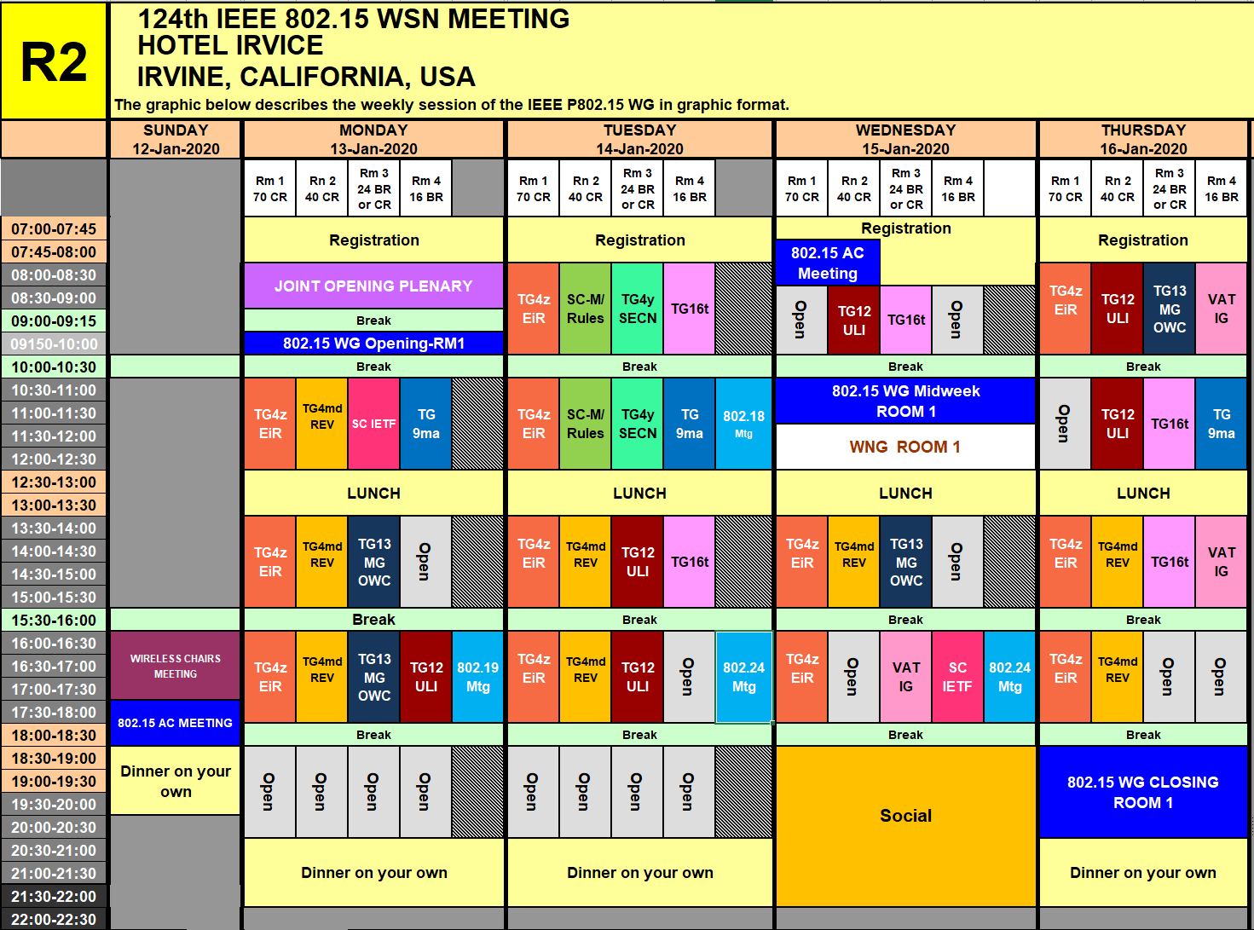

Slide 5
TG16t Schedule for the Week
 | Monday | Tuesday | Wednesday | Thursday
AM 1 | WG Plenary | TG16t | TG16t | 802.18
AM 2 |  | 802.18 | WG Plenary | TG16t
PM 1 |  | TG16t |  | TG16t
PM 2 |  | 802.24 | 802.24
PM 3 |  |  |  | WG Closing

Slide 6
Sign In for attendance
https://imat.ieee.org/my-site/home
Slide 6

Slide 7
Participants have a duty to inform the IEEE
  Participants shall inform the IEEE (or cause the IEEE to be informed) of the identity of each holder of any potential Essential Patent Claims of which they are personally aware if the claims are owned or controlled by the participant or the entity the participant is from, employed by, or otherwise represents
  Participants should inform the IEEE (or cause the IEEE to be informed) of the identity of any other holders of potential Essential Patent Claims
  Early identification of holders of potential Essential Patent Claims is encouraged
Slide #1

Slide 8
Ways to inform IEEE
Cause an LOA to be submitted to the IEEE-SA (patcom@ieee.org); or
Provide the chair of this group with the identity of the holder(s) of any and all such claims as soon as possible; or
Speak up now and respond to this Call for Potentially Essential Patents
If anyone in this meeting is personally aware of the holder of any patent claims that are potentially essential to implementation of the proposed standard(s) under consideration by this group and that are not already the subject of an Accepted Letter of Assurance, please respond at this time by providing relevant information to the WG Chair
Slide #2

Slide 9
Other guidelines for IEEE WG meetings
All IEEE-SA standards meetings shall be conducted in compliance with all applicable laws, including antitrust and competition laws.
  Don’t discuss the interpretation, validity, or essentiality of patents/patent claims.
  Don’t discuss specific license rates, terms, or conditions.
    Relative costs of different technical approaches that include relative costs of patent licensing terms may be discussed in standards development meetings.
      Technical considerations remain the primary focus
  Don’t discuss or engage in the fixing of product prices, allocation of customers, or division of sales markets.
  Don’t discuss the status or substance of ongoing or threatened litigation.
  Don’t be silent if inappropriate topics are discussed … do formally object.
---------------------------------------------------------------
For more details, see IEEE-SA Standards Board Operations Manual, clause 5.3.10 and
Antitrust and Competition Policy: What You Need to Know at http://standards.ieee.org/develop/policies/antitrust.pdf
Slide #3

Slide 10
Patent-related information
  The patent policy and the procedures used to execute that policy are documented in the:
    IEEE-SA Standards Board Bylaws
    (http://standards.ieee.org/develop/policies/bylaws/sect6-7.html#6)
    IEEE-SA Standards Board Operations Manual (http://standards.ieee.org/develop/policies/opman/sect6.html#6.3)
  Material about the patent policy is available at
  http://standards.ieee.org/about/sasb/patcom/materials.html
  If you have questions, contact the IEEE-SA Standards Board Patent Committee Administrator at patcom@ieee.org
Slide #4

Slide 11
IEEE SA Copyright Policy
By participating in this activity, you agree to comply with the IEEE Code of Ethics, all applicable laws, and all IEEE policies and procedures including, but not limited to, the IEEE SA Copyright Policy.
  Previously Published material (copyright assertion indicated) shall not be presented/submitted to the Working Group nor incorporated into a Working Group draft unless permission is granted.
  Prior to presentation or submission, you shall notify the Working Group Chair of previously Published material and should assist the Chair in obtaining copyright permission acceptable to IEEE SA.
  For material that is not previously Published, IEEE is automatically granted a license to use any material that is presented or submitted.

Slide 12
IEEE SA Copyright Policy
    The IEEE SA Copyright Policy is described in the IEEE SA Standards Board Bylaws and IEEE SA Standards Board Operations Manual
      IEEE SA Copyright Policy, see
      Clause 7 of the IEEE SA Standards Board Bylaws
      https://standards.ieee.org/about/policies/bylaws/sect6-7.html#7
      Clause 6.1 of the IEEE SA Standards Board Operations Manual
      https://standards.ieee.org/about/policies/opman/sect6.html
    IEEE SA Copyright Permission
      https://standards.ieee.org/content/dam/ieee-standards/standards/web/documents/other/permissionltrs.zip
    IEEE SA Copyright FAQs
      http://standards.ieee.org/faqs/copyrights.html/
    IEEE SA Best Practices for IEEE Standards Development
      http://standards.ieee.org/develop/policies/best_practices_for_ieee_standards_development_051215.pdf
    Distribution of Draft Standards (see 6.1.3 of the SASB Operations Manual)
      https://standards.ieee.org/about/policies/opman/sect6.html

Slide 13
Participant behavior in IEEE-SA activities is guided by the IEEE Codes of Ethics & Conduct
All participants in IEEE-SA activities are expected to adhere to the core principles underlying the:
  IEEE Code of Ethics
  IEEE Code of Conduct
The core principles of the IEEE Codes of Ethics & Conduct are to:
  Uphold the highest standards of integrity, responsible behavior, and ethical and professional conduct
  Treat people fairly and with respect, to not engage in harassment, discrimination, or retaliation, and to protect people's privacy.
  Avoid injuring others, their property, reputation, or employment by false or malicious action
The most recent versions of these Codes are available at
  http://www.ieee.org/about/corporate/governance

Slide 14
Participants in the IEEE-SA “individual process” shall act independently of others, including employers
The IEEE-SA Standards Board Bylaws require that “participants in the IEEE standards development individual process shall act based on their qualifications and experience”
This means participants:
  Shall act & vote based on their personal & independent opinions derived from their expertise, knowledge, and qualifications
  Shall not act or vote based on any obligation to or any direction from any other person or organization, including an employer or client, regardless of any external commitments, agreements, contracts, or orders
  Shall not direct the actions or votes of other participants or retaliate against other participants for fulfilling their responsibility to act & vote based on their personal & independently developed opinions
By participating in standards activities using the “individual process”, you are deemed to accept these requirements; if you are unable to satisfy these requirements then you shall immediately cease any participation

Slide 15
IEEE-SA standards activities shall allow the fair & equitable consideration of all viewpoints
The IEEE-SA Standards Board Bylaws (clause 5.2.1.3) specifies that “the standards development process shall not be dominated by any single interest category, individual, or organization”
  This means no participant may exercise “authority, leadership, or influence by reason of superior leverage, strength, or representation to the exclusion of fair and equitable consideration of other viewpoints” or “to hinder the progress of the standards development activity”
This rule applies equally to those participating in a standards development project and to that project’s leadership group
Any person who reasonably suspects that dominance is occurring in a standards development project is encouraged to bring the issue to the attention of the Standards Committee or the project’s IEEE-SA Program Manager

Slide 16
16t Task Group
Attendance Reminder: https://imat.ieee.org/my-site/home
Approve Agenda

Slide 17
IEEE 802 New Member Orientation
Offered at Plenary Meetings (March, July, November)
https://mentor.ieee.org/802-ec/dcn/19/ec-19-0098-01-00EC-ieee-802-orientation-2019.pdf
Brief review here for benefit of new participants
IMAT
Mentor

Slide 18










IEEE 802
802.1
802.3
802.11
802.15
802.16
802.18
802.21
802.22
802.24
Architecture
Interworking
Security
Ethernet
ZigBee
TAG:
Radio
Regulatory
Media
Independent
Services
TAG:
Smart Grid
IoT
Hibernating
Working Groups

Slide 19
802.15 Working Group: Names
Original Name: Wireless Personal Area Networks (WPAN)
  Still used in many places within IEEE 802
  Name assigned with first project 802.15.1 – AKA Bluetooth 1.0
Preferred Name: Wireless Specialty Networks (WSN)
  More aligned with current scope and activities of WG
  WPAN is still included, but many other types as well

Slide 20
15-19-0492-01-0000-nov-2019-plenary-opening-report-for-802-15
802.15 Organization Chart
802.15WG Chair
Bob Heile, Decawave
802.15 Vice Chairs
Rick Alfvin, Linespeed
Pat Kinney, Kinney Consulting
To add your name
to the WG/TG/SG/IG reflectors
please go to www.ieee802.org/15
Secretary
Pat Kinney, Kinney Consulting
Assistant Secretary
Mike McInnis, Boeing
STUDY GROUPS:
INTEREST GROUPS
IG Dependability (of Radio Links)
Chair: Ryuji Kohno,
IG Profiles
Chair: Don Sturek, Itron
IG Vehicular Assistive Technology
  ChairYeong Min Jang, Kookmin Uni
IG 15.4 Guide
Chair: TBD
STANDING COMMITTEES
SC IETF
Chair: Pat Kinney, Kinney Consulting
SC WNG
Chair:: Pat Kinney, Kinney Consulting
SC Maintenance / Rules
Chair:: Pat Kinney, Kinney Consulting
TAGs
TeraHertz (THZ)
  Chair: Thomas Kürner,
  Technische Universität Braunschweig
Working Group Technical Editor
James Gilb
Task Groups
TG4md 15.4 Revision
Chair: Gary Stuebing, Cisco
TG9ma 802.15.9 Revision 1
Chair: Tero Kivinen, Self
TG4w 15.4 Low Power Wide Area (LPWA)
  Chari: Robert, Jörg
  Friedrich-Alexander-Universität
TG12 Consolidated 15.4 ULI
Chair: Pat Kinney, Kinney Consulting
TG4y Security Next Gen (SECN)
Chair: Don Sturek, Itron
TG13 Gigbit OWC
Chair: Volker Jungnickel
Fraunhofer Heinrich Hertz Institute
TG4z 15.4 Enhanced Impulse Radio (EIR)
Chair: Tim Harrington, Pro-ID
TG22 Spectrum Characterization
and Occupancy Sensing
Chair: Apurva Mody, BAE
xxx

Slide 21
802.15 Working Group Projects
Standard | Description | Status
802.15.1 | Bluetooth 1.0 | Completed, Withdrawn, widely adopted in evolved form
802.15.2 | Bluetooth / 802.11 coexistence | Withdrawn 2018
802.15.3 | High Rate Wireless Personal Area Network | Niche Markets
802.15.4 | Low Rate Wireless Personal Area Network | Widely Used (ZigBee, Wi-SUN), active development
802.15.5 | Mesh Networking | Very Limited adoption
802.15.6 | Body Area Networks | Very limited adoption
802.15.7 | Visible Light Communication | Limited adoption
802.15.8 | Peer Aware Communications | Very limited adoption
802.15.9 | Key Management Protocol | Widely used (part of Wi-SUN)
802.15.10 | Layer 2 Routing | Some adoption
802.15.12 | Upper Layer Interface (ULI) for IEEE 802.15.4 Networks | Now in development
802.15.13 | Multi-Gigabit/s Optical Wireless Communications | Now in development
802.15.16 | Licensed Narrowband Amendment | Now in development
802.15.22 | Spectrum Characterization and Occupancy Sensing | Now in development

Slide 22
802.15 Membership
Voting membership in 802.15 is granted based on meeting attendance and letter ballot response
Attendance: 2 out of 4 plenary meetings with 75% attendance of meeting slots. One interim can be substituted for a plenary
Letter Ballot Response: Members must vote on working group letter ballots.
  If you fail to vote on 2 out of 3 letter ballots you will lose your voting rights.
  This rule includes letter ballots for all 802.15 projects

Slide 23
PAR Background

Slide 24
Identified Task Group Participants
Tim Godfrey (EPRI)
Doug Gray (TCS)
Craig Tedrow (GE MDS)
Kathy Nelson (Ondas)
Menashe Shahar (Ondas)
Guy Simpson (Ondas)
Scott Schoepel (Motorola)
Anders Rendahl (Siemens)
Bob Saffari (Telewave)
Leonhard Korowajczuk (CelPlan)
Eugene Crozier (PowerTech Labs)
Bob Finch (Select Spectrum)
Klaus Bender (UTC)
Jerry Roberts (ENTELEC (Oil & Gas))
Tom Peters (WCC of AAR - Rail)
Robin Cohen (EWA two way users)
Mark Crosby (EWA)
Zach Smith (BNSF)
Rick Smith (Chevron)
Daoud Serang (CML Micro)
Lon Renner (Nebraska Public Power District)
Rich Hawkins (WiMAX Forum)

Slide 25
Supporters of IEEE P802.16t Amendment
BNSF
Great River Energy
Arizona Public Service
Tri-State G&T
Central Lincoln PUD
Cleco
Bay Electronics
NV Energy
Enterprise Products
Idaho Power
UTC (Utilities)
ENTELEC (Oil & Gas)
WCC of AAR (Rail)
EWA (two way users)
Chevron
Nebraska Public Power District
Connexus Energy
Herzog Technologies
Collins Aerospace
Centerpoint Energy

Slide 26
Supporters of IEEE P802.16t Amendment
Apache
Jagged Peak Energy
East River Electric
BC Hydro
Nashville Electric Service
Lee County Electric Cooperative
Dairyland Electric Cooperative
Puget Sound Energy
Others

Slide 27
Scope Statement from Approved PAR
24-19-0029-06-0000-P802_16t_PAR.pdf
  Standard for Air Interface for Broadband Wireless Access Systems
  Amendment - Fixed and Mobile Wireless Access in Narrowband Channels
5.2.b. Scope of the project:
  This project specifies Time Division Duplexing (TDD) operation in licensed spectrum with channel bandwidths greater than or equal to 5 kHz and less than 100 kHz. The project will specify a new PHY, and changes to the MAC as necessary to support the PHY. The amendment is frequency independent but focuses on spectrum less than 2 GHz. The range and data rate supported by the narrower channels are commensurate with those of the base standard, as scaled by the reduced channel bandwidth. The project also amends IEEE Std 802.16 as required to support aggregated operation in adjacent and non-adjacent channels.

Slide 28
Need Statement from Approved PAR
5.5 Need for the Project:
  Mission critical entities have a strong preference for private, licensed networks for their data communications needs. Licensed channels from 5 kHz to 1 MHz may be available from the FCC and other regulators, or may be purchased in secondary markets at a lower cost than commercial channels. Examples of operating frequencies include 160 MHz, 450 MHz, 700 MHz, and 900 MHz. Furthermore, VHF/UHF channels have superior propagation characteristics requiring less infrastructure and are capable of meeting capacity needs of private networks. The amendment facilitates the development of innovative, cost-effective, and interoperable multivendor products for private licensed wireless access systems for mission critical networks. Applications include smart grids supporting generation, transmission, and distribution; field area networks; smart fields and smart pipes for oil and gas; intelligent transportation for rail systems; and federal, state and local uses for homeland security, environmental and seismic monitoring and military communications.

Slide 29
PAR Development Process
Sept Interim: Presentation of project overview to 802.15 WNG 802.15-19-0412r3
  PAR Approved by 802.24 TAG
October 1st EC Teleconference
  EC was briefed on plan for PAR submittal and project assignment to 802.15 in November
802.24 teleconference October 1 – 1pm PDT
  Further discussion on PAR and CSD
PAR submitted to EC reflector Oct 8th for agenda at November plenary
  Per IEEE 802 LMSC O&M Section 9.2
  Including links to PAR, CSD, and this presentation describing PAR development process
802.24 provided the forum in November for addressing PAR comments
  802.24-19-0035r0
PAR and CSD were approved Friday Nov 15 at EC meeting
The PAR shows the project is assigned to WG 802.15
  802.15 approves the assignment of this project to them
  The 802.16 standard will not be renamed or renumbered by this amendment project

Slide 30
P802.16t PAR and CSD - EC Motion
Approve forwarding P802.16t PAR documentation in https://mentor.ieee.org/802.24/dcn/19/24-19-0029-06-0000-licensed-narrowband-amendment-par.pdf to NesCom
Approve CSD documentation in https://mentor.ieee.org/802.24/dcn/19/24-19-0030-01-0000-licensed-narrowband-amendment-csd.docx
See 802.24-19-0033r8 for supporting documentation
Vote in the 802.24 TAG, PAR (y/n/a): <7>,<0>,<1>; CSD (y/n/a): <7>,<0>,<1>
Vote in the 802.15 WG, PAR (y/n/a): <18>,<3>,<4>; CSD (y/n/a): <18>,<3>,<4>
Moved: T Godfrey
Second: R Alfvin

Slide 31
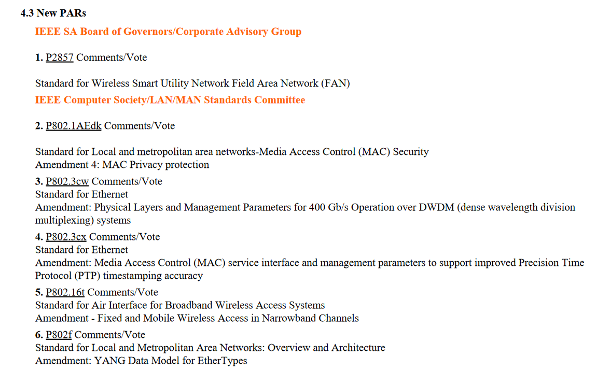
Since November
NESCOM Agenda 22 January 2020
PAR Approved by 802 EC
PAR Submitted to NESCOM by 802.15 Chair Bob Heile
First NESCOM meeting – 22 January 2020
PAR not formally approved
until next week

Slide 32
802.16 History
Full details of prior projects: http://www.ieee802.org/16/tgs.html
“Lineage” of standards forming basis of 16t amendment project
  IEEE Std 802.16e-2005: Amendment on enhancements to support mobility
  IEEE Std 802.16-2009: Revision
  IEEE Std 802.16-2012: Revision
    Split out 16m amendment into separate standard: 802.16.2
    Added 802.16h Coexistence Mechanisms for License-Exempt Operation
  Amendments to 802.16-2012
    IEEE Std 802.16p-2011: Amendment to IEEE Std 802.16 for Enhancements to Support Machine-to-Machine Applications
    IEEE Std 802.16n-2013: Amendment to IEEE Std 802.16 for Higher Reliability Networks
    IEEE Std 802.16q-2015: Amendment to IEEE Std 802.16 for Multi-Tier Networks
    IEEE Std 802.16s-2017: Amendment to IEEE Std 802.16 for Channel Bandwidth up to 1.25 MHz
  IEEE Std 802.16-2017: Revision, incorporating 802.16p, 802.16n, 802.16q, and 802.16s
  Download 802.16-2017 at no cost through IEEE Get802 program: https://ieeexplore.ieee.org/document/8303870

Slide 33
Task Group Process

Slide 34
16t Task Group Leadership
16t Task Group Officers
  Chair Tim Godfrey
  Vice Chair
  Secretary
  Technical Editor

Slide 35
Example Process used by P802.16s
Develop System Requirements Document (SRD)
  Requirements for functionality to be added by the amendment
Develop System Description Document (SDD)
  Technical description of how the functionality in the SRD is accomplished
Outline Draft
  Using the base document (IEEE Std 802.16-2017), identify the affected clauses, mapping content from SDD into amendment structure
Draft Standard
  Developed through contributions until ready for balloting

Slide 36
Discussion on process
Contribution Driven Process
Contributions of text proposals may be voted to be included in documents (SRD, SDD, Draft)
Adopting text proposals into SRD, SDD, or Draft is a technical motion requiring 75% approval.

Slide 37
Discussion on TDD vs FDD
PAR now specifies TDD operation
Are there issues using TDD in existing channel pairs.
Half-duplex FDD would reduce efficient use of spectrum
Certain sites may require FDD due to adjacent channel users

Slide 38
Duplexing option requirements
TDD
FDD (base and remote)
FDD at base, half duplex FDD at remote
FDD half duplex at base and remote

Slide 39
Project Timeline - Milestones
Milestone | Date
Task Group Start | January 2020
SRD Approval | July 2020
SDD Approval | January 2021
Informal TG review of draft | May 2021
Working Group Letter Ballot | July 2021
Working Group Recirculation Letter Ballot | November 2021
SA Ballot | March 2022
Forward to RevCom | October 2022
Editor
From PAR

Slide 40
Call for Contributions
This Call for Contributions solicits input documentation toward the development of a Project P802.16t on Licensed Narrowband operation. The approved PAR is available <here>. The group is considering removing the limitation to TDD mode in the project scope.
Contributions are sought on the following topics;
  Presentations on use cases and applications
  Contributions toward System Requirements Document
The deadline for contributions to be considered the March 2020 plenary meeting is Friday, 13 March 2020, AOE (Anywhere On Earth)
Documents should be uploaded to https://mentor.ieee.org/802.15, to the TG16t task group.

Slide 41
Presentations
On the SRD
  Wednesday AM1
    Menashe Shahar - Terminology
  Thursday AM2
    Menashe Shahar Outline Requirements

Slide 42
Closing
Action Items
Objectives for next meeting
Any Other Business
Adjourn

Slide 43
Upcoming Sessions
March 15-20, 2020, Hilton Atlanta, Atlanta Georgia, USA, 802 Plenary Session.
May 10-15, 2020, Marriott Hotel, Warsaw, Poland, 802 Wireless Interim Session.
July 12-17, 2020, Sheraton Centre Montreal, Montreal Canada, 802 Plenary Session.
September 13-18, 2020, Grand Hyatt Atlanta in Buckhead, Atlanta, Georgia, 802 Wireless Interim Session.
November 18-13, 2020, Marriott Marquis Queen's Park, Bangkok, Thailand, 802 Plenary Session.

