Slide 1
IEEE 802.15 TG13 Multi-Gbit/s Optical Wireless Communication November 2019 Closing Report
November 2019
Date: 2019-11-15
Author:

Slide 2
November 2019
Abstract
This presentation contains the IEEE 802.15 TG13 Multi- Gbit/s Optical Wireless Communication Closing Report for the November 2019 session in Waikoloa.

Slide 3
November 2019
Logistics (2)
Position(s) | Officer(s)
Chair | Volker Jungnickel
Vice Chairs | Sang-Kyu Lim, Nikola Serafimovski
Secretary | Sang-Kyu Lim, Tuncer Baykas
TG Technical Editor | Kai Lennert Bober

Slide 4
November 2019
TG13 schedule for Waikoloa
 | MON | TUE | WED | THU
AM1 | TGbb#1(be) | TG13#2 | TGbb#4(ax)
AM2 | WG Opening | TG13#3 | WG Midweek | TG13#6
PM1 | TGbb#2(be) | TGbb#3(be) | TG13#5
PM2 | TG13#1 | TG13#4 | TGbb#5(be) | WG Closing
PM3

Slide 5
November 2019
TG13 activities this week
6 Slots in Waikoloa
Send copyright letter to ITU-T
Finalized TG13 draft
~100 comments resolved
Editorial comments from James
Coexistence assurance document created
Formed a CRG
Update the draft after Waikoloa session
TG13 D8.0 goes to WGLB

Slide 6
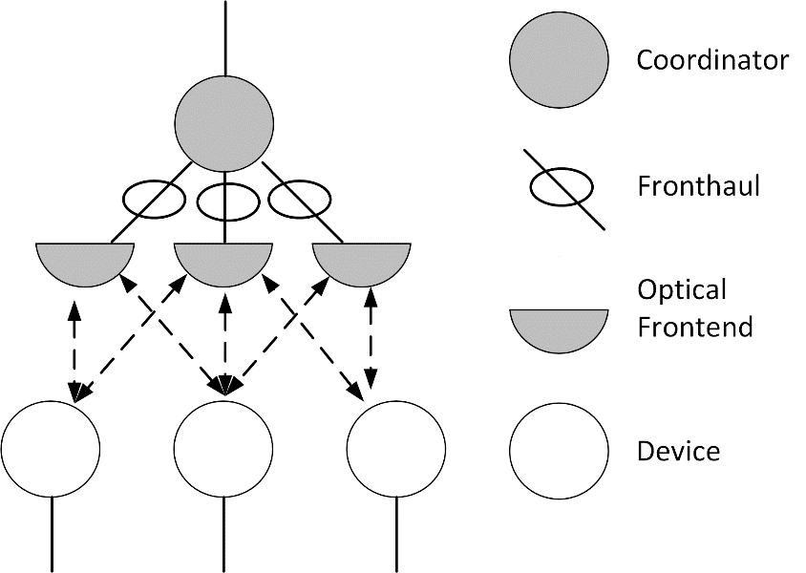
November 2019
TG13 main contributions
New standard for LiFi in wireless specialty networks
i.e. Industrial, Medical, Secure Office
New 802.15.13 MAC with two modes of operation
Beacon-enabled: Deterministic access with support for distributed MIMO → Industry, Medical
works with PM and HB PHYs
Non-beacon-enabled Polling → Office
works with LB PHY
3 PHYs
Pulsed Modulation (PM) PHY: Low energy: Uplink, IoT
High Bandwidth (HB) PHY: High throughput: Downlink
Low-bandwidth (LB) PHY: Medium throughput, UL+DL

Slide 7
November 2019
TG13 draft development
802.15.7: 309 pages (2011)
TG7r1 D0: 579 pages → added OCC and LiFi text
TG7r1 D1: 634 pages → split OCC and LiFi
TG13 D0: 430 pages → removed OCC PHYs (March 2017)
TG13 D1.0: 390 pages
TG13 D2.0: 373 pages → added PM PHY text (Nov. 2017)
TG13 D3.0: 379 pages
TG13 D3.1: 382 pages → added HB PHY text
TG13 D4.0: 251 pages → removed TG7 MAC (Feb. 2019)
TG13 D5.0: 169 pages → added TG13 MAC
TG13 D6.0: 163 pages
TG13 D7.0: 153 pages (Sept. 2019)
TG13 D8.0: (Nov. 2019)

Slide 8
Plan for finalization of TG13 Work
November 2019
Nov. to January complete D8.0, send to WG LB, create comments
January Interim Resolve comments from WG LB, create D9.0, start recirc
March Plenary Submit draft to SA LB

Slide 9
November 2019
TG13 Plans for January meeting
4 slots requested
Comment resolution against WGLB
Create D9.0
Start recirc

Slide 10
September 2019
TG13 Motion #66
Instruct the Technical Editor to include the resolution of comment resolution in doc. 15-19/0534r2 in the new TG13 draft D8.0. The Technical Editor is granted the right to correct the section, figure and table numbering and make editorial changes.
Moved by Nikola
Seconded by Tuncer
Y / N / A = 4 / 0 / 0 Motion passed.

Slide 11
September 2019
TG13 Motion #67
Move that TG13 formally request that the 802.15 WG start a WG Letter Ballot requesting approval of CA document 15-19/0572r0 and document P802-15-13_D8 and to forward document P802-15-13_D8, as edited in accordance with the instructions in document 15-19/0534r2, to Standards Association ballot pending the completion and inclusion of the edits in the draft.
Moved by Nikola
Seconded by Lennert
Y / N / A = 4 / 0 / 0 Motion passed.

Slide 12
September 2019
TG13 Motion #68
Move that 802.15 WG approve the formation of a Comment Resolution Group (CRG) for the WG balloting of the P802.15.13_D8 with the following membership: Volker Jungnickel, Nikola Serafimovski, Tuncer Baykas, Kai Lennert Bober, Jörg Robert. The 802.15.13 CRG is authorized to approve comment resolutions, edit the draft according to the comment resolutions, and to approve the start of recirculation ballots of the revised draft on behalf of the 802.15 WG. Comment resolution on recirculation ballots between sessions will be conducted via reflector email and via teleconferences announced to the reflector as per the LMSC 802 WG P&P.
Moved by Nikola
Seconded by Lennert
Y / N / A = 3 / 0 / 0 Motion passed.

Slide 13
September 2019
802.15 WG Motion
Move that 802.15 WG start a WG Letter Ballot requesting approval of CA document 15-19/0572r0 and document P802-15-13_D8 (as edited in accordance with the instructions in document 15-19/0534r2) and to forward document P802-15-13_D8, as edited in accordance with the instructions in document 15-19/0534r2, and CA document 15-19/0572r0 to Standards Association ballot pending the completion and inclusion of the edits in the draft.
Moved by Volker Jungnickel
Seconded by
Y / N / A = _ / _ / _
TG13 result: Y / N / A = 4 / 0 / 0

Slide 14
September 2019
802.15 WG Motion
Move that 802.15 WG approve the formation of a Comment Resolution Group (CRG) for the WG balloting of the P802.15.13_D8 with the following membership: Volker Jungnickel, Nikola Serafimovski, Tuncer Baykas, Jörg Robert. The 802.15.13 CRG is authorized to approve comment resolutions, edit the draft according to the comment resolutions, and to approve the start of recirculation ballots of the revised draft on behalf of the 802.15 WG. Comment resolution on recirculation ballots between sessions will be conducted via reflector email and via teleconferences announced to the reflector as per the LMSC 802 WG P&P.
Moved by Volker Jungnickel
Seconded by
Y / N / A = _ / _ / _
TG13 result: Y / N / A = 3 / 0 / 0

