Slide 1
Project: IEEE P802.15 IG VAT
Submission Title: Object Detection framework for High-Rate Optical Vehicular Communication System
Date Submitted: November 2019
Source: Tung Lam Pham and Yeong Min Jang [Kookmin University].
Contact: +82-2-910-5068 E-Mail: yjang@kookmin.ac.kr
Re:
Abstract : Introduce the application of object detection framework in High-rate Optical Vehicular Communication System
Purpose: Increasing the communication range and reliability of High-rate Optical Vehicular Communication System.
Notice: This document has been prepared to assist the IEEE P802.15. It is offered as a basis for discussion and is not binding on the contributing individual(s) or organization(s). The material in this document is subject to change in form and content after further study. The contributor(s) reserve(s) the right to add, amend or withdraw material contained herein.
Release: The contributor acknowledges and accepts that this contribution becomes the property of IEEE and may be made publicly available by P802.15.

Slide 2
Object Detection framework for High-rate Optical Vehicular Communication System
Notes:
Object Detection framework for High-rate Optical Vehicular Communication System

Slide 3
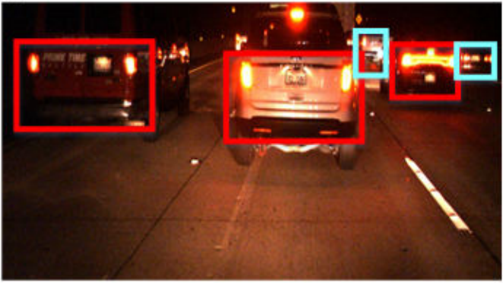
Challenges in Optical Vehicular Communication system
In a challenge communication environment (e.g. vehicular condition), an OCC system should detect and track a large number of light sources (region-of-interest (RoI)) with strictly requirement of time processing.
Typical OCC system has its drawbacks when deploying in challenge environment such as vehicular conditions.
Complex channel model (noise, blur, interference, etc) and high mobility are the main challenges in Optical Vehicular Communication system.
Illustration of multi-RoI detection in challenge vehicular environment
Kookmin University

Slide 4
Network design: You Only Look Once (YOLO)
The YOLO network architecture is inspired by the GoogleNet model for image classification, with 24 convolutional layers followed by 2 fully connected layers.
Kookmin University

Slide 5
Network design: YOLO-tiny
YOLO
YOLO tiny
The YOLO tiny architecture reduce from 24 convolutional layers to 9 convolutional layer only, make the model lighter and faster (boost the processing frame rate from 45 to 155 fps), with the trade back in accuracy
Kookmin University

Slide 6
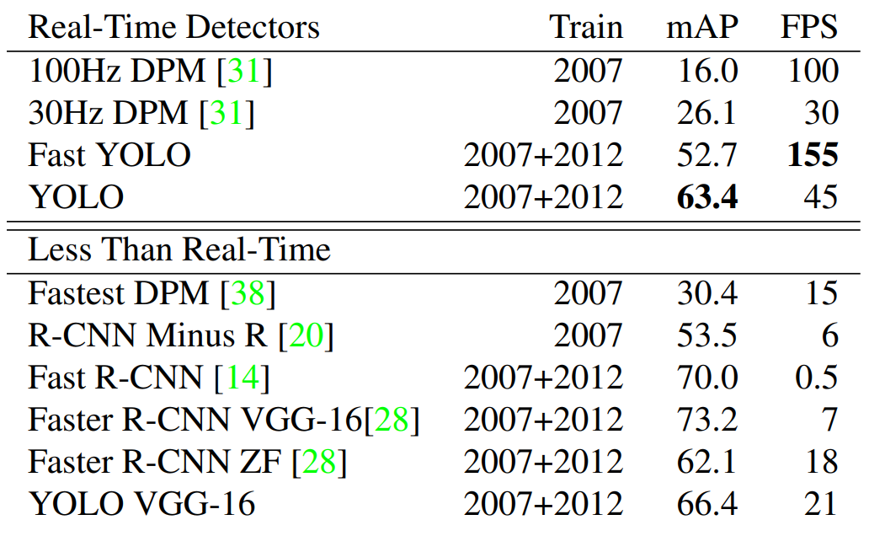
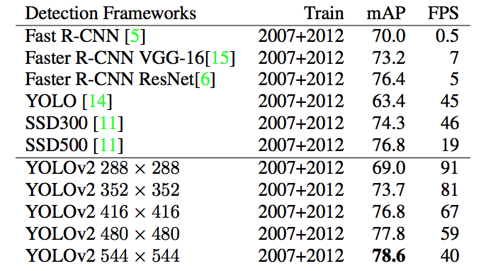
Performance comparison
Comparing the performance and speed of fast detectors. Fast YOLO is the fastest detector on record for PASCAL VOC detection and is still twice as accurate as any other real-time detector. YOLO is 10 mAP more accurate than the fast version while still well above real-time in speed.
Kookmin University
Notes:
The Gaussian distribution

Slide 7
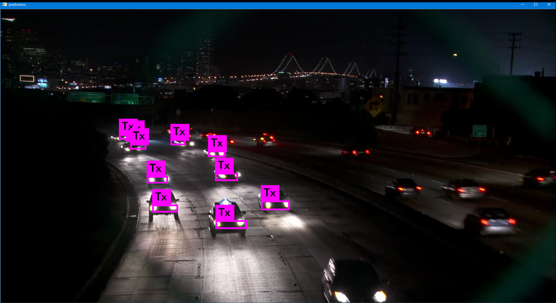
Vehicle front light detection
Vehicular front light detection using YOLO in Optical Vehicular Communication system
Kookmin University

Slide 8
References
[1] T. L. Pham, H. Nguyen, T. Nguyen, and Y. M. Jang, “A Novel Neural Network-Based Method for Decoding and Detecting of the DS8-PSK Scheme in an OCC System,” Applied Sciences, vol. 9, no. 11, p. 2242, May 2019.
[2] J. Redmon, S. Divvala, R. Girshick, and A. Farhadi, “You Only Look Once: Unified, Real-Time Object Detection”, arXiv, 2015
[3] J. Redmon and A. Farhadi, “YOLO9000: Better, Faster, Stronger”, arXiv, 2016
Notes:
YOLO9000:} Better, Faster, Stronger

