Slide 1
Project: IEEE P802.15 IG VAT
Submission Title: Neural Network Decoder for High-Rate Optical Vehicular Communication System
Date Submitted: November 2019
Source: Tung Lam Pham and Yeong Min Jang [Kookmin University].
Contact: +82-2-910-5068 E-Mail: yjang@kookmin.ac.kr
Re:
Abstract : Introduce the Neural Network Decoder for High-Rate Optical Vehicular Communication System
Purpose: Enhancing bit error rate (BER) in High-rate Optical Vehicular Communication System.
Notice: This document has been prepared to assist the IEEE P802.15. It is offered as a basis for discussion and is not binding on the contributing individual(s) or organization(s). The material in this document is subject to change in form and content after further study. The contributor(s) reserve(s) the right to add, amend or withdraw material contained herein.
Release: The contributor acknowledges and accepts that this contribution becomes the property of IEEE and may be made publicly available by P802.15.

Slide 2
Neural Network Decoder for High-rate Optical Vehicular Communication System
Notes:
Neural Network Decoder for High-rate Optical Vehicular Communication System

Slide 3
Challenges in Optical Vehicular Communication system
HS-PSK is a typical modulation scheme which had been introduced in IEEE 802.15.7-2018 standard as high-rate data scheme using in hybrid waveform of Optical Camera Communication (OCC) and Vehicle-to-Vehicle(V2V) scenario.
Commercialize OCC for Vehicular communication still be a challenging work due to the complexity of channel model caused by various type of noise and weather condition.
Can be modelled as two type: Additive White Gaussian noise (AWGN) and Blur (motion blur, rainy, snowy, foggy, etc.)
Kookmin University

Slide 4
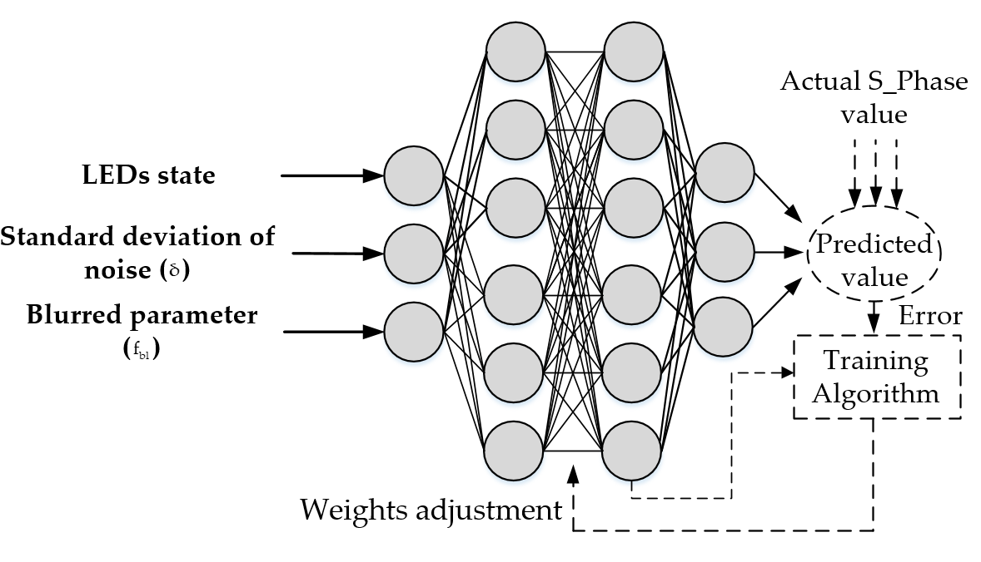
Neural Network Decoder
The neural network decoder principle and architecture for using in vehicular OCC system
A Neural Network Decoder learning from real-world input data can adjust its parameters to minimize the bias between a predicted value and the actual S_Phase value of a LED group based on the optimization algorithm.
Kookmin University

Slide 5
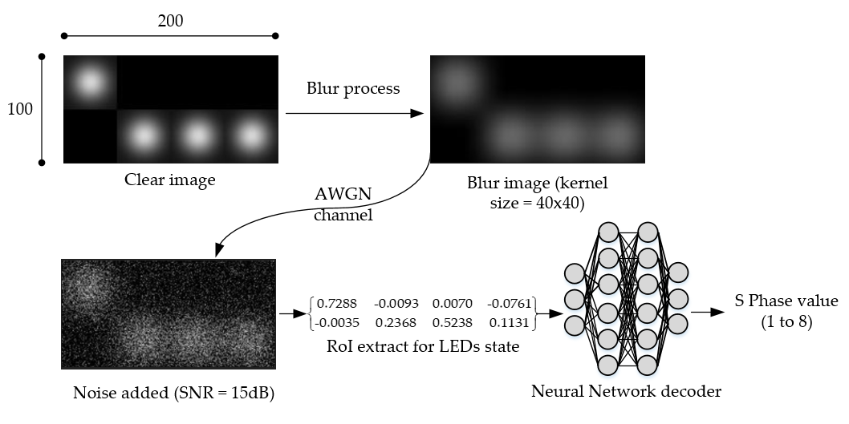
LED states extraction
The central points intensities are extracted from 16 LEDs in a pair of LED groups and translated to fuzzy logic states of 16 LEDs for input features of neuron network decoder. The image of both LED groups are contaminated by blur and white noise.
Kookmin University
Notes:
The Gaussian distribution

Slide 6
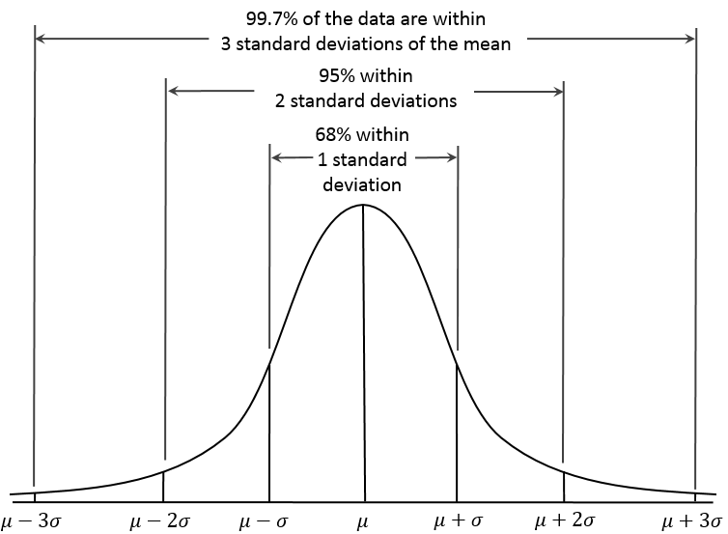
Standard deviation of noise
Additive Gaussian White Noise (AWGN), which follows Gaussian distribution
Kookmin University

Slide 7
Blur parameter
The received image of LEDs which is contaminated by the blur process and noise can be obtained by a convolutional process of the blur kernel with a clear image of LEDs, followed by the addition of noise, as follows:
where y is the captured image matrix, h is the blur kernel matrix, x is the original image matrix, and n is the noise matrix
The blur parameter is defined from dimming level and the ration between blur kernel area and image area.
Kookmin University

Slide 8
References
[1] T. L. Pham, H. Nguyen, T. Nguyen, and Y. M. Jang, “A Novel Neural Network-Based Method for Decoding and Detecting of the DS8-PSK Scheme in an OCC System,” Applied Sciences, vol. 9, no. 11, p. 2242, May 2019.
M. D. Thieu, T. L. Pham, T. Nguyen and Y. M. Jang, "Optical-RoI-Signaling for Vehicular Communications," IEEE Access, vol. 7, pp. 69873-69891, 2019.
Notes:
M. D. Thieu, T. L. Pham, T. Nguyen and Y. M. Jang, "Optical-RoI-Signaling for Vehicular Communications," IEEE Access, vol. 7, pp. 69873-69891, 2019.

