Slide 1
Project: IEEE P802.15 IG VAT
Submission Title: The potential of vehicular assistance technology (VAT) standardization using optical camera communication (OCC)
Date Submitted: Oct 2019
Source: Cong Hoan Nguyen and Yeong Min Jang [Kookmin University].
Contact: +82-2-910-5068 E-Mail: yjang@kookmin.ac.kr
Re:
Abstract : Introduce the potential standardization using optical camera communication in vehicular systems.
Purpose: To assist vehicular system
Notice: This document has been prepared to assist the IEEE P802.15. It is offered as a basis for discussion and is not binding on the contributing individual(s) or organization(s). The material in this document is subject to change in form and content after further study. The contributor(s) reserve(s) the right to add, amend or withdraw material contained herein.
Release: The contributor acknowledges and accepts that this contribution becomes the property of IEEE and may be made publicly available by P802.15.

Slide 2
The potential of vehicular assistance technology (VAT) standardization using optical camera communication (OCC)

Slide 3

Introduction
Optical Camera Communications (OCC)
A Pragmatic Form of Visible Light Communications
OCC is modulating an LED light with data bits that can be received by a camera, which then decodes the bits and extracts the data.
Today we have millions of mobile devices enabled to receive visible light communications via the camera, but we lack standards to describe the modulation format.
This contribution discusses some OCC topics of interest.
Kookmin University

Slide 4


Introduction
Basic idea:
each LED sign uses OCC to broadcast URL info
multiple parallel transmissions received by camera
each web page accessed via RAN
Google Glass displays webpage next to related LED sign
added information augments users reality
Augmented
Reality
Kookmin University

Slide 5

Introduction
Comphotogrammetry: the merger of OCC and Photogrammetry such that light sources become self-identifying anchor features
1HGCM82633A004352
rightt rear taillight
<x,y,z>
1HGCM82633A004352
rightt rear taillight
<x,y,z>
1HGCM82633A004352
center rear taillight
<x,y,z>
1HGCM82633A004352
rightt rear taillight
<x,y,z>
1HGCM82633A004352
rightt rear taillight
<x,y,z>
1HGCM82633A004352
left rear taillight
<x,y,z>
1HGCM82633A004352
rightt rear taillight
<x,y,z>
1HGCM82633A004352
rightt rear taillight
<x,y,z>
1HGCM82633A004352
rightt rear taillight
<x,y,z>
High Resolution Automobile Positioning
Kookmin University

Slide 6
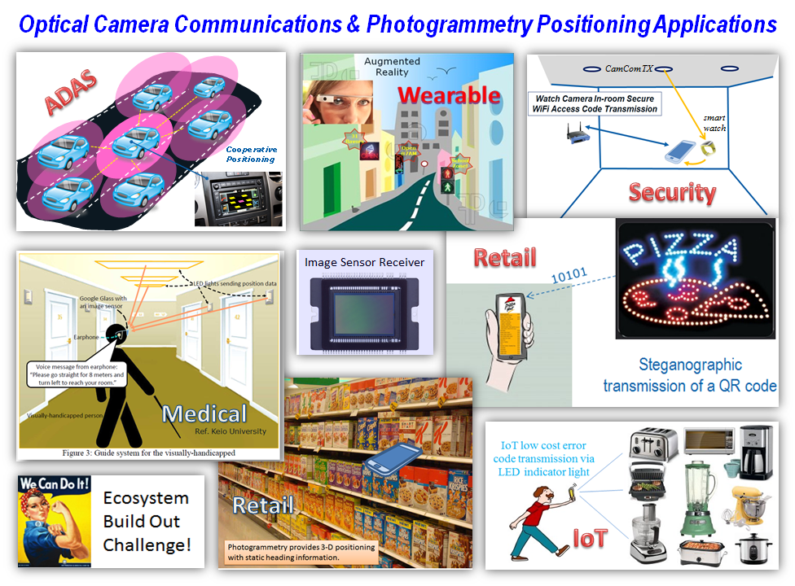
Introduction
Kookmin University

Slide 7
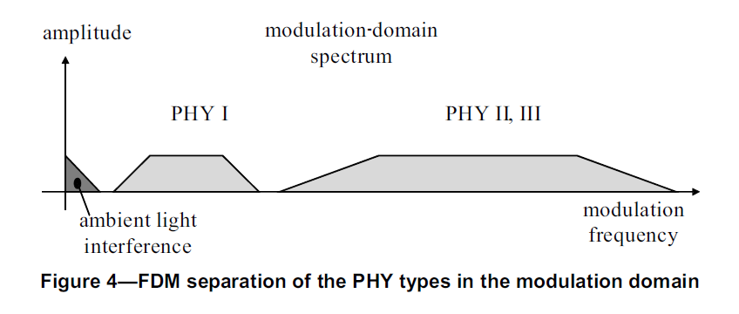
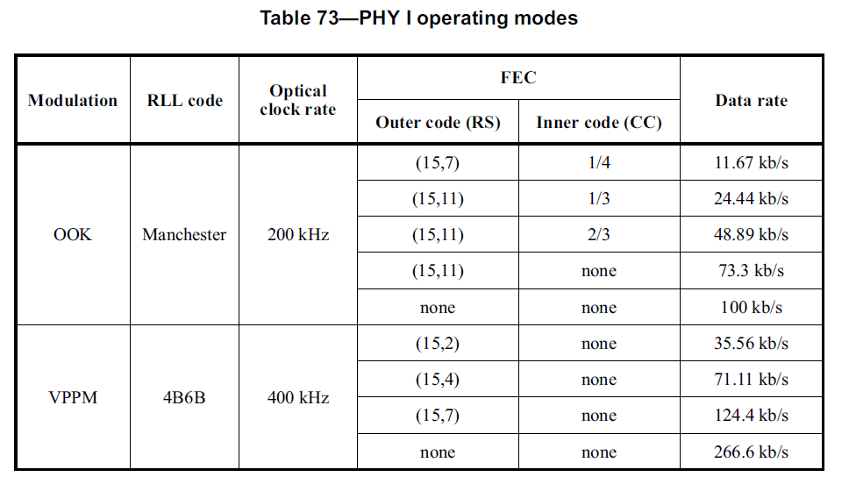
Standardization using optical camera communication
Kookmin University

Slide 8
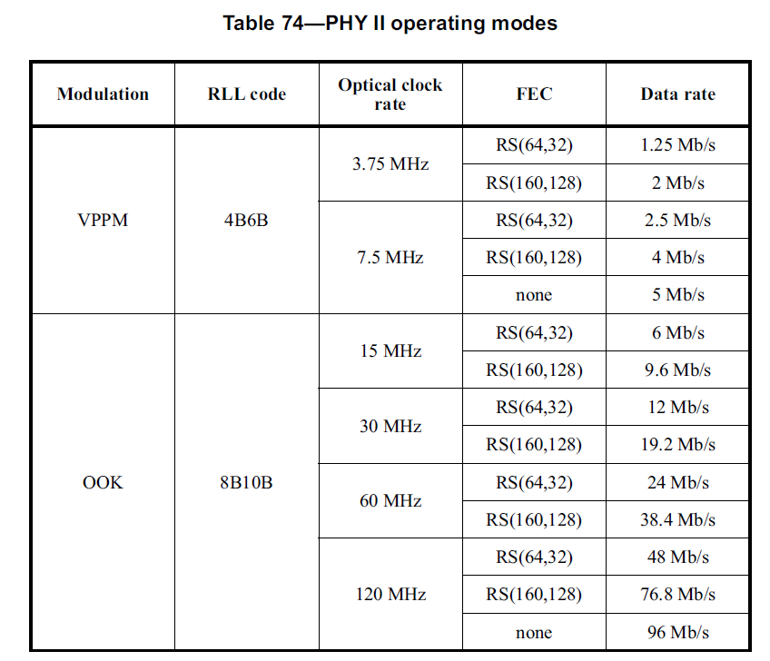
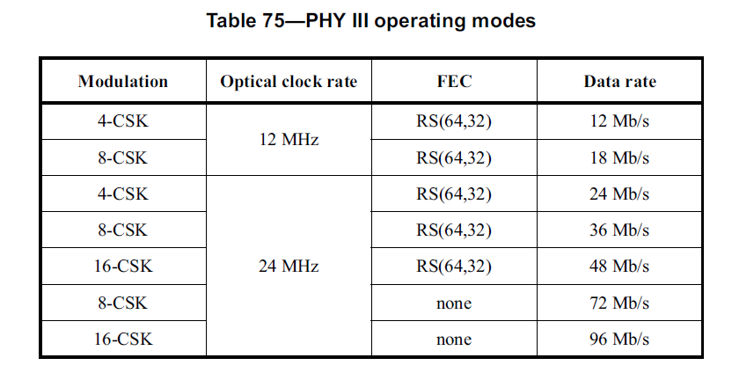
Standardization using optical camera communication
Kookmin University

Slide 9
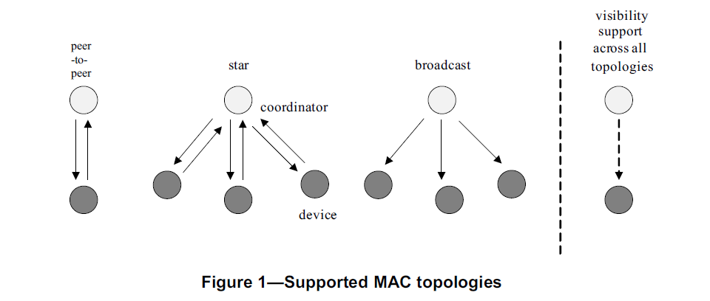
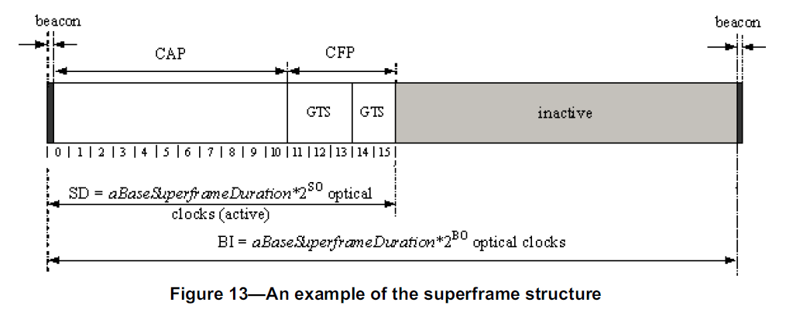
Standardization using optical camera communication
Kookmin University

Slide 10
Conclusion
The official TG7m web page reports the current progress of the standard. Notably, the draft standard is expected to be ready for letter balloting by December 2017.
Hopefully, the standard will be published in December 2018. The upcoming time from 2019 onwards will be a run of commercial products releasing and market acceptance.
The number of other companies getting interested in OCC keeps increasing and a bright future for OCC is predictable.
Kookmin University

Slide 11
References
[1]T. Nguyen, A. Islam, M. T. Hossan, and Y. M. Jang, “Current Status and Performance Analysis of Optical Camera Communication Technologies for 5G Networks,” IEEE Access, vol. 5, no. , pp. 4574-4594, 2017.
[2]A. Islam, M. A. Hossain, T. Nguyen, and Y. M. Jang, “High temporal spatial resolution optical wireless communication technique using image sensor,” in Proc. of 2016 International Conference on Information and Communication Technology Convergence (ICTC), Jeju, 2016, pp. 1165- 1169.

