Slide 1
Project: IEEE P802.15 IG VAT
Submission Title: Artificial Intelligence Applications in High-rate Optical Vehicular Communication System
Date Submitted: November 2019
Source: Tung Lam Pham, Huy Nguyen and Yeong Min Jang [Kookmin University].
Contact: +82-2-910-5068 E-Mail: yjang@kookmin.ac.kr
Re:
Abstract : Introduce the applications of AI in High-rate Optical Vehicular Communication System
Purpose: Increasing communication range and reliability of the high-rate Optical Vehicular Communication System.
Notice: This document has been prepared to assist the IEEE P802.15. It is offered as a basis for discussion and is not binding on the contributing individual(s) or organization(s). The material in this document is subject to change in form and content after further study. The contributor(s) reserve(s) the right to add, amend or withdraw material contained herein.
Release: The contributor acknowledges and accepts that this contribution becomes the property of IEEE and may be made publicly available by P802.15.

Slide 2
Artificial Intelligence Applications in High-rate Optical Vehicular Communication system

Slide 3
Challenges in Optical Vehicular Communication system
HS-PSK is a typical modulation scheme which had been introduced in IEEE 802.15.7-2018 standard as high-rate data scheme using in hybrid waveform of Optical Camera Communication (OCC) and Vehicle-to-Vehicle(V2V) scenario.
Commercialize OCC for Vehicular communication still be a challenging work due to the complexity of channel model caused by various type of noise and weather condition.
These technical issues lead to the design of an adaptive Rx that could be trained to self-modify its parameters and better reflect the correlation between real-world input data and our desired system output
Kookmin University

Slide 4
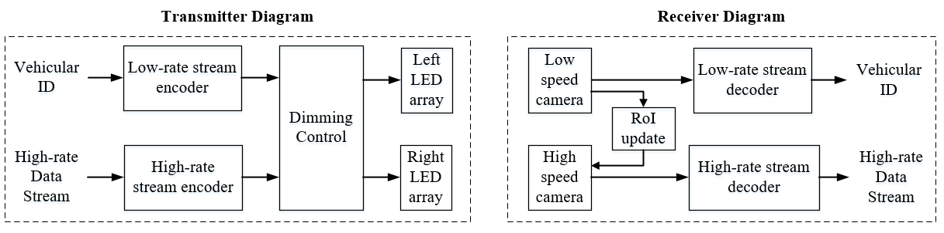
Optical Vehicular Communication system
Hybrid region-of-interest (RoI)-signaling OCC system is proposed in IEEE 802.15.7-2019 to mitigate the processing workload of Rx and minimize the computational cost of the system.
Architecture of the vehicular OCC system using hybrid modulation scheme
Kookmin University
Notes:
The Gaussian distribution

Slide 5
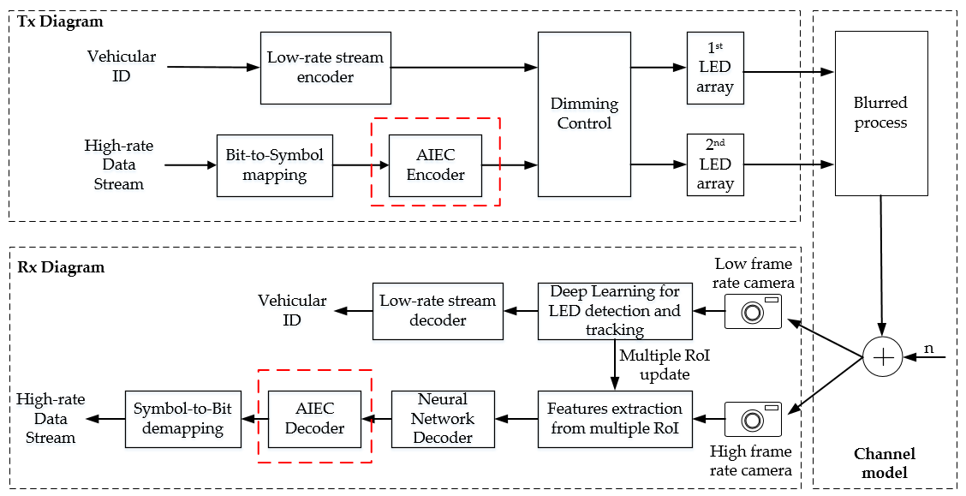
AI-based Error Correction
AIEC encoder: By using an unique pre-defined mapping rule, the datastream is encoded to a new bitstream.
AIEC decoder: Base on the neural network principle, which is pre-trained to learn the pre-defined mapping rule. AIEC decoder then be used to decode the original datastream from the received bitstream.
Kookmin University

Slide 6
AI-based RoI detection and tracking
LED detection and tracking: You Only Look Once (YOLO) platform can be used for real-time light source detection.
Low-rate data stream is used to make a receiver be able to distinguish the actual transmitters among all detected light source.
Kookmin University

Slide 7
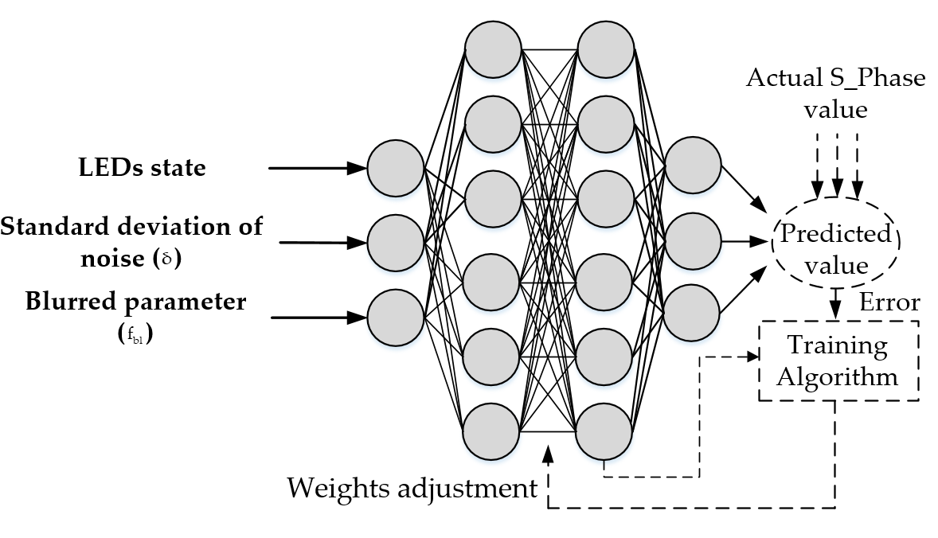
Neural Network Decoder
The neural network decoder principle and architecture for using in vehicular OCC system
A Neural Network Decoder learning from real-world input data can adjust its parameters to minimize the bias between a predicted value and the actual S_Phase value of a LED group based on the optimization algorithm.
Kookmin University

Slide 8
References
[1] T. L. Pham, H. Nguyen, T. Nguyen, and Y. M. Jang, “A Novel Neural Network-Based Method for Decoding and Detecting of the DS8-PSK Scheme in an OCC System,” Applied Sciences, vol. 9, no. 11, p. 2242, May 2019.
[2] T. L. Pham, T. Nguyen, M. D. Thieu, H. Nguyen, H. Nguyen and Y. M. Jang, “An Artificial Intelligence-Based Error Correction for Optical Camera Communication," 2019 Eleventh International Conference on Ubiquitous and Future Networks (ICUFN), Zagreb, 2019

