Slide 1
Project: IEEE P802.15 Working Group for Wireless Personal Area Networks (WPANs)
Submission Title: OWC beacon-based Mobile Mini House Fixing and Loading Management on the Seaside Warehouse
Date Submitted: January 2019
Source: Jaesang Cha (VTASK Co., Ltd), Juphil Cho (Kunsan National Univ.), Sangwoon Lee (Namseoul Univ.), Komolov Shokhrukh, Li Vadim, Jungdo Han (SNUST), Daeyoon Cha (VTASK Co., Ltd), Hwang Hyeonseok (Seoil Univ.), Jinyoung Kim (Kwangwoon Univ.), YoungMin Kim (Welfrun Co., Ltd), Hyejeong Cho (RIZM), Timur Khudaybergenov, Deokgun Woo (SNUST), Sooyoung Chang (SYCA) Minwoo Lee(SNUST)
Address: Contact Information: +82-2-970-6431, FAX: +82-2-970-6123, E-Mail: chajs@seoultech.ac.kr
Re:
Abstract: This documents introduce the high speed optical wireless communications link model proposed to introduce the possibility of using light communication for beacon-based carrier ship docking and loading management on the seaside warehouse solution. This proposed solution can be utilized as a part of a complex of monitoring, logistics and scheduling.
Purpose: To provided concept models of Li-Fi based OCC solution for Vehicular Assistant Technology (VAT) Interest Group
Notice: This document has been prepared to assist the IEEE P802.15. It is offered as a basis for discussion and is not binding on the contributing individual(s) or organization(s). The material in this document is subject to change in form and content after further study. The contributor(s) reserve(s) the right to add, amend or withdraw material contained herein.
Release: The contributor acknowledges and accepts that this contribution becomes the property of IEEE and may be made publicly available by P802.15.
Slide 1

Slide 2
Contents
Needs for Mobile Mini House Fixing and Loading Management
OWC beacon-based Mobile Mini House Fixing and Loading Management on the Seaside Warehouse
Conclusion
Slide 2

Slide 3
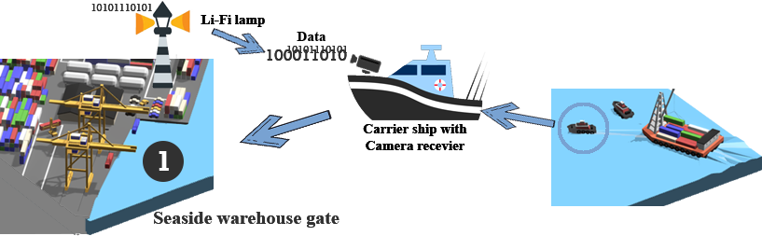
Needs for Mobile Mini House Fixing and Loading Management
Needs
  To pay high-price of time management of carrier ship docking and loading and unloading activities o seaside warehouse sites
  Requires easy solution to provide optimal scheduling and docking gates recognizing, staying time, working scope and prevent fail loading and unloading.
  Basic concept
  Operative information broadcasting to load carrying ships about correct position of the seaside warehouse gate
  Information providing for time timetabling
  Information providing for working scope (For example, use case – Type of cargo which should be uploaded or downloaded in particular gate)
  < High Speed OWC Link Based Container Management System >
Slide 3

Slide 4
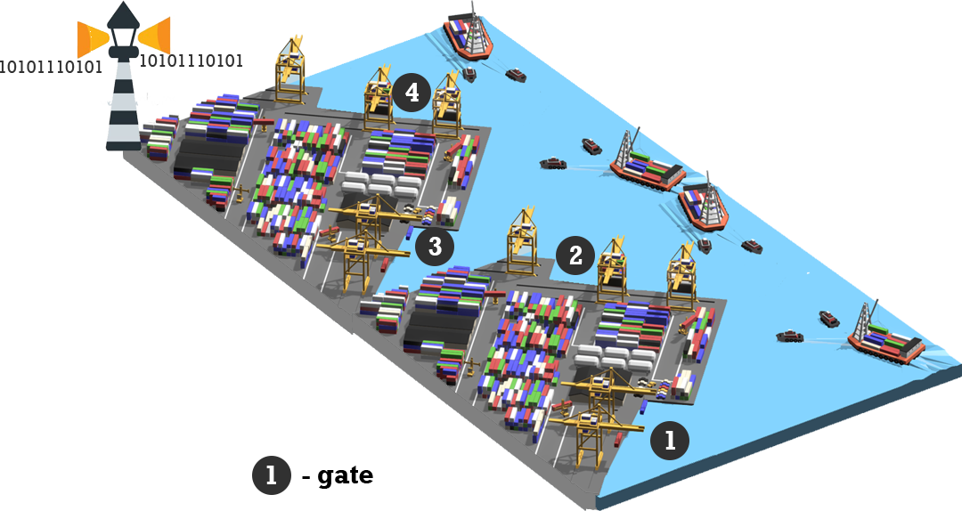
OWC beacon-based Mobile Mini House Fixing and Loading Management on the Seaside Warehouse
OWC beacon-based Mobile Mini house Fixing and Loading Management
  Tx : Lamp
  Rx : Camera Installed on Truck
  Modulations :
    OOK, VPPM, Offset-VPWM, Multilevel PPM, Inverted PPM, Subcarrier PPM, DSSS SIK etc.
    Day-Night Communication Mode
  Data Rate : 1K ~ 1Mb/s
  Supported LoS(Line of Sight)
  Available Distance : 60m around
  < Mobile Mini House Fixing and Loading Management>
Slide 4

Slide 5
Conclusion
Proposed the OWC beacon-based Mobile Mini House Fixing and loading management on the seaside warehouse
Uses the existing LED Lamp Light sources, used in the Seaside Warehouse gates outside lighting site and carrier ships built-in cameras
Proposed solution can be utilized as a part of a complex of logistics, monitoring and timetabling, etc.
Slide 5

