Slide 1
Project: IEEE P802.15 Working Group for Wireless Personal Area Networks (WPANs)
Submission Title: Image Sensor Communication Linked IoT Opensource Light Controller for Automatic Control System
Date Submitted: September 2019
Source: Jaesang Cha (VTASK Co., Ltd), Jinyoung Kim (Kwangwoon Univ.), Youngkeun Yoon (Kogen Co., Ltd), Sunghoon Yoon (Kogen Co., Ltd) , Kilsoo Lee (Kogen Co., Ltd) , Vinayagam Mariappan (SNUST)
Address: Contact Information: +82-2-970-6431, FAX: +82-2-979-7903, E-Mail: chajaesang@gmail.com
Re:
Abstract: This documents introduce the V2X image sensor communication (ISC) link design consideration for VAT. This proposed image sensor communication link for automatic control system solution using opensource IoT opensource light controller. This solution can used for OWC based indoor and outdoor monitoring, ITS, ADAS, remote weather monitoring, etc.
Purpose: To provided concept models of visible light communication based ISC for Vehicular Assistant Technology (VAT) Interest Group.
Notice: This document has been prepared to assist the IEEE P802.15. It is offered as a basis for discussion and is not binding on the contributing individual(s) or organization(s). The material in this document is subject to change in form and content after further study. The contributor(s) reserve(s) the right to add, amend or withdraw material contained herein.
Release: The contributor acknowledges and accepts that this contribution becomes the property of IEEE and may be made publicly available by P802.15.
Slide 1

Slide 2
Contents
Need for Automatic Control System Solution
IoT Opensource Light Controller for Automatic Control System
Conclusion
Slide 2

Slide 3
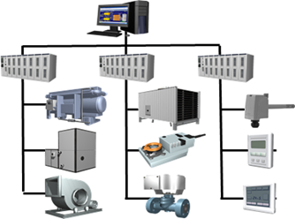
Need for Automatic Control System Solution
Needs
automatic controls is enormous, covering the control of variables such as temperature, pressure, flow level, and speed.
The process plant or buildings require automatic controls to provide Safety, Stability, and Accuracy to provide quality, efficiency and maintain comfort on system in use.
IoT based automatic control system consist of the plant, the detecting or sensing element, the measuring or indicating element, the controller, and connectivity elements
Basic concepts
Uses the Camera installed IoT open source LED light controller connected with control system module to provide automatic control system solution using visible light based image sensor communication (ISC) for connectivity.
The facility installed CCTV Camera and LED Lights with Camera installed on IoT opensource LED light controller provided light communication based ISC link to provide automatic control on process plant or buildings facility.
< Existing Control System Concept Model >
Slide 3

Slide 4
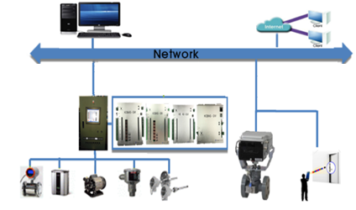
IoT Opensource Light Controller for Automatic Control System
Open Source Light Controller based ISC Link for Automatic System Control Solution
Tx : Facility LED Light
Rx : Facility and IoT Open Source Controller Cameras
Day-Night Communication Mode
Modulations :
OOK, VPPM, Offset-VPWM, Multilevel PPM, Inverted PPM, Subcarrier PPM, DSSS SIK etc.
Data Rate : 1K ~ 1Mb/s
Supported LoS (Line of Sight)
Available Distance : 500m around
Monitoring
Remote Control
ISC Link
ISC Link
ISC Link
Control Systems
< ISC Link for Automatic Control Solution >
Camera Embedded IoT Open Source Light Controller connected with facility control system module to provide automatic control system solution using ISC link.
Access Control System solution using IoT Open Source light Controller based on ISC Link provides flexible , secure, and efficient facility system control.
Slide 4

Slide 5
Conclusion
Proposed the image sensor communication (ISC) linked IoT open source light controller for automatic control system for process plant or buildings .
Uses the Camera embedded IoT open source LED light controller connected with control and provides automatic facility system control using image sensor technology.
Facility Cameras and LED Light with IoT open source LED light controller installed camera provides image sensor based optical wireless communication link to do facility system control.
Slide 5

