Slide 1
Project: IEEE P802.15 Working Group for Wireless Personal Area Networks (WPANs)
Submission Title: Smart Access Control Solution Using IoT Open Source Controller For Smart Building
Date Submitted: September 2019
Source: Jaesang Cha (VTASK Co., Ltd), Jinyoung Kim (Kwangwoon Univ.), Youngkeun Yoon (Kogen Co., Ltd), Sunghoon Yoon (Kogen Co., Ltd) , Kilsoo Lee (Kogen Co., Ltd) , Vinayagam Mariappan (SNUST)
Address: Contact Information: +82-2-970-6431, FAX: +82-2-979-7903, E-Mail: chajaesang@gmail.com
Re:
Abstract: This documents introduce the V2X optical wireless communications (OWC) link design consideration for VAT. This proposed optical wireless link model uses IoT open source controller embedded with LED Controllers and the Camera for smart access control in smart building using smart devices. This solution can used for OWC based indoor and outdoor monitoring, ITS, ADAS, remote weather monitoring, etc.
Purpose: To provided concept models of the optical wireless communications solution for Vehicular Assistant Technology
Notice: This document has been prepared to assist the IEEE P802.15. It is offered as a basis for discussion and is not binding on the contributing individual(s) or organization(s). The material in this document is subject to change in form and content after further study. The contributor(s) reserve(s) the right to add, amend or withdraw material contained herein.
Release: The contributor acknowledges and accepts that this contribution becomes the property of IEEE and may be made publicly available by P802.15.
Slide 1

Slide 2
Contents
Needs for Smart Access Control Solution
Smart Access Control Solution Using IoT Open Source Controller
Conclusion
Slide 2

Slide 3
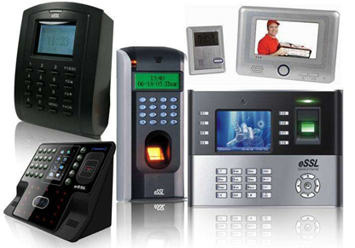
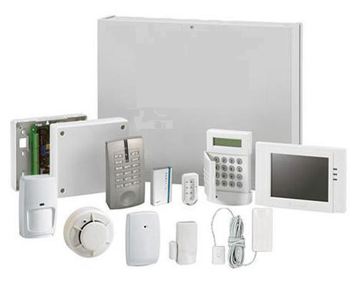
Needs for Smart Access Control Solution
Needs
The safety and security of people, property and premises plays an important role due to unbalanced social and economical conditions of the human life.
Secure access control solutions and locking systems are in demand in industry, small companies, public institutions, and homes, etc. as are easy-to-use economical access solutions.
Smart device based flexible , secure, and safety access solution is the key focus point on smart access control solutions.
Basic concepts
Uses the LED controllers and Camera embedded IoT open source controller connected with access controller to provide smart access control solution using smart device.
Smart device Camera and Flash Light with LED and Camera on IoT open source controller provided light communication based optical wireless link to give smart access control for the end user.
Optical wireless communication is more secure and reliable than RF communication interfaces.
GOOGLE
< Commercial Access Control Systems >
Slide 3

Slide 4
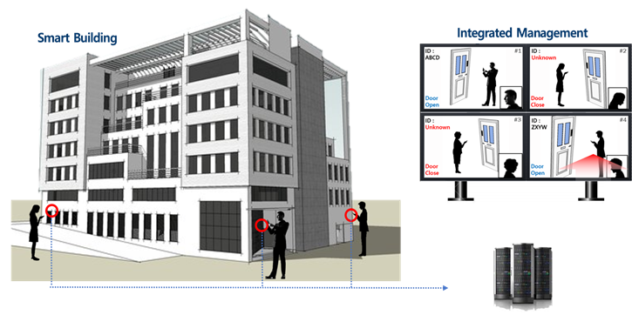
Smart Access Control Solution Using IoT Open Source Controller
Open Source Controller based OWC Link for Smart Access Control in Smart Building
Tx : LED and Flash Light
Rx : Smart Device and IoT Open Source Controller Cameras
Day-Night Communication Mode
Modulations :
OOK, VPPM, Offset-VPWM, Multilevel PPM, Inverted PPM, Subcarrier PPM, DSSS SIK etc.
Data Rate : 1K ~ 1Mb/s
Supported LoS (Line of Sight)
Available Distance : 500m around
OWC Link
OWC Link
Integrated Monitoring Server
< OWC Link based Smart Access Control System Using Open Source Controller >
Embedding LED Controllers and the Camera on the IoT Open Source Controller Panels connected with access controller provides smart access control using smart devices for smart building solution.
Access Control using IoT Open Source Controller based on OWC Link provides flexible , secure, and safety user access.
Slide 4

Slide 5
Conclusion
Proposed the smart access control solution through optical wireless communication link on smart devices using IoT open source controller for smart building.
Uses the LED controllers and Camera embedded IoT open source controller connected with access controller to provide smart access control solution using smart device.
Smart device Camera and Flash Light with LED and Camera on IoT open source controller provided light communication based optical wireless link to give smart access control for the end user.
Proposed Access Control using IoT open source controller based on OWC Link provides flexible , secure, and safety user access in buildings.
Slide 5

