Slide 1
Project: IEEE P802.15 Working Group for Wireless Personal Area Networks (WPANs)
Submission Title: VLC interconnected Sensor Controller for Power Generation Facilities Condition Monitoring
Date Submitted: September 2019
Source: Jaesang Cha (SNUST, VTASK Co., Ltd), Kaewon Choi (SKKU), Kim Jintae, Song Hunsub, Yang Seungyoun, Shin Jaekwon (Fivetek Co., Ltd.), Vinayagam Mariappan (SNUST)
Address: Contact Information: +82-2-970-6431, FAX: +82-2-979-7903, E-Mail: chajaesang@gmail.com
Re:
Abstract: This documents introduce the V2I VLC Link design consideration for VAT. This proposed VLC technology used in the sensor integrated controller design for power generation facilities condition monitoring solutions. This VAT solution can be used to operate on the application services like ITS, Indoor and outdoor monitoring, and other connected condition monitoring services etc.
Purpose: To provided concept models of VLC for Vehicular Assistant Technology (VAT) Interest Group Notice: This document has been prepared to assist the IEEE P802.15. It is offered as a basis for discussion and is not binding on the contributing individual(s) or organization(s). The material in this document is subject to change in form and content after further study. The contributor(s) reserve(s) the right to add, amend or withdraw material contained herein.
Release: The contributor acknowledges and accepts that this contribution becomes the property of IEEE and may be made publicly available by P802.15.
Slide 1

Slide 2
Contents
Need for Power Generation Facilities Condition Monitoring
VLC interconnected Sensor Controller for Power Generation Facilities
Conclusion
Slide 2

Slide 3
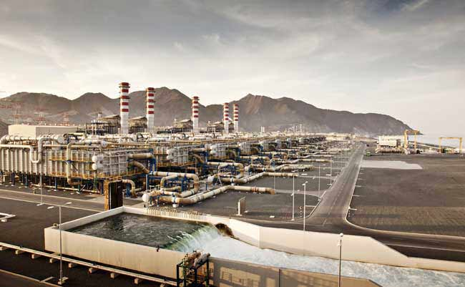
Need for Power Generation Facilities Condition Monitoring
Needs
Power generation facilities condition monitoring plays a significant role for efficient power generation.
By employing an effective solution that monitors the temperature, pressure, and humidity levels of a plant’s assets, operators can diagnose problems inconsistencies among power generation processes.
Need to continuously monitor the facilities condition before y become problems saves downtime and replacement costs.
Basic Concept
Proposed the Mobile sensing system with optical wireless link using visible light communication technology to transmit the data through surveillance network.
Cane be used in various power generation facilities like nuclear power, biogas and an increasing use of renewables such as solar, wind, wave and hydroelectric, etc.
GOOGLE
< Power Generation Facilities >
Slide 3

Slide 4
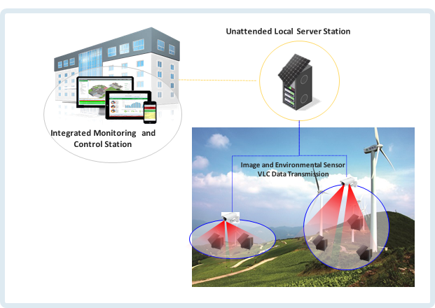
VLC interconnected Sensor Controller for Power Generation Facilities
VLC Link Integrated Sensor Controller System for Power Generation Facilities Condition Monitoring
Tx : LED Light Installed in Mobile Sensor System
Rx : CCTV Camera Installed in Indoor Facility
Day-Night Communication Mode
Modulations
OOK, VPPM, Offset-VPWM, Multilevel PPM, Inverted PPM, Subcarrier PPM, DSSS SIK etc.
Data Rate : 1K ~ 1Mb/s
Supported LoS (Line of Sight)
Available Distance : 5m ~ 200m
< VLC Integrated Sensor Controller for Remote Wind Power Generation Facilities >
※ Sense and transmit the power condition information to the integrated monitoring and control system trough VLC link using sensor unit attached LED light and CCTV installed for surveillance.
※ Used to predict the power generation facilities condition and required instant emergency control.
Slide 4

Slide 5
Conclusion
Proposed the VLC interconnected sensor controller for remote power generation facilities condition monitoring.
Proposed solution, sense and transmit the power condition information to the integrated monitoring and control system trough VLC link using sensor unit attached LED light and CCTV installed for remote surveillance.
Used to predict the power generation facilities condition and required instant emergency control.
Proposed solution can be utilized as a part of a complex of environment monitoring system in indoor and outdoor environment.
Slide 5

