Slide 1
Project: IEEE P802.15 Working Group for Wireless Personal Area Networks (WPANs)
Submission Title: Vehicular Edge Computing Enabled IoT/IoL Connected Vehicle for Onroad Distracted Driving Prediction and Control
Date Submitted: September 2019
Source: Jaesang Cha (SNUST), Sangwoon Lee (Namseoul Univ.), Jintae Kim (Fivetek Co., Ltd.), Sooyoung Chang (SYCA), Vinayagam Mariappan (SNUST)
Address: Contact Information: +82-2-970-6431, FAX: +82-2-970-6123, E-Mail: chajs@seoultech.ac.kr
Re:
Abstract: This documents introduce V2X IoT/IoL connectivity link design considerations for VAT. This proposed IoT/IoL connectivity link between cars uses the vehicular edge computing technology on gathered sensor data to decide on distracted driving and forward the data to onroad connected vehicles and ITS Server. Also this VAT solutions can used to operate on the application services like ITS, ADAS, etc. on road condition
Purpose: To provided concept models of the high speed optical wireless/light communications solution for Vehicular Assistant Technology
Notice: This document has been prepared to assist the IEEE P802.15. It is offered as a basis for discussion and is not binding on the contributing individual(s) or organization(s). The material in this document is subject to change in form and content after further study. The contributor(s) reserve(s) the right to add, amend or withdraw material contained herein.
Release: The contributor acknowledges and accepts that this contribution becomes the property of IEEE and may be made publicly available by P802.15.
Slide 1

Slide 2
Contents
Needs of Vehicular Edge Computing in Vehicles
Vehicular Edge Computing Enabled IoT/IoL Connected Vehicles
Conclusion
Slide 2

Slide 3
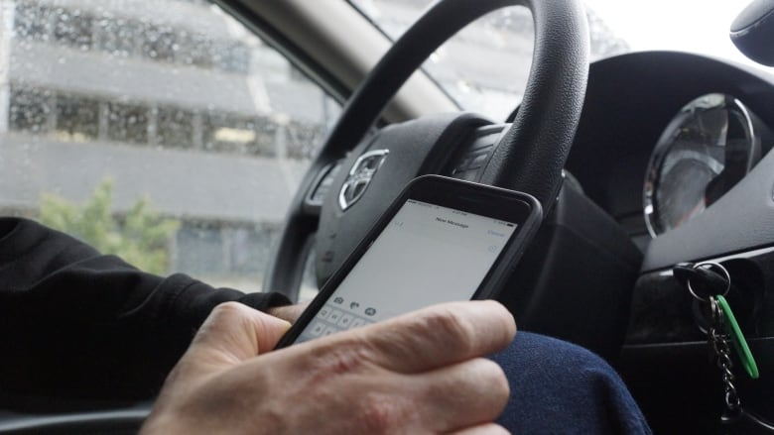
Needs of Vehicular Edge Computing in Vehicles
Needs
Distracted driving is an critical activity that diverts attention from driving, including talking or texting on your phone, eating and drinking, talking to people in side vehicle, fiddling with the stereo, entertainment or navigation system, Driving after drinking, Sleeping while driving, etc.
Even the best drivers sometimes fall back on bad driving habits
To prevent the accidents, vehicles need to embed the Vehicular Edge Computing method to detect the onroad vehicles driving habits and connectivity between vehicles to forward those information to connected vehicles.
Basic Concept
Vehicular Edge Computing, has been introduced in recent years to the vehicular network to augment its computing capacity.
Uses the Camera and ADAS information to implement Vehicular Edge Computing to analyze the driving habits.
Uses the vehicle light based IoT/IoT communication link to enable connectivity between vehicles.
Google
< Onroad Distracted Driving Scenario >
Google
< Roadway Vehicle Accident Scenario >
Slide 3

Slide 4
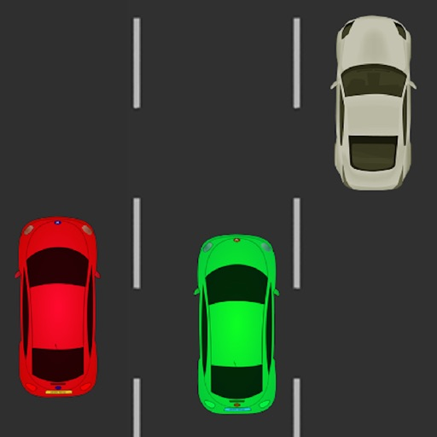
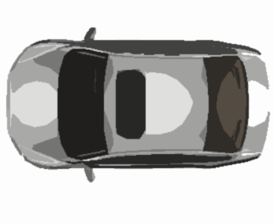
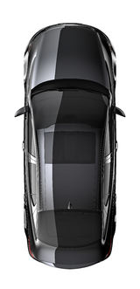
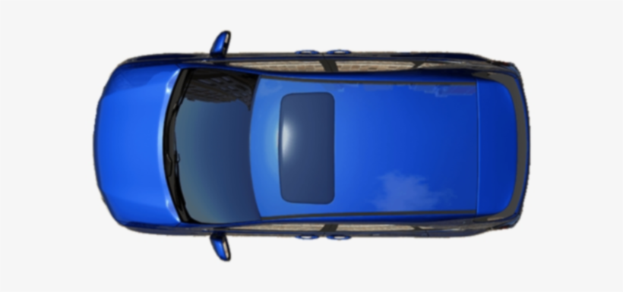
Vehicular Edge Computing Enabled IoT/IoL Connected Vehicles
Vehicular Edge Computing Embedded connected Vehicles using IoT/IoL Link
Tx : Head, Tail, Side lights on Car
Rx : Camera Installed on Car
Day-Night Communication Mode
Modulations
OOK, VPPM, Offset-VPWM, Multilevel PPM, Inverted PPM, Subcarrier PPM, DSSS SIK etc.
Data Rate : 1K ~ 5Mb/s
Supported LoS (Line of Sight)
Available Distance : 5m ~ 200m
IoT/IoL Link
IoT/IoL Link
< Edge Computing Enabled IoT/IoL Connected Vehicles >
※ Use the Vehicular Edge Computing technology on vehicle to predict the status of car, driving habit, traffic status, etc. and the predicted information's are shared to the connected vehicles using IoT/IoL optical wireless link.
Slide 4

Slide 5
Conclusion
Proposed the vehicular edge computing enabled IoT/IoL connected vehicle for onroad distracted driving prediction and control
Uses the head, tail and side lights of the vehicle to transmit the vehicle and road condition information's and uses the camera installed in the vehicle to decode using image sensor communication technology.
The propose method provides efficient method to predict distracted driving and avoid accidents in the roadway.
Slide 5

