Slide 1
Project: IEEE P802.15 Working Group for Wireless Personal Area Networks (WPANs)
Submission Title: Warehouse Position Localization Using OCC Link for Solar Powered Warehouse Safety Solution
Date Submitted: September 2019
Source: Jaesang Cha (VTASK Co., Ltd), Juphil Cho (Kunsan National Univ.), Sangwoon Lee (Namseoul Univ.), Hwang Hyeonseok (Seoil Un.v.), Daeyoon Cha (VTASK Co., Ltd), YoungMin Kim (Welfrun Co., Ltd), Kaewon Choi (SKKU),Minsoo Kim(Sang Rim Corp.), Taejoon Park(Sang Rim Corp.), Hyejeong Cho (RIZM), Sung Hoon Yoon (Kogen Corp.),Timur Khudaybergenov (SNUST), Deokgun Woo (SNUST), Vinayagam Mariappan (SNUST)
Address: Contact Information: +82-2-970-6431, FAX: +82-2-970-6123, E-Mail: chajs@seoultech.ac.kr
Re:
Abstract: This documents introduce the V2I Optical Wireless link design consideration for VAT. This proposed optical camera communication (OCC) link using visible light communication (VLC) technology to do position localization of an Fire Fighting Drone in the smart warehouse security Service. This solution is introduced as a part of a complex of security and logistics automation in the smart warehouse.
Purpose: To provided concept models of OCCs Link using VLC technology for Vehicular Assistant Technology (VAT) Interest Group
Notice: This document has been prepared to assist the IEEE P802.15. It is offered as a basis for discussion and is not binding on the contributing individual(s) or organization(s). The material in this document is subject to change in form and content after further study. The contributor(s) reserve(s) the right to add, amend or withdraw material contained herein.
Release: The contributor acknowledges and accepts that this contribution becomes the property of IEEE and may be made publicly available by P802.15.
Slide 1

Slide 2
Contents
Needs for Security Drone in Warehouse Security
OCC Link Based Security Drone Position Localization
Conclusion
Slide 2

Slide 3
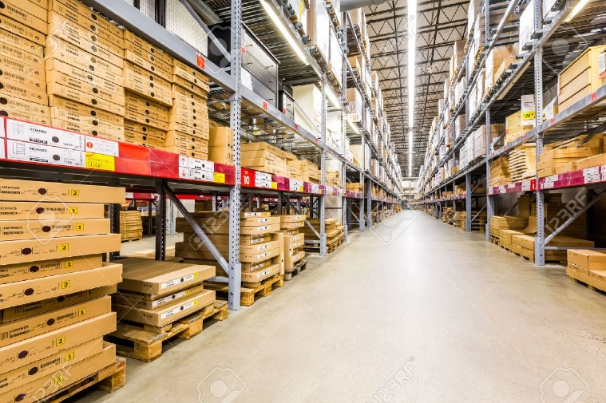
Needs for Security Drone in Warehouse Security
Needs
Warehouses and storage facilities are often targeted by burglars or nature fire accidents due to stocked items.
To provide reliable warehouse security, everything logistic items risk-related needs to be factored in, from theft prevention, access control, surveillance, fire and safety, to disaster recovery, data security and environmental monitoring.
Drones already used for emergency and disaster management programs, national weather service tracking and traffic management programs, etc.
Need to add connectivity between warehouse infrastructure and security service drone.
Basic concept
Uses the warehouse lightings built-in sensor interface to transmit the warehouse area environmental conditions and Drone installed with camera to receive information using light communication technology to predict the every areas environmental safety measures.
Google
< Warehouse Logistic Storage Area >
Google
< Fire in Warehouse Logistic Storage Area >
Slide 3

Slide 4
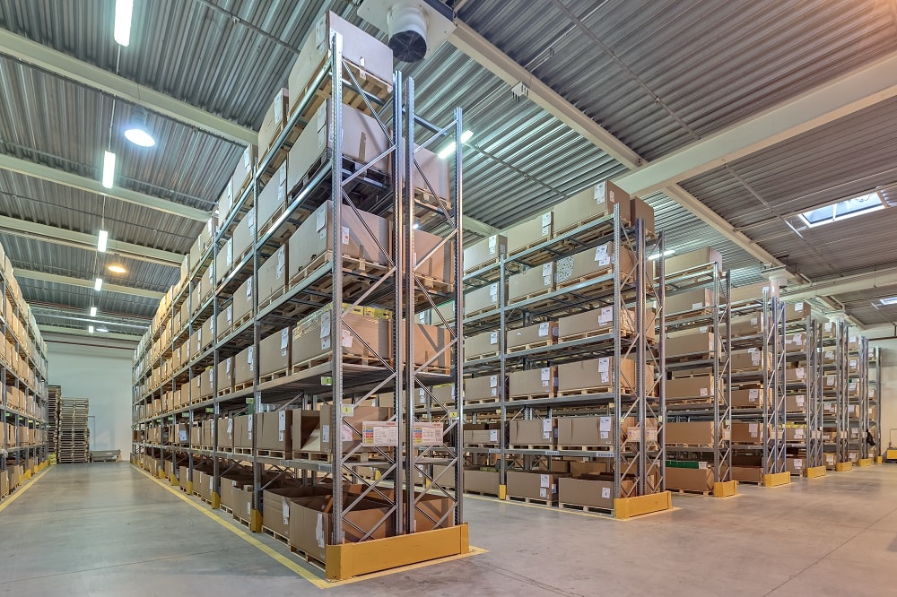
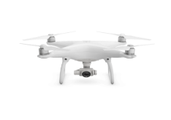
OCC Link Based Security Drone Position Localization
OCC link on Fire Fighting Drone for Warehouse Security Services
Tx : Warehouse Lighting Infrastructure
Rx : CMOS Camera Installed in the Fire Fighting Drone
Day-Night Communication Mode
Modulations
OOK, Offset-VPWM, Multilevel PPM, Inverted PPM, Subcarrier PPM, DSSS SIK etc.
Data Rate : 1K ~ 5Mb/s
Supported LoS (Line of Sight)
Available Distance : 5m ~ 200m
OCC Link
OCC Link
OCC Link
< OCC Link for Fire Fighting Drone Position Location in Warehouse >
※ Fire Fighting Futured Drones used in warehouse security service to prevent the theft prevention, access control, surveillance, fire and safety, to disaster recovery, data security and environmental monitoring.
※ Use the sensor embedded Lighting infrastructure to transmit environmental condition information about particular position, position information, emergency and safety access status and etc.
Slide 4

Slide 5
Conclusion
Proposed the warehouse position localization using OCC link for solar powered warehouse safety solution .
This proposed solution used for security drone position localization in smart warehouse security services to prevent the warehouse accidents.
Uses the ware lighting infrastructure built-in with sensor interface to transmit warehouse environmental condition to drones installed for warehouse security.
Security Drone installed with camera uses the OCC technology to collect sensor data and predict the environmental safety measures.
The proposed solution provides the every logistic items risk-related needs to be factored in, from theft prevention, access control, surveillance, fire and safety, to disaster recovery, data security and environmental monitoring, etc.
Slide 5

