Slide 1
Project: IEEE P802.15 Working Group for Wireless Personal Area Networks (WPANs)
Submission Title: IoT/IoL Enabled Warehouse Logistics Service Position Alignment through Optical Wireless Link
Date Submitted: September 2019
Source: Jaesang Cha (VTASK Co., Ltd), Juphil Cho (Kunsan National Univ.), Sangwoon Lee (Namseoul Univ.), Hwang Hyeonseok (Seoil Un.v.), Daeyoon Cha (VTASK Co., Ltd), YoungMin Kim (Welfrun Co., Ltd), Kaewon Choi (SKKU),Minsoo Kim(Sang Rim Corp.), Taejoon Park(Sang Rim Corp.), Hyejeong Cho (RIZM), Sung Hoon Yoon (Kogen Corp.),Timur Khudaybergenov (SNUST), Deokgun Woo (SNUST), Vinayagam Mariappan(SNUST)
Address: Contact Information: +82-2-970-6431, FAX: +82-2-970-6123, E-Mail: chajs@seoultech.ac.kr
Re:
Abstract: This documents introduce the V2I Optical Wireless link design consideration for VAT. This proposed optical wireless link used to do position alignment of an Warehouse Automated Guided Vehicles. This solution is introduced as a part of a complex of logistics monitoring and scheduling in the warehouse automation.
Purpose: To provided concept models of Optical Wireless Link for Vehicular Assistant Technology (VAT) Interest Group
Notice: This document has been prepared to assist the IEEE P802.15. It is offered as a basis for discussion and is not binding on the contributing individual(s) or organization(s). The material in this document is subject to change in form and content after further study. The contributor(s) reserve(s) the right to add, amend or withdraw material contained herein.
Release: The contributor acknowledges and accepts that this contribution becomes the property of IEEE and may be made publicly available by P802.15.
Slide 1

Slide 2
Contents
Needs for Warehouse Logistics Service Position Alignment
Optical Wireless Link for Warehouse Logistics Service Position Alignment
Conclusion
Slide 2

Slide 3
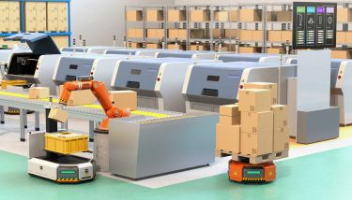
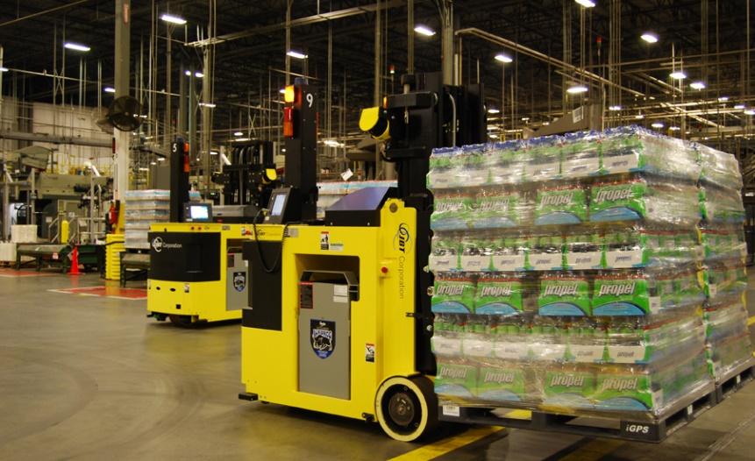
Needs for Warehouse Logistics Service Position Alignment
Needs
Efficient automated solution have been the key to maintaining success for smart warehouse management in recent years
Automated Guided Vehicles (AGV) have been proved to be an one of the most popular technologies used in warehouse automation due to their modularity, accuracy and speed.
Location precision is key feature in autonomous vehicle development.
Need to increase the accuracy and productivity of AGV by sharing information of transported goods between every warehouse AGVs.
Basic concept
AGV needs align with precise position to handle goods for timely and efficient logistic services.
Uses the warehouse lightings and 2D LED Tag on logistic items to transmit position co-ordinates of the logistics items.
Use the Camera installed in the AGV to receive position information to align the AGV position.
Google
< AGV Logistic Carrier Usage in Warehouse >
Slide 3

Slide 4
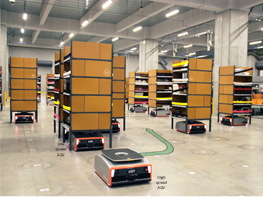
Optical Wireless Link for Warehouse Logistics Service Position Alignment
OWC communication link for Warehouse AGV solution
Tx : Lighting of AGV or 2D Color Coded Package Distribution LED Tag
Rx : CMOS Camera Installed in the AGV
Day-Night Communication Mode
Modulations
VTASC, SS2DC, Quick-QR Code, 2D Color Code
OOK, Offset-VPWM, Multilevel PPM, Inverted PPM, Subcarrier PPM, DSSS SIK etc.
Data Rate : 1K ~ 5Mb/s
Supported LoS (Line of Sight)
Available Distance : 5m ~ 50m
OWC Link
OWC Link
OWC Link
< Optical Wireless Communication Link for AGV Position Alignment>
※ AGV used for transportation goods in the warehouse uses the optical wireless decoded information to align the AGV positions for an precise and efficient warehouse logistic services .
※ Use the Lightings or 2D LED Tags to transmit information about position information, type of goods, weight and etc.
Slide 4

Slide 5
Conclusion
Proposed the IoT/IoL Enabled Warehouse Logistics Service Position Alignment through Optical Wireless Link to increase the accuracy and productivity solution for smart warehouse logistic management.
Uses the Lighting and Camera System installed in the Warehouse and AGV
In this proposed optical wireless link, the 2D Color coded LED Tag attached on goods as a Transmitter and CMOS Camera installed in the AGV as a receiver to share the position and transported goods’ information.
Slide 5

