Slide 1
Project: IEEE P802.15 Working Group for Wireless Personal Area Networks (WPANs)
Submission Title: Transparent Heads Up Display based OCC of Vehicle Front Glass for Delivery Vehicle Tracking Solutions
Date Submitted: September 2019
Source: Jaesang Cha (SNUST), Gooman Park (SNUST),Sangwoon Lee (Namseoul Univ.), Hyoungkyu Song (Sejong Univ.), Sooyoung Chang (SYCA), Vinayagam Mariappan (SNUST)
Address: Contact Information: +82-2-970-6431, FAX: +82-2-970-6123, E-Mail: chajs@seoultech.ac.kr
Re:
Abstract: This documents introduce the V2I Optical Camera Communication (OCC) Link design consideration for VAT. This proposed heads up display (HUD) based OCC solution used to find the location of delivery vehicle during delivery service time on the road. This VAT solution can used to operate on the application services like ITS, ADAS, digital signage with connected information services etc. on road condition..
Purpose: To Provided Concept models of transparent heads up display based OCC for Vehicular Assistant Technology (VAT) Interest Group
Notice: This document has been prepared to assist the IEEE P802.15. It is offered as a basis for discussion and is not binding on the contributing individual(s) or organization(s). The material in this document is subject to change in form and content after further study. The contributor(s) reserve(s) the right to add, amend or withdraw material contained herein.
Release: The contributor acknowledges and accepts that this contribution becomes the property of IEEE and may be made publicly available by P802.15.
Slide 1

Slide 2
Contents
Needs for Delivery Vehicle Tracking Solutions
Transparent Display based OCC for Vehicle Tracking
Conclusion
Slide 2

Slide 3
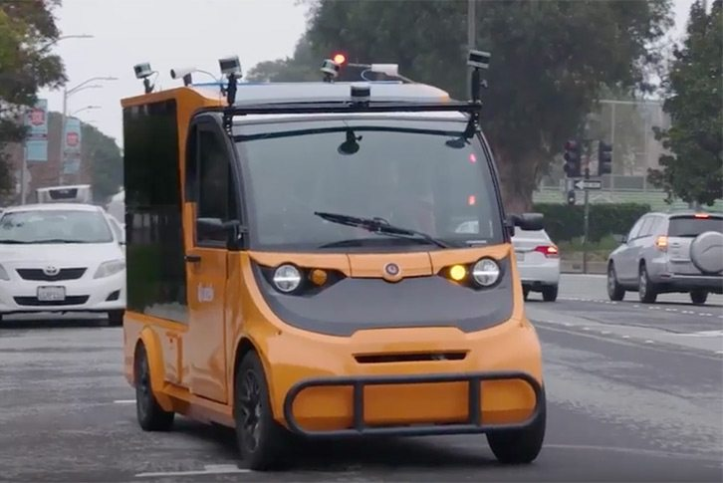
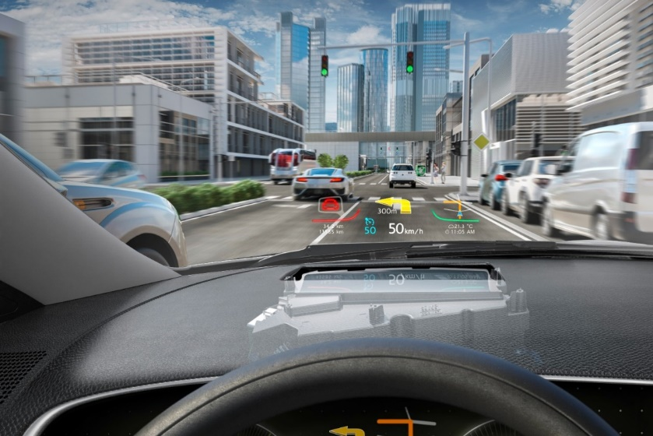
Needs for Delivery Vehicle Tracking Solutions
Needs
Delivery service companies require a great amount of organization, planning, and correct execution in order to ensure quick, efficient, and secure delivery of packages to desired destinations.
Frequent Traffic congestion and accidental conditions can delay in the delivery and customers used to wait for long time and postponed their other activities.
Need to inform the delivery vehicle position and on road condition to customer in order to avoid customers delivery dissatisfactions.
Basic Concept
Utilize the vehicles heads up display (HUD) as a transmitter for Optical Camera Communication Link to connect with ITS Infrastructure.
Vehicles transmits the ID and On-road condition information using transparent HUD of the vehicle.
The vehicle transmitter information's are decoded by roadway lights connected with camera and deliver the data to the ITS Infrastructure.
ITS infrastructure server receives the vehicles information and gives the information to delivery service provider in real time.
GOOGLE
< Delivery Vehicle on Road Driving Conditions >
GOOGLE
< Heads Up Display Usage in Vehicles >
Slide 3

Slide 4
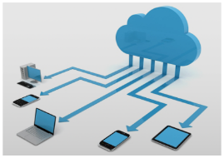
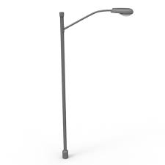
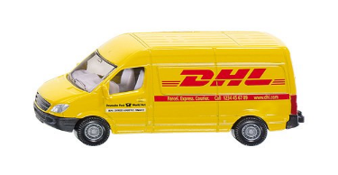
Transparent Display based OCC for Vehicle Tracking
Transparent HUD based OCC Link for Delivery Vehicle Tracking
Tx : Transparent HUD of Vehicle
Rx : Roadway Traffic Signal Connected CMOS Image Sensor
Day-Night Communication Mode
Modulations : VTASC, SS2DC, Quick-QR Code, 2D Color Code
Data Rate : 1K ~ 1Mb/s
Supported LoS (Line of Sight)
Available Distance : 5m ~ 100m
< HUD with OCC Code>
< Transparent HUD based V2I OCC Link Model >
※ Uses the OCC technology to identify vehicle, location of the vehicle, and inroad conditions near the vehicle to the delivery service provider in real time.
※ Use the road traffic monitoring camera systems, to recognize and decode the data from the transmitter delivery vehicle.
Slide 4

Slide 5
Conclusion
Proposed the transparent heads up display (HUD) based OCC of Vehicle Front Glass for Delivery Vehicle Tracking Solutions.
Utilize the existing CCTV Camera installed for traffic monitoring to make install the proposed service in a wide range.
Uses the transparent HUD of the vehicle to transmit vehicle specific information and road condition information to ITS connected infrastructure.
ITS infrastructure server forward the vehicles information to delivery service provider for delivery vehicle tracking in real time.
Slide 5

