Slide 1
Project: IEEE P802.15 Working Group for Wireless Personal Area Networks (WPANs)
Submission Title: Display Based OWC Link Embedded Airport Guide Robot for Travelers Assistance
Date Submitted: September 2019
Source: Jaesang Cha (SNUST), Gooman Park (SNUST),Sangwoon Lee (Namseoul Univ.), Hyoungkyu Song (Sejong Univ.), Sooyoung Chang (SYCA), Vinayagam Mariappan (SNUST)
Address: Contact Information: +82-2-970-6431, FAX: +82-2-970-6123, E-Mail: chajs@seoultech.ac.kr
Re:
Abstract: This documents introduce the V2X OWC Link design consideration for VAT. This proposed VAT solution used for travelers assistance in the airport through guide robot using display based optical wireless communication (OWC) technology. Also this VAT solution can be used to operate on the application services like ITS, ADAS, digital signage with connected information services, etc. on road condition.
Purpose: To provided concept models of OWC technology solution based on based on display for Vehicular Assistant Technology (VAT) Interest Group.
Notice: This document has been prepared to assist the IEEE P802.15. It is offered as a basis for discussion and is not binding on the contributing individual(s) or organization(s). The material in this document is subject to change in form and content after further study. The contributor(s) reserve(s) the right to add, amend or withdraw material contained herein.
Release: The contributor acknowledges and accepts that this contribution becomes the property of IEEE and may be made publicly available by P802.15.
Slide 1

Slide 2
Contents
Needs for Guide Robot to Assist Travelers in Airport
Display Based OWC Link Embedded Airport Guide Robot
Conclusion
Slide 2

Slide 3
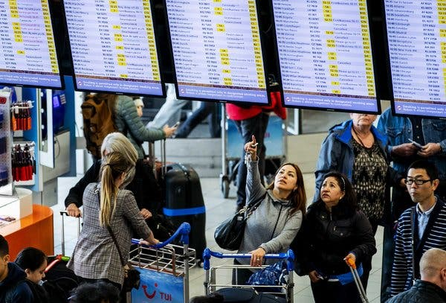
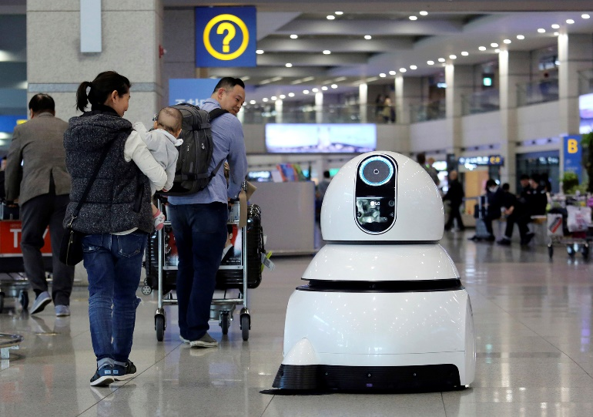
Needs for Guide Robot to Assist Travelers in Airport
Needs
Every day, some passengers can miss their connecting flight due to delays, language barriers or because they lose their way.
Passenger expectations on airport service have changed dramatically over the past decade.
Passenger expecting to use Robotics, AI and augmented reality to improve airport service.
Airport authority started offering travelers the assistance by guide robot that tells travelers the locations of departure gates, duty-free shops, baggage claims and check-in counters as well as other useful information.
Provides imitated way to share the information with travelers.
Basic Concept
User cannot remember all the details and required to look for details after some interval of time
Best way to solve this issue is to transfer the requested information on travelers smart device so that travelers can see and visualize any moment.
Use the Airport Guide Robot display as a transmitting media and camera on smart devices as receiver to create optical wireless (OWC) link between Airport Guide Robot and Travelers.
GOOGLE
< Navigation Stress for Travelers In Airport >
GOOGLE
< Airport Guide Robot >
Slide 3

Slide 4
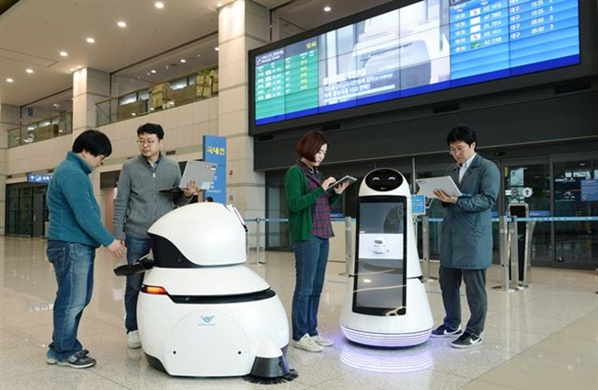
Display Based OWC Link Embedded Airport Guide Robot
Airport Guide Robot Display Based OWC Link for Travelers Assistance
Tx : Display of the Guide Robot
Rx : Travelers Smart Devices CMOS Image Sensor
Day-Night Communication Mode
Modulations :
VTASC, SS2DC, Quick-QR Code, 2D Color Code
Data Rate : 1K ~ 1Mb/s
Supported LoS (Line of Sight)
Available Distance : 5m ~ 100m
OWC Link
OWC Link
OWC Link
< Display based OWC Link Model >
※ Use the Airport Guide Robot embedded display devices to provide the optical wireless connectivity link with travelers.
※ Uses the OWC technology to provide Airport Map, the locations of departure gates, duty-free shops, baggage claims and check-in counters as well as other useful information.
Slide 4

Slide 5
Conclusion
Proposed the display based OWC connectivity link embedded airport guide Robot for travelers assistance.
The proposed OWC link uses the airport guide robot display as a transmitting media and camera on travelers smart devices as receiver to create optical wireless (OWC) link between airport guide robot and travelers.
Used to provide Airport Map, the locations of departure gates, duty-free shops, baggage claims and check-in counters as well as other useful information to traveler through optical wireless connectivity link.
Slide 5

