Slide 1
Project: IEEE P802.15 Working Group for Wireless Personal Area Networks (WPANs)
Submission Title: LiFi/CamCom Data Relay Link for Ground Condition Monitoring in Underground Mining Facility
Date Submitted: September 2019
Source: Jaesang Cha, Seongkwon Kim (SNUST), Sangwoon Lee (Namseoul Univ.), Hyeongho Lee (Netvision Telecom Inc., Korea Univ.), Yoonkwan Kim (The Catholic Univ.), Minseok Oh (Kyonggi Univ.), Jinyoung Kim (Kwangwoon Univ.), Jeonggon Kim (Korea Polytechnic Univ.), Chanhyeong Chung (RAPA), Sooyoung Chang (SYCA),Vinayagam Mariappan (SNUST)
Address: Contact Information: +82-2-970-6431, FAX: +82-2-970-6123, E-Mail: chajs@seoultech.ac.kr
Re:
Abstract: This documents introduce the V2X LiFi/CamCom Link design consideration for VAT. This proposed LiFi/CamCom Data Relay Link is used to forward the underground mining facility information through Mining Facility and Mining vehicle Lighting Infrastructure This approach helps to enable reliable data connectivity inside the underground mining facility with ground condition monitoring room.
Purpose: To provided concept models of Light Communication based LiFi/CamCom solution for Vehicular Assistant Technology (VAT) Interest Group
Notice: This document has been prepared to assist the IEEE P802.15. It is offered as a basis for discussion and is not binding on the contributing individual(s) or organization(s). The material in this document is subject to change in form and content after further study. The contributor(s) reserve(s) the right to add, amend or withdraw material contained herein.
Release: The contributor acknowledges and accepts that this contribution becomes the property of IEEE and may be made publicly available by P802.15.
Slide 1

Slide 2
Contents
Need for Ground Condition Monitoring in Underground Mining Facility
LiFi/CamCom Data Relay Link for Ground Condition Monitoring
Conclusion
Slide 2

Slide 3
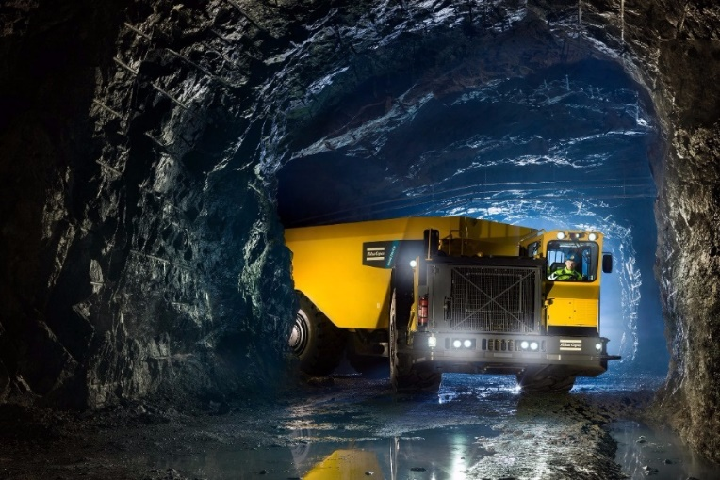
Need for Ground Condition Monitoring in Underground Mining Facility
Needs
The underground mining extend from gaseous build up, to mining at extreme depths, where both natural and mine-induced seismic activity presents the highest likelihood of severe events occurring.
Fire, flood, collapse, toxic atmospheric contaminants, and dust or gas explosion are the most critical hazards specifically linked to underground mining.
Need ground condition monitoring to avoid risks associated with different types of underground mining.
Basic Concept
To avoid critical hazards in underground mining facility, need an easy and effective connectivity method.
Proposed LiFi/CamCom Data Relay Link using light communication method for underground mining facility.
Uses the lighting device and cameras installed on the mining vehicles and mining facility.
Google
< Underground Mining Facility >
Slide 3

Slide 4
LiFi/CamCom Data Relay Link for Ground Condition Monitoring
LiFi/CamCom Link for Underground Mining Facility
Tx : Mining Facility and Mining Vehicle Lighting System
Rx : Mining Facility and Mining Vehicle Installed Camera
Day-Night Communication Mode
Modulations
OOK, VPPM, Offset-VPWM, Multilevel PPM, Inverted PPM, Subcarrier PPM, DSSS SIK etc.
Data Rate : 1K ~ 1Mb/s
Supported LoS (Line of Sight)
Available Distance : 5m ~ 200m
Inside Mine Tunnel
※ Forward the ground condition zone information to the control room of the mining facility Mining Facility Lighting System and Mining Vehicle Installed Lights and Camera
VLC
VLC
< LiFi/CamCom Data Relay Link for Ground Condition Monitoring>
Slide 4

Slide 5
Conclusion
Proposed LiFi/CamCom data relay link for ground condition monitoring in underground mining facility to prevents the risks.
Uses the lighting systems and cameras installed in the underground facility and mining vehicles.
Provides the effective connectivity for ground control monitoring practice to prevent hazards in underground mining facility.
Slide 5

