Slide 1
Project: IEEE P802.15 Working Group for Wireless Personal Area Networks (WPANs)
Submission Title: CID 422 Proposal
Date Submitted: 14 August, 2019
Source: Chris Hett Company Landis+Gyr
Address Alpharetta, GA USA
Voice: +1-678-258-1398, E-Mail: chris.hett@landisgyr.com
Re: LB158 Comment Resolution
Abstract: Proposed resolution for CID 422
Purpose: Resolve comment ID 422 from LB158
Notice: This document has been prepared to assist the IEEE P802.15. It is offered as a basis for discussion and is not binding on the contributing individual(s) or organization(s). The material in this document is subject to change in form and content after further study. The contributor(s) reserve(s) the right to add, amend or withdraw material contained herein.
Release: The contributor acknowledges and accepts that this contribution becomes the property of IEEE and may be made publicly available by P802.15.

Slide 2
LB158 – CID 422
Section 19.2.3
How are Operation Modes #1a and #1b handled with the mode switch? We should either say this feature is not supported for these operating modes or define how #1a and #1b are handled.

Slide 3
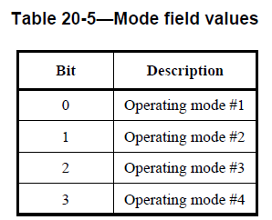
LB158 – CID 422
Existing New Mode field has 4-bits to specify the FSK operating mode, however, up to 7 operating modes are available in some cases [1a, 1b, 1, 2, 3, 4, 5]

Slide 4
LB158 – CID 422
Propose changing Mode field values in Table 20-5 from a bitmap to a numeric value:
Mode Value | Mode Description
0x0 | Operating Mode #1
0x1 | Operating Mode #2
0x2 | Operating Mode #3
0x3 | Operating Mode #4
0x4 | Operating Mode #5
0x5 | Operating Mode #1a
0x6 | Operating Mode #1b
0x7 – 0xF | RESERVED

Slide 5
LB158 – CID 422
In addition, the text on page 580 lines 16-17 should be changed from:
If the modulation scheme is FSK, the Mode field is a bitmap where a bit is set to one if the operating mode given in Table 20-5 is supported and is set to zero otherwise.
To:
If the modulation scheme is FSK, the Mode field indicates the operating mode to switch to as shown in Table 20-5.

Slide 6
LB158 – CID 422
Since this feature was slated for deprecation, backward compatibility of the Mode field does not need to be preserved.

