Slide 1
Project: IEEE P802.15 Working Group for Wireless Personal Area Networks (WPANs)
Submission Title: Adaptive MIMO OFDM in IEEE 802.15.13
Date Submitted: July, 2019
Source: Tuncer Baykas (Vestel, Istanbul Medipol University), Murat Uysal (Ozyegin University), Omer Narmanlioglu (Ozyegin University), Refik Kizilirmak (Nazarbayev University), Cihat Aytac (Vestel)
Address: Istanbul Medipol University, Istanbul, Turkey E-Mail: tbaykas@ieee.org
Abstract: This contribution presents adaptive MIMO OFDM architecture for IEEE 802.15.13.
Purpose: This document provides an adaptive MIMO OFDM architecture.
Notice: This document has been prepared to assist the IEEE P802.15. It is offered as a basis for discussion and is not binding on the contributing individual(s) or organization(s). The material in this document is subject to change in form and content after further study. The contributor(s) reserve(s) the right to add, amend or withdraw material contained herein.
Release: The contributor acknowledges and accepts that this contribution becomes the property of IEEE and may be made publicly available by P802.15.
Notes:
Note1:

Slide 2
Outline
  Description of adaptive MIMO OFDM VLC System
  Simulation Settings and Results
Conclusions

Slide 3
Background (1): MIMO Communications
  MIMO schemes can provide either improvement in spectral efficiency (through multiplexing gain) or link reliability (through diversity gain).
  Spatial Multiplexing (SMUX)
    Independent data streams are sent through each transmit element.
    Multiplexing gain is min (N_{T}, N_{R}) where N_{T} and N_{R} respectively denote the transmit and receive elements.
  Space-Time Coding (STC)
    Coded data streams are sent through each transmit element.
    STC provides SNR gains.
    Unlike RF communications with coherent detection, VLC systems can use simple versions of space-time coding (repetition coding, RC) ^{1, 2}.
¹ T. Fath and H. Haas, "Performance Comparison of MIMO Techniques for Optical Wireless Communications in Indoor Environments," IEEE Transactions on Communications, vol.61, no.2, pp.733-742, February 2013.
² M. Safari and M. Uysal, “Do We Really Need OSTBCs for Free-Space Optical Communication with Direct Detection?”, IEEE Transactions on Wireless Communications, vol. 7, no. 11, p. 4445-4448, November 2008.

Slide 4
Background (2): Link Adaptation
  In adaptive communication systems, transmission parameters such as modulation type/size, transmit power etc. can be selected according to channel conditions.
  Example: In low SNR conditions, to ensure link reliability, a modulation with small constellation size (e.g., BPSK) can be used. In high SNR conditions, high order modulation (e.g., 8-PSK) can be used to increase the data link.
  In MIMO systems, spatial dimension can be further included as an additional adaptive parameter, i.e., MIMO type, configuration etc.
  Link adaptation is commonly deployed in RF wireless standards, i.e., cellular, WiFi etc.

Slide 5
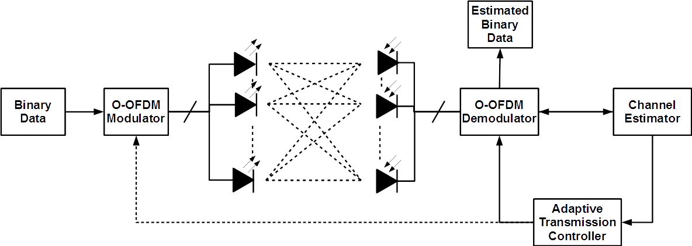
Block Diagram of Adaptive MIMO OFDM
  Channel state information (CSI) is estimated. This includes the estimation of signal-to-noise-ratio, multipath channel coefficients, etc.
  According to the CSI, adaptive transmission controller at the receiver selects the optimal transmission parameters (i.e., modulation type, modulation order, MIMO configuration and MIMO type) that yield the highest performance metric under a given constraint metric and feeds back to the transmitter.
  To further improve the system performance, bit loading can be further performed.
Notes:
Note1:

Slide 6
Look-Up Table (LUT)
Transmission Mode (TM) | MIMO Configuration | MIMO Type | Modulation Type | Modulation Order | Performance Metric | Constraint Metric
1 2 . . . | 1x1 1x2 ... N_{T}xN_{R} | RC SMUX | PSK QAM | 2 4 8 16 32 64 128 256 512 1024 2048 4096 | Pre-determined values for performance metric according to QoS requirements for targeted applications | Pre-determined values for constraint metric according to QoS requirements for targeted applications
Each transmission mode (TM) is a unique combination of
  MIMO configuration
  MIMO type
  Modulation type
  Modulation order

Slide 7
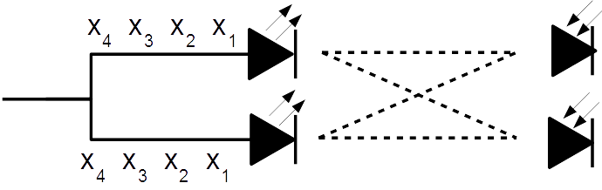
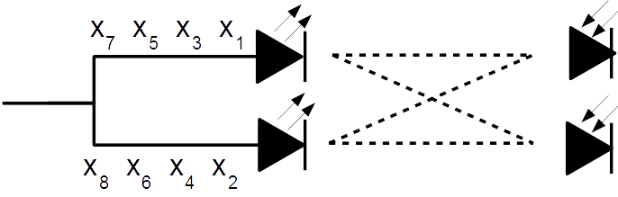
MIMO Schemes
  In our proposal, we use repetition code or spatial multiplexing to provide diversity or multiplexing gain.
  Repetition coding (RC)
  Spatial Multiplexing (SMUX)

Slide 8
Calculation of Data Rate
  RC
  SMUX
Notes:
Ts : 2BW (Nyquist Rate)
Ideal sinc kullanılmış oluyor

Slide 9
PHY Data Rates
System Parameters
B | 20 MHz
L_{SC} | 256
L_{D} | 96
L_{CP} | 12
Diversity Mode
Multiplexing Mode
PHY data rates (Mbit/s)
Modulation | 1x1 | 2x2 | 4x4 | 6x6 | 8x8
BPSK | 14,33 | 14,33 | 14,33 | 14,33 | 14,33
4-QAM | 28,66 | 28,66 | 28,66 | 28,66 | 28,66
8-QAM | 42,99 | 42,99 | 42,99 | 42,99 | 42,99
16-QAM | 57,31 | 57,31 | 57,31 | 57,31 | 57,31
32-QAM | 71,64 | 71,64 | 71,64 | 71,64 | 71,64
64-QAM | 85,97 | 85,97 | 85,97 | 85,97 | 85,97
128-QAM | 100,30 | 100,30 | 100,30 | 100,30 | 100,30
256-QAM | 114,63 | 114,63 | 114,63 | 114,63 | 114,63
512-QAM | 128,96 | 128,96 | 128,96 | 128,96 | 128,96
1024-QAM | 143,28 | 143,28 | 143,28 | 143,28 | 143,28
2048-QAM | 157,61 | 157,61 | 157,61 | 157,61 | 157,61
4096-QAM | 171,94 | 171,94 | 171,94 | 171,94 | 171,94
PHY data rates (Mbit/s)
Modulation | 1x1 | 2x2 | 4x4 | 6x6 | 8x8
BPSK | 14,33 | 28,66 | 57,31 | 85,97 | 114,63
4-QAM | 28,66 | 57,31 | 114,63 | 171,94 | 229,25
8-QAM | 42,99 | 85,97 | 171,94 | 257,91 | 343,88
16-QAM | 57,31 | 114,63 | 229,25 | 343,88 | 458,51
32-QAM | 71,64 | 143,28 | 286,57 | 429,85 | 573,13
64-QAM | 85,97 | 171,94 | 343,88 | 515,82 | 687,76
128-QAM | 100,30 | 200,60 | 401,19 | 601,79 | 802,39
256-QAM | 114,63 | 229,25 | 458,51 | 687,76 | 917,01
512-QAM | 128,96 | 257,91 | 515,82 | 773,73 | 1031,64
1024-QAM | 143,28 | 286,57 | 573,13 | 859,70 | 1146,27
2048-QAM | 157,61 | 315,22 | 630,45 | 945,67 | 1260,90
4096-QAM | 171,94 | 343,88 | 687,76 | 1031,64 | 1375,52

Slide 10
PHY Data Rates
System Parameters
B | 200 MHz
L_{SC} | 2048
L_{D} | 960
L_{CP} | 96
Diversity Mode
Multiplexing Mode
PHY data rates (Gbit/s)
Modulation | 1x1 | 2x2 | 4x4 | 6x6 | 8x8
BPSK | 0,18 | 0,18 | 0,18 | 0,18 | 0,18
4-QAM | 0,36 | 0,36 | 0,36 | 0,36 | 0,36
8-QAM | 0,54 | 0,54 | 0,54 | 0,54 | 0,54
16-QAM | 0,72 | 0,72 | 0,72 | 0,72 | 0,72
32-QAM | 0,90 | 0,90 | 0,90 | 0,90 | 0,90
64-QAM | 1,07 | 1,07 | 1,07 | 1,07 | 1,07
128-QAM | 1,25 | 1,25 | 1,25 | 1,25 | 1,25
256-QAM | 1,43 | 1,43 | 1,43 | 1,43 | 1,43
512-QAM | 1,61 | 1,61 | 1,61 | 1,61 | 1,61
1024-QAM | 1,79 | 1,79 | 1,79 | 1,79 | 1,79
2048-QAM | 1,97 | 1,97 | 1,97 | 1,97 | 1,97
4096-QAM | 2,15 | 2,15 | 2,15 | 2,15 | 2,15
PHY data rates (Gbit/s)
Modulation | 1x1 | 2x2 | 4x4 | 6x6 | 8x8
BPSK | 0,18 | 0,36 | 0,72 | 1,07 | 1,43
4-QAM | 0,36 | 0,72 | 1,43 | 2,15 | 2,87
8-QAM | 0,54 | 1,07 | 2,15 | 3,22 | 4,30
16-QAM | 0,72 | 1,43 | 2,87 | 4,30 | 5,73
32-QAM | 0,90 | 1,79 | 3,58 | 5,37 | 7,16
64-QAM | 1,07 | 2,15 | 4,30 | 6,45 | 8,60
128-QAM | 1,25 | 2,51 | 5,01 | 7,52 | 10,03
256-QAM | 1,43 | 2,87 | 5,73 | 8,60 | 11,46
512-QAM | 1,61 | 3,22 | 6,45 | 9,67 | 12,90
1024-QAM | 1,79 | 3,58 | 7,16 | 10,75 | 14,33
2048-QAM | 1,97 | 3,94 | 7,88 | 11,82 | 15,76
4096-QAM | 2,15 | 4,30 | 8,60 | 12,90 | 17,19

Slide 11
Adaptive Transmission: Flow Chart
Initialization
Receiver sends «transmission mode (TM) information request»
Channel Estimation
Receiver initiates channel estimation process with «channel information request»
Calculation of constraint metric for each mode in LUT
Construct list of modes that satisfy the constraint
Receiver selects the best transmission mode and informs transmitter
Select the mode which has highest performance metric
Data transmission
Data transmission starts based on selected transmission mode
Renewal of mode selection?
Mode selection is repeated in every transmission time interval or when
Low received signal strength from one or more transmitters.
Low throughput or high frame error rate from the current mode.
NO
YES

Slide 12
Adaptive Transmission: Setup Sequence
The number of transmission elements: N_{T}
The number of reception elements: N_{R}
VLC
Receiver
VLC
Transmitter
SISO mode
SISO mode using the transmitter element #1
TM Info Request
Receiver initiates configuration process
by requesting the capabilities of the transmitter.
TM Info Response
Comprises information below:
Value of N_{T}
MIMO type
Modulation type/order
Selection Procedure
Channel Info Request
Info Element#1
Comprises information below:
・Channel Estimation Sequence
Upon receiving Channel Info Request, the transmitter starts sending Information Elements from separate transmit elements (LEDs).
The number of information element packets is equal to N_{T} allowing receiver to create channel matrix and make a selection.
Info Element #2
…
Info Element # N_{T} − 1
Info Element # N_{T}
After required information is estimated, adaptive transmission controller at the receiver selects the best mode
Selected Transmission Mode Start Request
Switch to selected transmission mode
Switch to selected transmission mode
Data Transmission

Slide 13
Adaptive Transmission: PHY Frame Structure
TXD#1
SYNC
SFD
CES #1
0 values, unmodulated
Header
Payload #1
TXD#2
SYNC
SFD
CES #2
Header
Payload #2
TXD#3
SYNC
SFD
CES #3
Header
Payload #3
TXD#4
SYNC
SFD
CES #4
Header
Payload #4
Same signal is transmitted from each transmitter
for MIMO transmission channel estimation
N_{T} - streams data
Information for MIMO bitstream processing shall be included in header (Stream #)
Synchronization (SYNC) part is used for frame detection, frame synchronization, frequency recovery and timing acquisition. Start Frame Delimiter (SFD) is to show that SYNC part finished.
Channel Estimation Sequence (CES) should provide channel estimation of each transmitter.
In all those parts, known sequences with good autocorrelation should be used, such as m sequences or Golay sequences.
The Header contains essential information such as payload size, modulation, and coding (if used) in the payload.

Slide 14
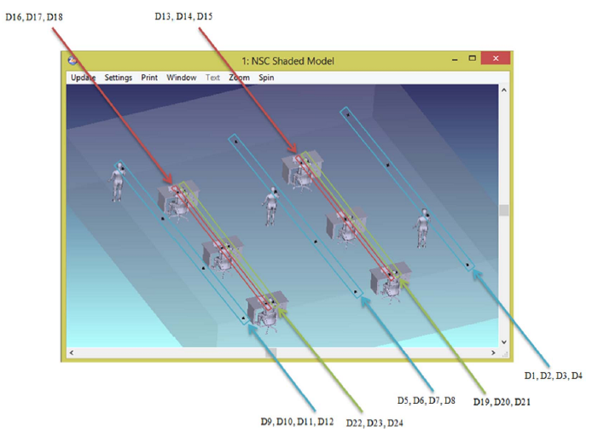
Simulation Results - Scenario 1 (1/6)
  First, we consider Scenario 1 (IEEE P802.15-15-0746-01-007a) where channel response is measured at 24 different points.
System Parameters
System Bandwidth | 20 MHz
Number of Subcarrier | 256
Number of Data Carrier | 96
Number of Cyclic Prefix | 12
Target BER | 10⁻³
Notes:
Noise PSD* 10⁻²² W/Hz
* J. Grubor, S. Randel, K. Langer and J. Walewski, «Broadband Information Broadcasting Using LED-Based Interior Lighting,» Journal of Lightwave Technology, Vol. 26, No. 24, December 2008.

Slide 15
Simulation Results - Scenario 1 (2/6)
Channel Frequency Response
  Large variations in channel gains with respect to locations
    Best channel conditions: D4, Worst channel conditions: D7
  This necessitates the use of adaptive transmission.

Slide 16
Simulation Results - Scenario 1 (3/6)
  At each location, the highest modulation order which satisfies target BER is selected. For example at D4, 128-QAM can be deployed since it satisfies the target BER. However, at D7, BPSK should be deployed.

Slide 17
Simulation Results - Scenario 1 (4/6)
  The peak rates (with adaptive modulation) of a user walking through these points are shown below.
  Worst case design provides only 14 Mbit/s.
  Significant improvements are achieved through adaptive transmission. Peak rate reaches to 100 Mbit/s.
Peak value is 100 Mbps
Worst case design: 14.33 Mbps

Slide 18
Simulation Results - Scenario 1 (5/6)
In AWGN channel,
Scenario 1 - D4 Channel
At D4, the path loss is around -60 dB
At a given SNR value, the modulation order which gives the highest peak rate, while satisfying target BER, is deployed in transmission. The achieved data rates are plotted next.

Slide 19
Simulation Results - Scenario 1 (6/6)
Modulation | SNR [dB]
BPSK | 67
QPSK | 70
8-QAM | 75
16-QAM | 77
32-QAM | 81
64-QAM | 83
128-QAM | 87
256-QAM | 89
512-QAM | 93
1024-QAM | 95
2048-QAM | 99
4096-QAM | 101

Slide 20
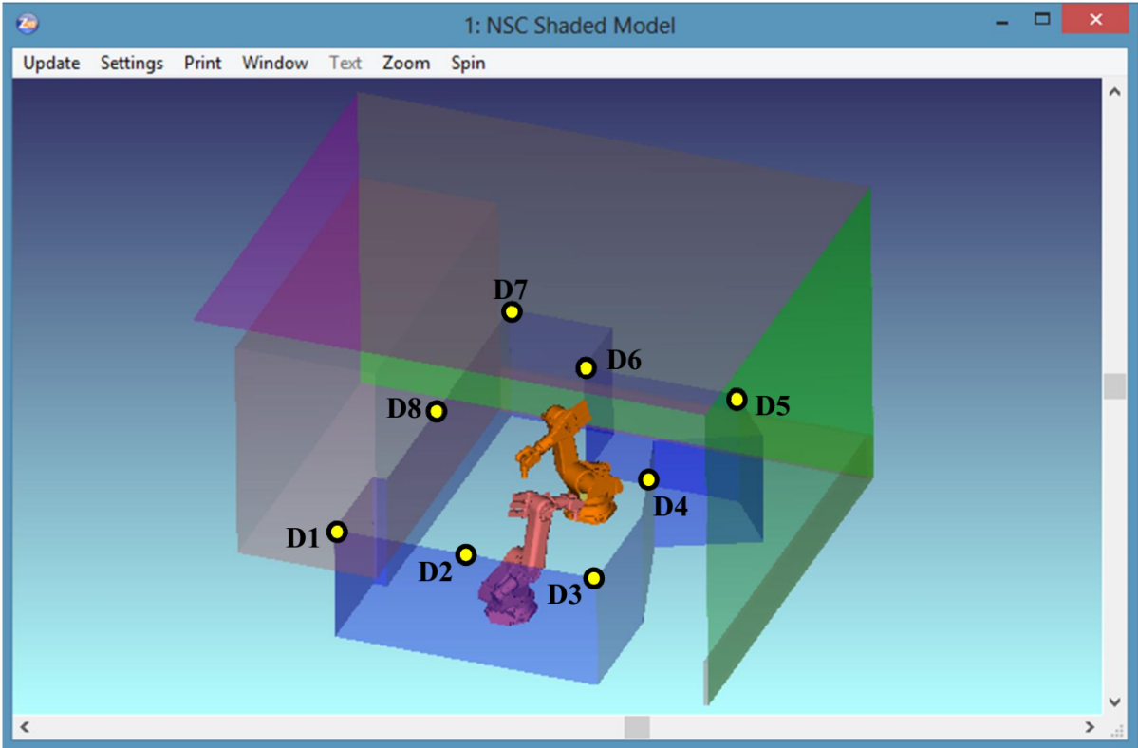
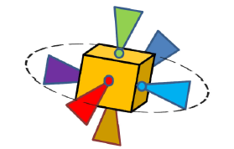

Simulation Results - Scenario 4 (1/10)
  Scenario 4 (IEEE P802.15-15-0746-01-007a) with multiple transmitters are used for simulations.
  Repetition code and spatial multiplexing are considered as MIMO types.

Slide 21
Simulation Results - Scenario 4 (2/10)
System Parameters
System Bandwidth | 20 MHz | 200 MHz
Number of Subcarrier | 256 | 2048
Number of Data Carrier | 96 | 960
Number of Cyclic Prefix | 12 | 96
Target BER | 10⁻³ | 10⁻³
Maximum likelihood (optimal) decision rule is used for RC
Zeroforcing (not optimal but simple) is used for SMUX.
Notes:
In 2x2 MIMO, used LEDs are L1 and L6
used photodetectors are D4 and D5
In 4x4 MIMO, used LEDs are L1, L3, L5 and L6
used photodetectors are D3, D4, D5 and D8.
In 6x6 MIMO, all LEDs are used
used photodetectors are D1, D2, D3, D4, D5 and D6
Noise Power Spectral Density: 10⁻²² W/Hz

Slide 22
Simulation Results - Scenario 4 (3/10)

Slide 23
Simulation Results - Scenario 4 (4/10)

Slide 24
Simulation Results - Scenario 4 (5/10)
2x2 MIMO systems (B=20 MHz)
With adaptive MIMO, a data rate of 344 Mbits/s is achieved.

Slide 25
Simulation Results - Scenario 4 (6/10)
4x4 MIMO systems (B=20 MHz)
With adaptive MIMO, a data rate of 688 Mbps data rate is achieved.
Under the same spectral efficiency, RC suffers from high modulation order and SMUX is required to get better performance. For example,
  RC with 16 QAM outperforms SMUX with BPSK
  RC with 256 QAM outperforms SMUX with QPSK
  SMUX with 8 QAM outperforms RC 4096 QAM !!

Slide 26
Simulation Results - Scenario 4 (7/10)
6x6 MIMO systems (B=20 MHz)
With adaptive MIMO, a data rate of 1 Gbit/s is achieved.
SMUX suffers from channel correlations. Maximum likelihood decoder and/or coding are required to improve the performance.
Notes:
ZF enhances the noise because of inter-chanel interference.

Slide 27
Simulation Results - Scenario 4 (8/10)
2x2 MIMO systems (B=200 MHz)
With adaptive MIMO, a data rate of 4.3 Gbit/s is achieved.

Slide 28
Simulation Results - Scenario 4 (9/10)
4x4 MIMO systems (B=200 MHz)
With adaptive MIMO, a data rate of 8.6 Gbit/s is achieved.

Slide 29
Simulation Results - Scenario 4 (10/10)
6x6 MIMO systems (B=200 MHz)
Targeted data rate of 10 Gbit/s is achieved via SMUX & 1024-QAM.

