Slide 1
Project: IEEE P802.15 Working Group for Wireless Personal Area Networks (WPANs)
Submission Title: VLC Linked based Smart Parking Solution for Solar-Powered Movable Smart House
Date Submitted: July 2019
Source: Jaesang Cha (VTASK Co., Ltd), Daeyoon Cha (VTASK Co., Ltd), YoungMin Kim (Welfrun Co., Ltd), Kaewon Choi (SKKU), Timur Khudaybergenov (SNUST) , Deokgun Woo (SNUST), Vinayagam Mariappan(SNUST)
Address: Contact Information: +82-2-970-6431, FAX: +82-2-970-6123, E-Mail: chajs@seoultech.ac.kr
Re:
Abstract: This documents introduce the V2I VLC link design consideration for VAT. This proposed VLC data link model V2I optical wireless communication between living vehicle and parking area lighting infrastructures to part the movable smart house in respective positions. This solution is introduced as a part of the smart city development to manage living vehicles in a public area.
Purpose: To provided concept models of VLC Link solution for Vehicular Assistant Technology (VAT) Interest Group
Notice: This document has been prepared to assist the IEEE P802.15. It is offered as a basis for discussion and is not binding on the contributing individual(s) or organization(s). The material in this document is subject to change in form and content after further study. The contributor(s) reserve(s) the right to add, amend or withdraw material contained herein.
Release: The contributor acknowledges and accepts that this contribution becomes the property of IEEE and may be made publicly available by P802.15.
Slide 1

Slide 2
Contents
Needs for Living Vehicles Smart-Parking Solution
VLC Link for Solar Powered Movable Smart House Parking Management
Conclusion
Slide 2

Slide 3
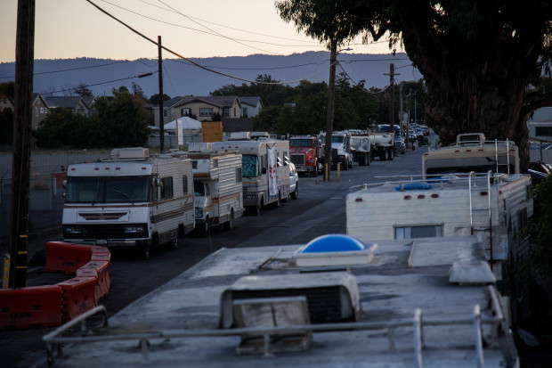
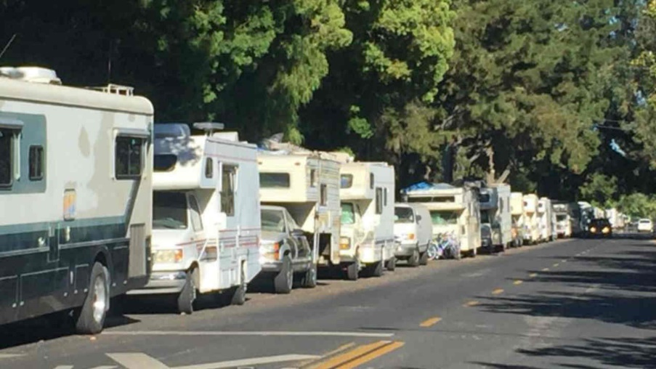
Needs for Living Vehicles Smart-Parking Solution
Needs
Movable Smart Living Vehicles based living is renewed trend of modern society.
Overnight parking of recreational vehicles, boats, and trailers from parking on public streets creates traffic and public disturbances
As part of the smart city management, the city council thinking to regularize the permit to park and connect city’s water and sewage systems.
Needs Parking Authentication System.
Basic concept
Public Lighting based Parking Authentication using Light communication can resolve the issues
Use the City Lighting Infrastructure to Authenticate parking location and Vehicle Camera used to get authenticate information from City Light Infrastructure.
Google
< Living House Parking Scenario >
Slide 3

Slide 4
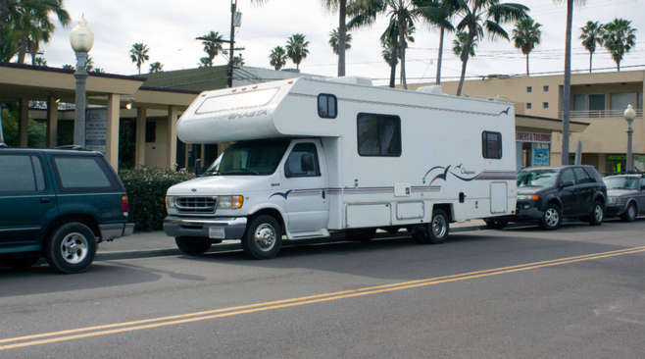
VLC Link for Solar Powered Movable Smart House Parking Management
VLC Data Link for Solar Power Movable Smart House
Tx : City and Vehicle Lighting Infrastructure
Rx : Camera Installed in City and On Vehicle
Day-Night Communication Mode
Modulations :
OOK, VPPM, Offset-VPWM, Multilevel PPM, Inverted PPM, Subcarrier PPM, DSSS SIK etc.
Data Rate : 1K ~ 1Mb/s
Supported LoS (Line of Sight)
Available Distance : 5m ~ 200m
VLC Link
< VLC Optical Wireless Data Link for Parking Management >
※ Utilize the City Lighting Infrastructure to send the Authenticated Location ID to Movable smart house and Camera Installed in the vehicle receives authentication information through camera using Visible Light Communication Data OCC Link.
Slide 4

Slide 5
Conclusion
Proposed the VLC Linked based Smart Parking Solution for Solar-Powered Movable Smart House.
Uses the existing City Lighting Infrastructure and Vehicle built-in cameras to enable VLC link for parking management solution.
Proposed solution can to regularize the permit to park and connect city’s water and sewage systems.
Avoids the vehicle accidents, traffic condition management and provide safe journey on road ways.
Slide 5

Slide 6
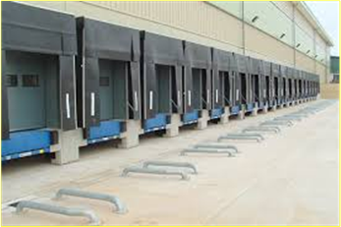
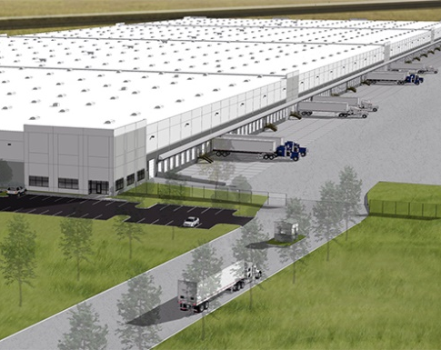
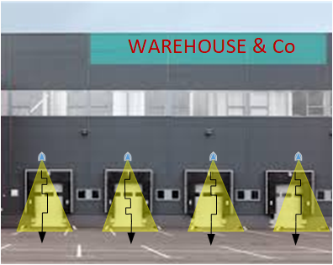
Needs for Automated Truck Loading Management on Warehouse Sites
Needs
To pay high-price of time management of trucks during loading and unloading activities o warehouse sites
Requires easy solution to provide optimal scheduling and docking gates recognizing , staying time, working scope and prevent fail loading and unloading.
Basic concept
Operative information broadcasting to load carrying vehicles about correct position of the warehouse gate
Information providing for time scheduling
Information providing for working scope (For example, use case – Type of cargo which should be uploaded or downloaded in particular gate)
< Warehouse gates example>
Slide 3

