Slide 1
Project: IEEE P802.15 Working Group for Wireless Personal Area Networks (WPANs)
Submission Title: Automated Truck Loading Management in Warehouse Sites through Optical Camera Communication Link
Date Submitted: July 2019
Source: Jaesang Cha (VTASK Co., Ltd), Daeyoon Cha (VTASK Co., Ltd), YoungMin Kim (Welfrun Co., Ltd), Kaewon Choi (SKKU), Timur Khudaybergenov (SNUST) , Deokgun Woo (SNUST), Vinayagam Mariappan(SNUST)
Address: Contact Information: +82-2-970-6431, FAX: +82-2-970-6123, E-Mail: chajs@seoultech.ac.kr
Re:
Abstract: This documents introduce the V2X OCC link design consideration for VAT. This proposed OCC data link model is to introduce the possibility of using light communication for truck management in warehouse sites loading and unloading. This solution is introduced as a part of a complex of logistics monitoring and scheduling in the warehouse automation.
Purpose: To provided concept models of Optical Camera Communication Link solution for Vehicular Assistant Technology (VAT) Interest Group
Notice: This document has been prepared to assist the IEEE P802.15. It is offered as a basis for discussion and is not binding on the contributing individual(s) or organization(s). The material in this document is subject to change in form and content after further study. The contributor(s) reserve(s) the right to add, amend or withdraw material contained herein.
Release: The contributor acknowledges and accepts that this contribution becomes the property of IEEE and may be made publicly available by P802.15.
Slide 1

Slide 2
Contents
Needs for Automated Truck Loading Management in Warehouse Sites
OCC Link for Truck Loading Management Solutions
Conclusion
Slide 2

Slide 3
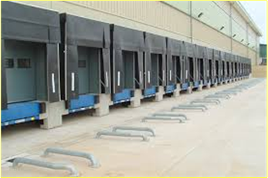
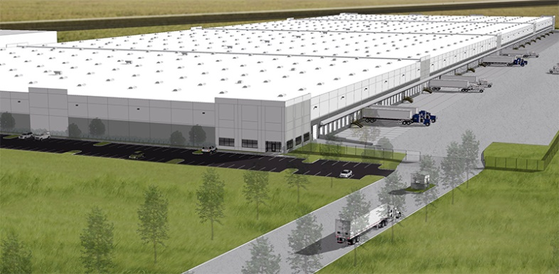
Needs for Automated Truck Loading Management in Warehouse Sites
Needs
Today the warehouse sites, pay high-price of resource and time management of trucks during loading and unloading activities due to increasing growth in the e-commerce sector
Requires easy solution to provide optimal scheduling and docking gates recognizing , staying time, working scope and prevent fail loading and unloading.
Basic concept
To operative information broadcasting to load carrying vehicles about correct position of the warehouse gate
To provide information for time scheduling
To provide information providing for working scope. For example, Type of cargo which should be uploaded or downloaded in particular gate.
Google
Google
< Warehouse Gates and Trucks Loading / Unloading Scenario >
Slide 3

Slide 4
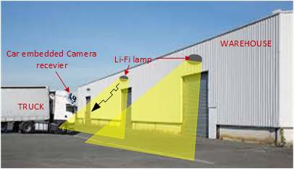
OCC Link for Truck Loading Management Solutions
Automated Truck Loading Management based on OCC Data Link
Tx : Warehouse Lighting Infrastructure
Rx : Camera Installed on Truck
Day-Night Communication Mode
Modulations :
OOK, VPPM, Offset-VPWM, Multilevel PPM, Inverted PPM, Subcarrier PPM, DSSS SIK etc.
Data Rate : 1K ~ 1Mb/s
Supported LoS (Line of Sight)
Available Distance : 60m around
< OCC Data Link for Truck Loading Management >
※ Utilized as a part of Warehouse Sites Using OCC Link for Logistics monitoring and work scheduling, etc.
Slide 4

Slide 5
Conclusion
Proposed the OCC Link for Truck Loading Management On Warehouse sites.
Uses the existing LED Warehouse Light sources and trucks built-in cameras to enable OCC Link for warehouse logistics inventory management.
Proposed solution can be utilized as a part of a complex warehouse monitoring, logistics and work scheduling, etc.
Slide 5

Slide 6
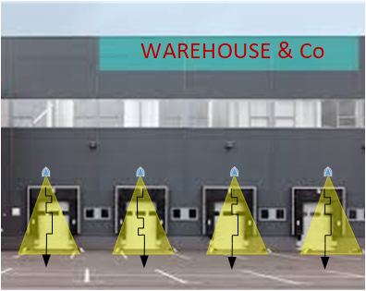
Needs for Automated Truck Loading Management on Warehouse Sites
Needs
To pay high-price of time management of trucks during loading and unloading activities o warehouse sites
Requires easy solution to provide optimal scheduling and docking gates recognizing , staying time, working scope and prevent fail loading and unloading.
Basic concept
Operative information broadcasting to load carrying vehicles about correct position of the warehouse gate
Information providing for time scheduling
Information providing for working scope (For example, use case – Type of cargo which should be uploaded or downloaded in particular gate)
< Warehouse gates example>
Slide 3

