Slide 1
Project: IEEE P802.15 Working Group for Wireless Personal Area Networks (WPANs)
Submission Title: Transparent LED Display based High Speed OWC Technology Design Considerations
Date Submitted: July 2019
Source: Jaesang Cha (SNUST), Minwoo Lee (SNUST), JinYoung Choi (SHINHAN BANK), Hyoungkyu Song (Sejong Univ.), Sooyoung Chang (SYCA), Vinayagam Mariappan (SNUST)
Address: Contact Information: +82-2-970-6431, FAX: +82-2-970-6123, E-Mail: chajs@seoultech.ac.kr
Re:
Abstract: This documents introduce the V2I OWC Link design consideration for VAT. This proposed OWC technology design consideration to develop precise OWC solution using transparent LED display for VAT application services. This VAT solution design consideration is to operate on the application services like ITS, ADAS, IoT/IoL, etc. on road condition.
Purpose: To provided concept models design consideration of OWC technology solution for Vehicular Assistant Technology (VAT) Interest Group
Notice: This document has been prepared to assist the IEEE P802.15. It is offered as a basis for discussion and is not binding on the contributing individual(s) or organization(s). The material in this document is subject to change in form and content after further study. The contributor(s) reserve(s) the right to add, amend or withdraw material contained herein.
Release: The contributor acknowledges and accepts that this contribution becomes the property of IEEE and may be made publicly available by P802.15.
Slide 1

Slide 2
Contents
Issue in Display based OWC Solution
Required Design Considerations for Transparent LED Display
Conclusion
Slide 2

Slide 3
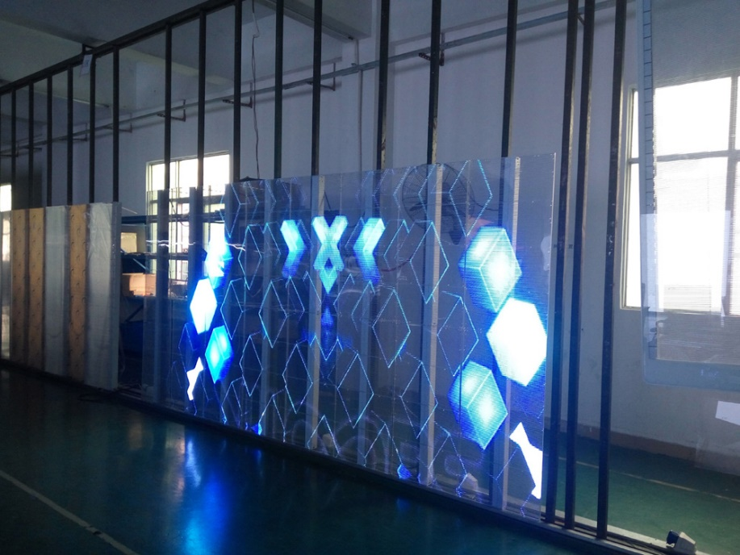
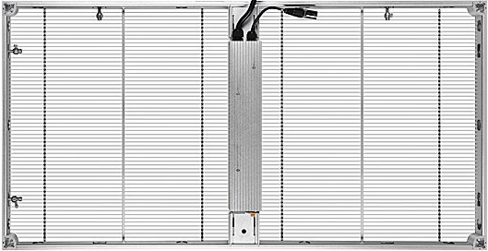
Issue in Display based OWC Solution
Issues in Display based OWC Technology
Camera Calibration
Motion Stabilization
RoI Selection
Interpixel Interferences
Fast 2D Color Decoder
Camera Sampling Rate and Frame Rate Variations
Fast Synchronization Method
Solutions
Adaptive Image Processing Methods like Machine Learning, Machine Learning, AI, etc.
Sampling and Frame variation controller using Spread Spectrum
Synchronization Using Spread Spectrum
Adaptive Denoising Methods like Region Pixel Adaptive Filtering Methods
< LED based Transparent Display Media Samples >
Slide 3

Slide 4
Required Design Considerations for Transparent LED Display (1)
Adaptive Camera Calibration and Image Stabilization Method
Lucas–Kanade method – regarding image patches and an affine model for the flow field
Horn–Schunck method – optimizing a functional based on residuals from the brightness constancy constraint, and a particular regularization term expressing the expected smoothness of the flow field
Buxton–Buxton method – based on a model of the motion of edges in image sequences
Black–Jepson method – coarse optical flow via correlation
Adaptive Imaging Method for RoI Detection Method
Optical Flow
Machine Learning
Deep Learning
AI, etc.
< LED and Camera based OWC Link Decoding Flow >
Slide 4

Slide 5
Required Design Considerations for Transparent LED Display (2)
Noise and Interference Minimization Techniques
Adaptive Optical Image Filter
Adaptive Infrared filter
Robust modulation techniques
Robust Modulation Techniques
With Multi Level, Sub-Carrier Multiplexed Techniques, Spread Spectrum Techniques
Multilevel PPM
Sub-carrier multiplexed (SCM) PPM
DSSS SIK (Direct-Sequence Spread Spectrum with Sequence Inverse Keying)
VTASC
SS2DC
< LED and Camera based OWC Link Decoding Flow >
Slide 5

Slide 6
Conclusion
Discussed the OWC technology design consideration to develop precise OWC solution using transparent LED display for VAT application services.
Issues in Display based OWC Technology Camera Calibration, Motion Stabilization, RoI Selection, Interpixel Interferences, Fast 2D Color Decoder, Camera Sampling Rate and Frame Rate Variations, Fast Synchronization Method, etc.
Provided the required considerable techniques for display based OWC technology like Adaptive Camera Calibration and Image Stabilization Method, Adaptive Imaging Method for RoI Detection Method, Noise and Interference Minimization Techniques, Robust Modulation Techniques.
Slide 6

