Slide 1
Project: IEEE P802.15 Working Group for Wireless Personal Area Networks (WPANs)
Submission Title: IoT/IoL Networked Edge Computing Build-In Drones For Logistics Automation Solution in Modern Warehouse
Date Submitted: July 2019
Source: Jaesang Cha (SNUST), Sangwoon Lee (Namseoul Univ.), Jinyoung Kim (Kwangwoon Univ.), SeongKweon Kim(SNUST), Yong Ik Yoon (Sookmyung Women's University), Jinyong Choi (SHINHAN BANK), Jintae Kim (Fivetek Co., Ltd.), Sungdoo Kang (Feelux Co., Ltd.), Changsoo Lee (L&S LED Co., Ltd.), Sangil Lim (SignTelecom Co. Ltd.) , Seong Soon Joo (ETRI), Sangsung Choi (Woosong University), Sooyoung Chang (SYCA), Vinayagam Mariappan (SNUST)
Address: Contact Information: +82-2-970-6431, FAX: +82-2-970-6123, E-Mail: chajs@seoultech.ac.kr
Re:
Abstract: This documents introduce the V2X IoT/IoL connectivity link design considerations for VAT. This proposed IoT/IoL connectivity between drones and smart warehouse used for logistic automation. This VAT solutions can used to operate on the application services like ITS, ADAS, etc. on road condition
Purpose: To provide concept models of the high speed optical wireless / light communications solution for Vehicular Assistant Technology (VAT) Interest Group
Notice: This document has been prepared to assist the IEEE P802.15. It is offered as a basis for discussion and is not binding on the contributing individual(s) or organization(s). The material in this document is subject to change in form and content after further study. The contributor(s) reserve(s) the right to add, amend or withdraw material contained herein.
Release: The contributor acknowledges and accepts that this contribution becomes the property of IEEE and may be made publicly available by P802.15.
Slide 1

Slide 2
Contents
Needs for Logistics Automation Solution in Warehouse
IoT/IoL Networked Edge Computing Build-In Drones For Logistics Solution
Conclusion
Slide 2

Slide 3
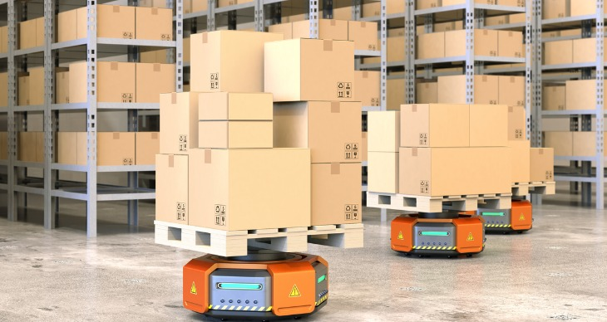
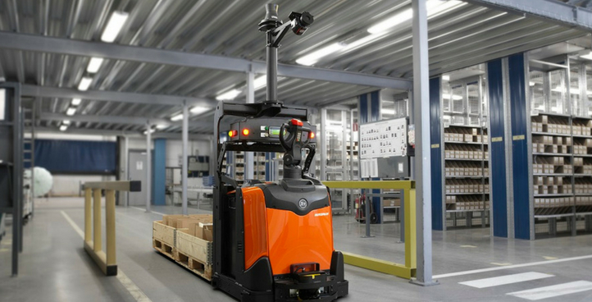
Needs for Logistics Automation Solution in Warehouse
Needs
The extensive growth in the e-commerce sector has pushed new ideas and innovation forward in warehouses automation solution since required to handle wide range of products with short lead times and fast deliveries.
Needs advances and precise automation solution in the warehouses inventory logistics management with less investment
Use of the existing lighting infrastructure is effective approach to provide high precision automation solution in the warehouses
Basic Concept
Uses the lighting Infrastructure and Camera Installed in the warehouse infrastructures to enable IoT/IoL Connectivity link for logistics automation solution
Uses the 2D Color Codes embedded on product packages to transmit packages related information and Camera installed on Drone work as a receiver to decode the product information to move packages to indoor package carrier vehicles like Forklifts, pallet jacks, etc.
Google
< Warehouse Logistics Solution Model >
Slide 3

Slide 4
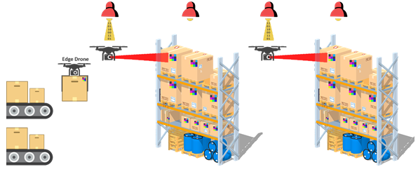
IoT/IoL Networked Edge Computing Build-In Drones For Logistics Solution
IoT/IoL Networked for Logistics Automation Solution
Tx : Lighting Infrastructure in the Warehouse and 2D Color Coded Package Distribution LED Labels
Rx : CMOS Camera Installed in the Drone and Warehouse
Day-Night Communication Mode
Modulations
Color Code, QR-Code, VTASC, OOK, Offset-VPWM, Multilevel PPM, Inverted PPM, Subcarrier PPM, DSSS SIK etc.
Data Rate : 1K ~ 5Mb/s
Supported LoS (Line of Sight)
Available Distance : 5m ~ 200m
< IoT/IoL Networked Edge Computing Embedded Drone for Logistics Automation >
※ Logistics Automation Solution for managing the products in the distribution site uses decoded information with connected cloud server via IoT/IoL Technology.
※ Use the LED Labels to transmit location information of Package with ID, Customer Informations, Products in Package, Delivery times, and etc.
Slide 4

Slide 5
Conclusion
Proposed the IoT/IoL Networked Logistics Automation Solution for Smart Warehouse.
Uses the Lighting Installed and Camera System installed in the Warehouses and Drones
In this proposed logistics automation, the 2D Color coded LED Labels attached on packages as a Transmitter and CMOS Camera installed in the Drones as a receiver with edge computing technology.
The proposed method provides efficient logistic distribution in real time through Cloud Connected camera communication method which is attached to the Drone with LED labeled on packages things and warehouse lighting infrastructures
Slide 5

