Slide 1
Project: IEEE P802.15 Working Group for Wireless Personal Area Networks (WPANs)
Submission Title: IoT/IoL Connected Indoor Smart Parking Solution for Smart Building
Date Submitted: July 2019
Source: Jaesang Cha (SNUST), Sangwoon Lee (Namseoul Univ.), Jinyoung Kim (Kwangwoon Univ.), SeongKweon Kim(SNUST), Yong Ik Yoon (Sookmyung Women's University), Jinyong Choi(SHINHAN BANK), Jintae Kim (Fivetek Co., Ltd.), Sungdoo Kang (Feelux Co., Ltd.), Changsoo Lee (L&S LED Co., Ltd.), Sangil Lim (Signtelecom Co. Ltd.), Seong Soon Joo (ETRI), Sangsung Choi (Woosong University), Sooyoung Chang (SYCA), Vinayagam Mariappan (SNUST)
Address: Contact Information: +82-2-970-6431, FAX: +82-2-970-6123, E-Mail: chajs@seoultech.ac.kr
Re:
Abstract: This documents introduce the V2V IoT/IoL Link design consideration for VAT. This proposed IoT/IoL Link used for Indoor Smart Parking Solution for Smart Building . This VAT to operate on the application services like ITS, ADAS, IoT/IoL, etc. on road condition.
Purpose: To provided concept models of Light Communication based IoT/IoL Link solution for Vehicular Assistant Technology (VAT) Interest Group
Notice: This document has been prepared to assist the IEEE P802.15. It is offered as a basis for discussion and is not binding on the contributing individual(s) or organization(s). The material in this document is subject to change in form and content after further study. The contributor(s) reserve(s) the right to add, amend or withdraw material contained herein.
Release: The contributor acknowledges and accepts that this contribution becomes the property of IEEE and may be made publicly available by P802.15.
Slide 1

Slide 2
Contents
Needs for Indoor Smart Parking Solution
IoT/IoL Link for Indoor Smart Parking Solution In Smart Buildings
Conclusion
Slide 2

Slide 3
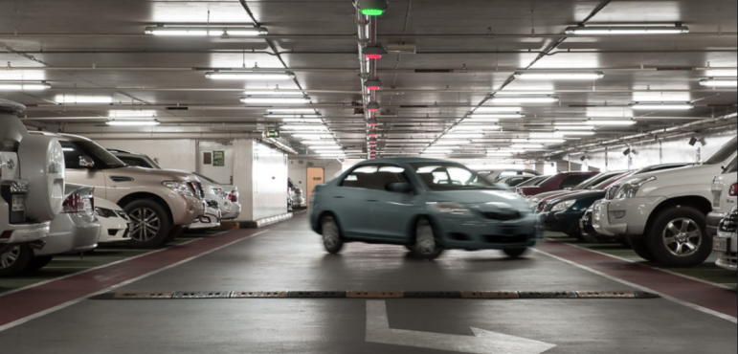
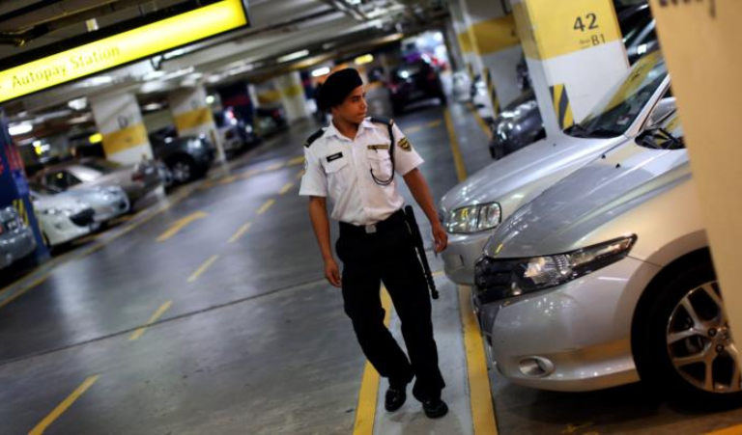
Needs for Indoor Smart Parking Solution
Needs
  Currently all major buildings such as shopping centers, supermarkets or amusement parks,... almost have indoor car parks, but the car parks in that house are operated under the guidance of signage or people, so we need a system to operate parking lots intelligently and scientifically.
  During peak periods such as holidays or festival days, parking area gets into high congestion due to too many vehicles and some vehicles cannot determine the direction and find parking
  Necessary to find smart parking solutions to overcome parking congestion problems.
Basic Concept
  IoT/IoL technology solution provide the smart parking solution in crowded buildings more effectively
  Uses the LED lights installed in the indoor parking area ceiling
  The LED transmits the corresponding vehicle position coordinate information and the cameras installed on the vehicles receives the VLC beams to analyze the transmitted vehicles location information from the information control stations.
Google
  < Indoor Car Parking Scenario >
Slide 3

Slide 4

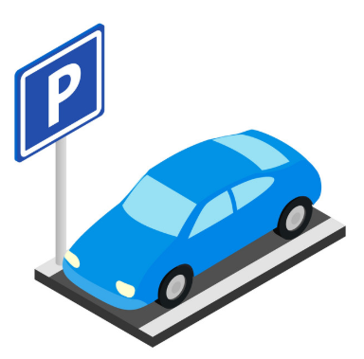

IoT/IoL Link for Indoor Smart Parking Solution In Smart Buildings
IoT/IoL Network Link for Smart Parking Solution In Smart Building
  Tx : Building Lighting System
  Rx : Vehicles Camera or Photo sensor
  Day-Night Communication Mode
  Modulations :
    OOK, VPPM, Offset-VPWM, Multilevel PPM, Inverted PPM, Subcarrier PPM, DSSS SIK etc.
  Data Rate : 1K ~ 1Mb/s
  Supported LoS (Line of Sight)
  Available Distance : 2m ~ 200m
Signal contain car location information, car parking location,….
1001001010101010
Signal the location information of the parking spot empty,
coordinates to move,…
1001001010101010
1001001010101010
Camera
1001001010101010
Camera
Move to an empty car parking location
  < IoT/IoL Link for Indoor Smart Parking Solution >
※ Uses the LED light to transmit the coordinates information of parking spots information to the vehicle which is looking for the empty parking spots
Slide 4

Slide 5
Conclusion
Proposed the IoT/IoL Link for smart vehicle parking solution in the indoor building area.
Use the building parking area ceiling lighting system through IoT/IoL technology to connect vehicle with central control room to find parking spots empty.
Easy to deploy IoT/IoL Link Beam in a indoor environment.
Helps to reduce traffic congestion in parking lots at rush hour
Slide 5

