Slide 1
Project: IEEE P802.15 Working Group for Wireless Personal Area Networks (WPANs)
Submission Title: Automated and Autonomous Vehicle Control ADAS Solution through IoT/IoL Relay Link
Date Submitted: July 2019
Source: Jaesang Cha (SNUST), Sangwoon Lee (Namseoul Univ.), Jinyoung Kim (Kwangwoon Univ.), SeongKweon Kim(SNUST), Yong Ik Yoon (Sookmyung Women's University), Jinyong Choi(SHINHAN BANK), Seongjhin Choi (SNUST), Jaesoo Kim (SNUST), Jonghoon Lee (SNUST), Jintae Kim (Fivetek Co., Ltd.), Sungdoo Kang (Feelux Co., Ltd.), Changsoo Lee (L&S LED Co., Ltd.), Sangil Lim (Signtelecom Co. Ltd.), Sooyoung Chang (SYCA), Vinayagam Mariappan (SNUST)
Address: Contact Information: +82-2-970-6431, FAX: +82-2-970-6123, E-Mail: chajs@seoultech.ac.kr
Re:
Abstract: This documents introduce the V2V IoT/IoL Relay Link design consideration for VAT. This proposed IoT/IoL Relay Link used for ADAS solution to provide Automated and Autonomous Vehicle Control. This VAT to operate on the application services like ITS, ADAS, IoT/IoL, etc. on road condition.
Purpose: To provided concept models of Light Communication based IoT/IoL Relay Link solution for Vehicular Assistant Technology (VAT) Interest Group
Notice: This document has been prepared to assist the IEEE P802.15. It is offered as a basis for discussion and is not binding on the contributing individual(s) or organization(s). The material in this document is subject to change in form and content after further study. The contributor(s) reserve(s) the right to add, amend or withdraw material contained herein.
Release: The contributor acknowledges and accepts that this contribution becomes the property of IEEE and may be made publicly available by P802.15.
Slide 1

Slide 2
Contents
Needs for Automated and Autonomous Vehicle Control
IoT/IoL Relay Link for ADAS Solution
Conclusion
Slide 2

Slide 3
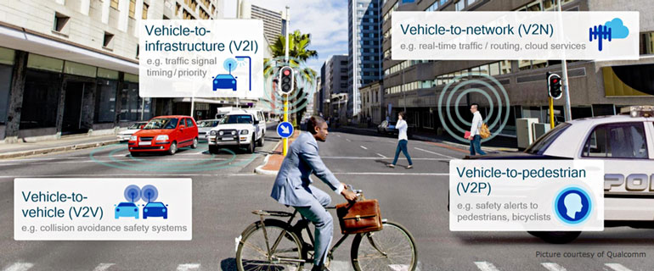
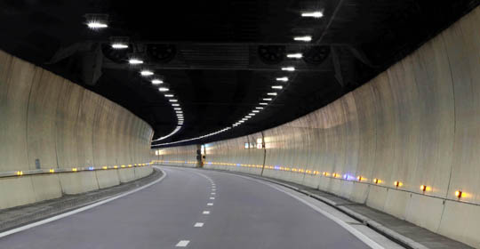
Needs for Automated and Autonomous Vehicle Control
Needs
  The automobile industry is experiencing exponential growth of automated and self-driving features.
  5G network connections have a major influence in the development of self-driving cars making them faster, smarter, and safer.
  Due to RF bands limits the coverage of autonomous network is an issue, also the RF interference in the tunnels, underground and indoor coverage usage of combined or mixed transmission systems are justified
  The IoT/IoL network connectivity is a good challenger for Femtocells and Picocells coverage of 5G network.
Basic Concept
  IoT/IoL is a wireless communication technology that uses the infrared and visible light spectrum for high speed data communication
  IoT/IoL coined in extends the concept of visible light communication (VLC) to achieve high speed, secure, bi-directional and fully networked wireless communications.
  Important aspect of IoT/IoL connectivity to note that VLC supports user mobility and multiuser access
  The bandwidth of the infrared and visible light spectrum together is approximately 2600 times the size of the entire radio frequency spectrum of 300 GHz.
Source: www.machinedesign.com
Google
Source: farazin-co.com
Google
  < Onroad Condition Scenario for Autonomous Vehicle Control >
Slide 3

Slide 4
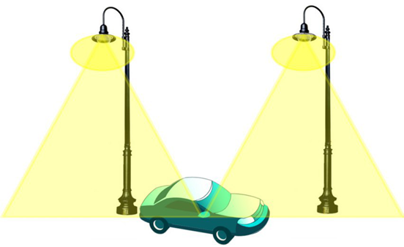
IoT/IoL Relay Link for ADAS Solution
IoT/IoL Network Connectivity for ADAS Solution
  Tx : Road Side Lighting System
  Rx : Vehicles Camera or Light Sensor
  Day-Night Communication Mode
  Modulations :
    OOK, VPPM, Offset-VPWM, Multilevel PPM, Inverted PPM, Subcarrier PPM, DSSS SIK etc.
  Data Rate : 1K ~ 1Mb/s
  Supported LoS (Line of Sight)
  Available Distance : 2m ~ 200m
IoT / IoL Access point
  < IoT/IoL Relay Link for Automated and Autonomous Vehicle Control >
※ Automated and Autonomous Vehicle Control uses the IoT/IoL Connectivity Link between V2V, V2V, V2N, and V2P to define precise vehicle control mechanism
Slide 4

Slide 5
Conclusion
Proposed the IoT/IoL Relay Link for Autonomous Vehicle Control.
IoT/IoL autonomous network system has wider spectrum, less susceptible to interference than RF.
Easy to deploy in a concrete building, tunnel or basement.
Utilize the Onroad Lighting System and Camera installed in the vehicle to enable IoT/IoL Link to notify onroad conditions to control vehicle automatically on the roadway.
Reduce the vehicle accident and provide safe journey in the roadways.
Slide 5

