Slide 1
Project: IEEE P802.15 Working Group for Wireless Personal Area Networks (WPANs)
Submission Title: [Comment resolutions on CID i-0120 and i-0121]
Date Submitted: [July, 2019]
Source: [Huan-Bang Li, Kenichi Takizawa, and Fumihide Kojima] Company [NICT, Japan]
Address [3-4 Hikarino-oka, Yokosuka, Kanagawa, Japan]
Voice:[-], E-Mail:[lee (at) nict.go.jp]
Re: [Proposed changes to IEEE802.15.4-2015 for enhancing UWB PHYs]
Abstract: [proposed comment resolutions to latter ballot comments to the draft of 15.4z]
Purpose: [improvement on draft 15.4z]
Notice: This document has been prepared to assist the IEEE P802.15. It is offered as a basis for discussion and is not binding on the contributing individual(s) or organization(s). The material in this document is subject to change in form and content after further study. The contributor(s) reserve(s) the right to add, amend or withdraw material contained herein.
Release: The contributor acknowledges and accepts that this contribution becomes the property of IEEE and may be made publicly available by P802.15.

Slide 2
Comment Resolutions on CID i-0120 and i-0121

Slide 3
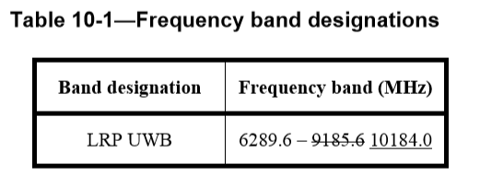
CID i-0120
CID i-0120
Table 10-1 does not reflect the channelization of LRP-SRDEV correctly.
p.89, 10.1.1 , L7
Point in question

Slide 4
CID i-0121
CID i-0121
The frequency range of '6289.6 MHz to 10184.0 MHz' does not reflect the channelization of LRP-SRDEV correctly.
p.89, 10.1.2.7 , L18
Point in question

Slide 5
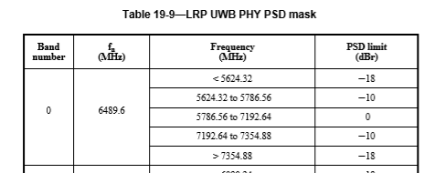
Band Defined in IEEE Std 802.15.4-2015

Slide 6
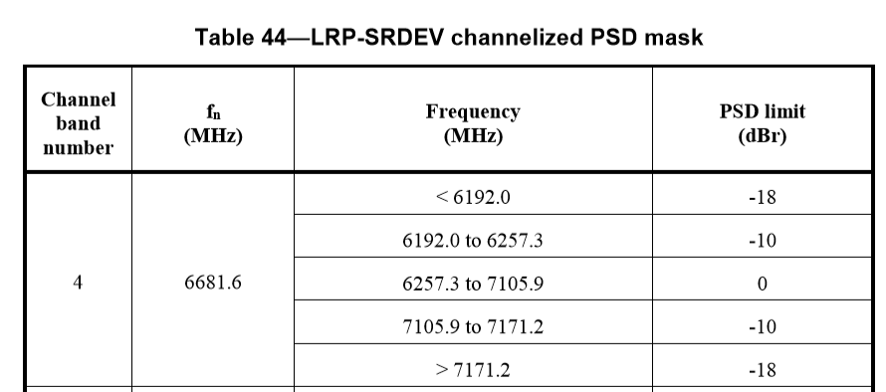
Band Defined in P802.15.4z-D1

Slide 7
Suggest Resolution to CID i-0120
5624.32 10435.2

Slide 8
Suggest Resolution to CID i-0121
5624.32 MHz 10435.2 MHz

